Slide 1
The Industrial Revolution
By Jack Blamire
Year 5

Slide 2
Why the industrial revolution happen?
There were many reasons for the British Industrial Revolution. Improved roads and the construction of canals and railways meant that transporting goods was relatively cheap and much easier. There were rich natural resources such as coal and iron.
Britain also had overseas colonies to provide cheap raw materials, such as cotton from India. These colonies provided a market for manufactured goods.
Steam power was in use as early as 1698 when Thomas Savery developed a steam-driven engine to pump water out of mines. The engine was improved by Thomas Newcomen and later by James Watt.
The power that drove the Industrial Revolution was steam. In 1769 James Watt patented a much improved steam engine.
Britain had the best banking system and it meant that there was enough money for business owners to borrow money to be able to build factories.

Slide 3
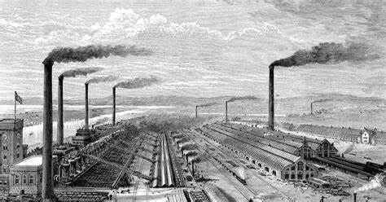
In the industrial revolution there where few government regulations based on working. The industrial revolution started in England.
The Industrial Revolution was a time when the manufacturing of goods moved from small shops and homes to large factories. This shift brought about changes in culture as people moved from rural areas to big cities in order to work. It also introduced new technologies, new types of transportation, and a different way of life for many. It happened between 1760 and mid 1800’s.

Slide 4
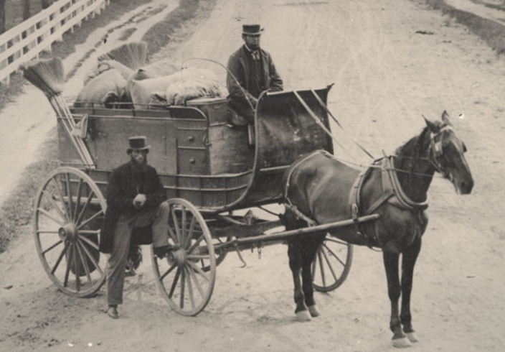
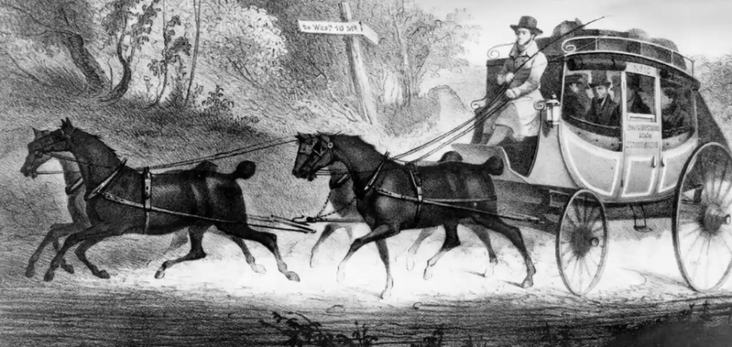
What was life like before the industrial revolution?
Before the start of the Industrial Revolution Britain was a quite different place to the one that exists today. Industrialisation brought with it new types of roads, trains and many other forms of communications which did not exist before.
Travel was very difficult before the Industrial Revolution as there was no means of mechanised transport.
It was so hard to move around, there were no cars, aeroplanes or even tarmac roads, people had to rely upon themselves and their communities to provide the vast majority of the things that they needed.
Transport before the Industrial Revolution

Slide 5
Food was produced locally and farmers could only provide enough and transport to a few small villages or towns. Clothing was made locally, making use of animal hides and furs: nylon wasn’t an option and cotton wasn’t imported in large quantities until developments enabled mass production of goods.
Life was, for most people, the life of a farmer.
Mostly, people worked in villages and small towns, working on the land and relying upon the local community to provide for them. Some people were lucky enough to get imported goods which came into ports such as London and Bristol. What was manufactured was done making use of natural elements. Windmills for example could make the life of a miller easier.
Education was poor. The rich used nannies and private tutors. There were few schools and universities. These were not for the ordinary man or woman though. Girls were largely excluded from education after the age of 7. Politics was based upon land ownership and military honours won, with women and ordinary men given few rights.

Slide 6
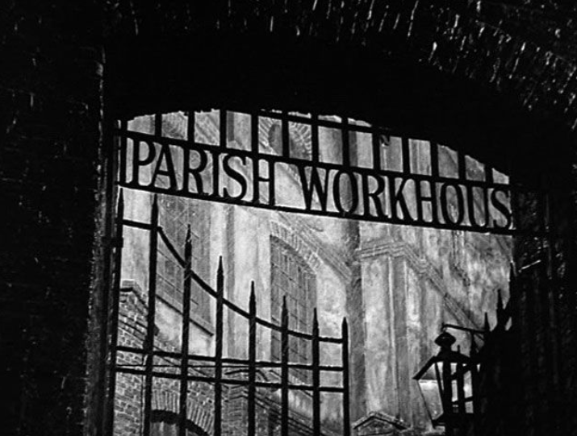
Life as a result was a constant battle against famine, a wicked landlord, overwork and bad luck. Industrialisation would change only some of these worries.
Poverty was a problem before the Industrial Revolution. Many jobs in agriculture are seasonal. This meant that they were only available at certain times of the year. Shopkeepers in towns often found that they had busy periods and quiet periods. In both cases, this led to people having work but not all of the time. Some people ended up in workhouses.

Slide 7
What was life like for Adults during the Industrial Revolution?
Most cities and towns were not prepared for the great increase of people looking for places to live near their work place.
There was a shortage of houses, so many people had to share a room in other peoples houses. Rooms were rented to whole families or perhaps several families. Often ten or twelve people shared one room. If there was no rooms to rent, people stayed in lodging houses.
Many factory owners built houses for their workers near their factories. The houses were built close together really quickly and cheaply.
These houses often had two rooms downstairs and two rooms upstairs. They were not really big enough for the large families people tended to have during the Victorian time.
The houses also did not have running water and toilets. Up to 100 houses had to share an outdoor pump to get their water and share an outside toilet. To make things worse, the water from the pump was often polluted.

Slide 8
Pollution and ill health
The household rubbish was thrown out into the narrow streets and the air was filled with black smoke from the factories chimneys.
Dirty streets and cramped living was a perfect breeding ground for diseases. More than 31,000 people died during an outbreak of cholera in 1832 and lots more were killed by typhus, smallpox and dysentery.
Public Health Act of 1875 banned open sewers, thanks to Joseph Bazalgette’s sewage system. Houses were made further apart, rubbish collection was introduced and public health inspectors had to be provided by the local council. They basically had to go round whatever town or city they were employed in and check that sanitation and health of the people was alright.
In 1853, the tax on soap was taken off, meaning poor people could buy it and become more hygienic by washing with it.
Working conditions
Many factory owners put profit above the health and safety of their workers. Children and young women were employed in terrible conditions in textile mills and mines. Furnaces were operated without proper safety checks. Workers in factories and mills were deafened by steam hammers and machinery. hours were long and there were no holidays.

Slide 9
What was life like for children during the Industrial revolution?
During the Industrial Revolution poor children often worked full time jobs in order to help support their families. Children as young as four years old worked long hours in factories under dangerous conditions. The practice of child labour continued throughout much of the Industrial Revolution until laws were eventually passed that made child labour illegal.
Children performed all sorts of jobs including working on machines in factories, selling newspapers on street corners, breaking up coal at the coal mines, and as chimney sweeps. Sometimes children were preferred to adults because they were small and could easily fit between machines and into small spaces.
Another reason that businesses liked to hire children workers was because they worked for little pay. In many cases, children weren't paid at all, but worked for their room and board. When they did earn wages, children often earned 10 to 20 percent of what an adult would earn for the same job.

Slide 10
Some businesses hired children because they were cheap, worked hard, and could do some jobs that adults couldn't do. In some cases, the businesses treated the children no better than slaves. They kept them locked up and forced them to work long hours. In other cases, the businesses felt they were helping the children out by feeding them and keeping them from starving.
The Industrial Revolution was a time of few government regulations on working conditions and hours. Children often had to work under very dangerous conditions. They lost limbs or fingers working on high powered machinery with little training. They worked in mines with bad ventilation and developed lung diseases. Sometimes they worked around dangerous chemicals where they became sick from the fumes.
Child labour was a common practice throughout much of the Industrial Revolution. Estimates show that over 50% of the workers in some British factories in the early 1800s were under the age of 14.

Slide 11
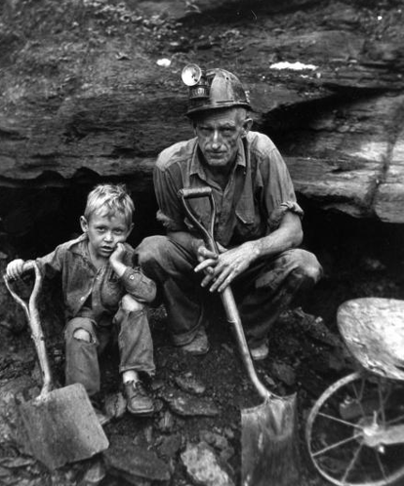
Interesting Facts about Child Labour during the Industrial Revolution
Children who worked often received little or no education.
Britain passed one of the first child labour laws in 1833. It made it illegal for children under the age of 9 to work.
Sometimes children workers were orphans who had little choice but to work for food.
Children in the coal mines often worked from 4 am until 5 pm. Some child workers worked all day pulling wagons of coal up small tunnels just a few feet tall.
Many young girls worked in match factories. The harsh chemicals would often cause them lose their teeth

Slide 12
How was transport affected by the Industrial Revolution?
Canals were built to allow heavy goods to be moved easily where they were needed.
The steam engine became the main source of power. It replaced horses and human labour.
Railways were built all around England and then the world. They carried freight (goods) and passengers much more quickly and cheaply than before.
Steamships began to replace sailing ships. They could be larger and faster than sailing ships and did not depend on wind and weather.
Roads
General Wade, Jack Metcalf, Thomas Telford and John Macadam developed better roads, with firm foundations, drainage and a smooth surface.
Ever since the 17th Century, Turnpike Trusts were set up to improve main roads, for which a toll was charged. This pre-dates the standard period of the Industrial Revolution.
In the early 1800s, investment in Britain's roads was more than £3 million a year.
Between 1803 and 1821, Thomas Telford alone built 1000 miles of road, including 1000 bridges. His greatest achievement was the London‒Holyhead road (1815‒1826). However, others had already been building new roads over the past several hundred years.

Slide 13
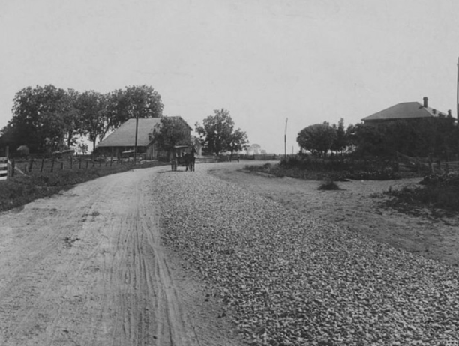
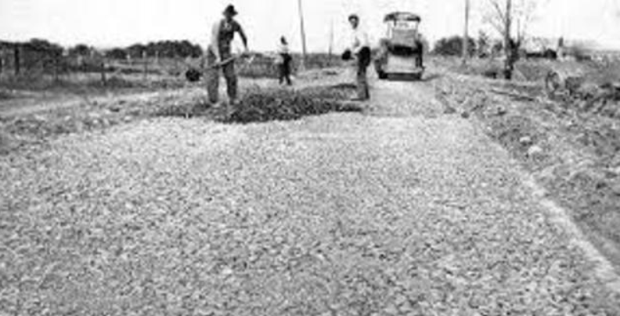
Improvements to the roads

Slide 14
Canals
The fact that more money was now spent on canals could be seen as a natural development as the country gets richer and trade is more necessary.
In 1761 an 11 kilometre canal between Worsley and Manchester. It was planned and paid for by the wealthy Duke of Bridgewater.
He owned coalmines in Worsley and it was very expensive to transport coal to Manchester by road. After opening the canal he was able to transport the coal for a much lower price. The success of the canal aroused a lot of interest and soon landowners and business people were forming companies to raise money to build canals.
The canals brought many different benefits. They provided cheap transportation for goods such as coal, and linked up parts of the country that had previously been without access to waterways, such as the Potteries in Stoke on Trent. The building of canals also called upon considerable engineering skills to construct tunnels, locks and aqueducts. Engineers such as James Brindley and Thomas Telford worked on many famous canal-building projects.

Slide 15
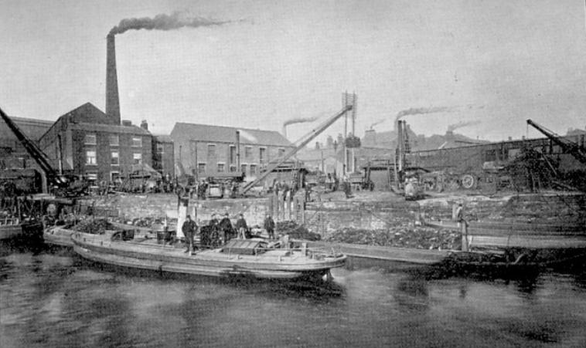
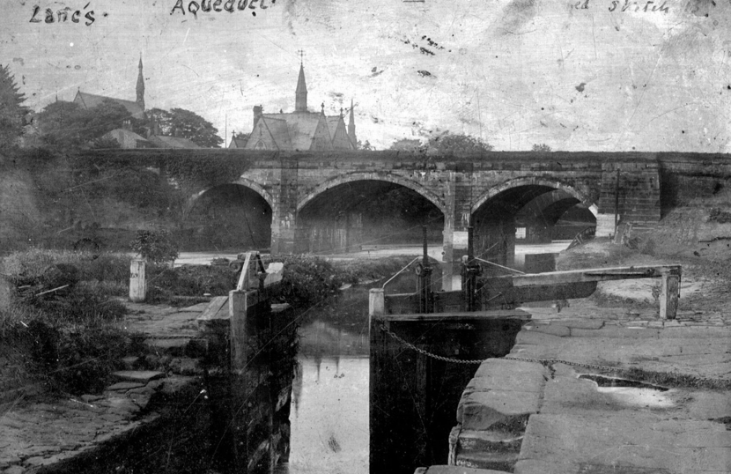
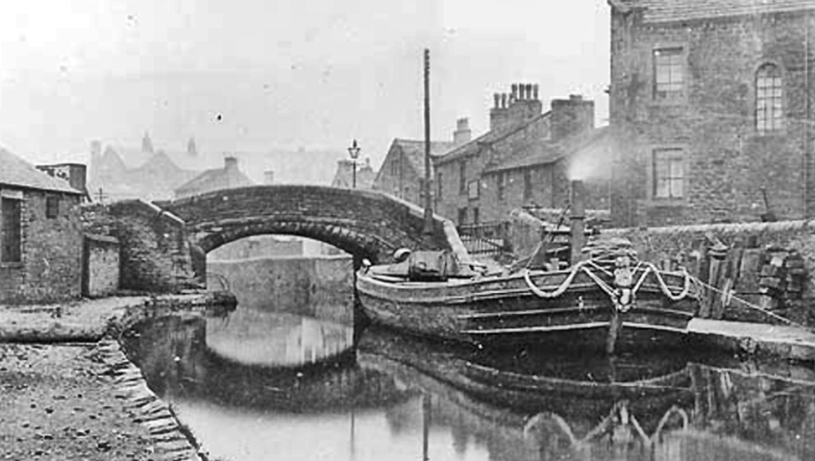

Slide 16
Railways
George Stephenson designed the first railway. It went from Stockton to Darlington and was opened in 1825. Like with the canals, its purpose was to carry coal. The first passenger carrying railway was opened in 1830. It ran from Liverpool to Manchester. This was the beginning of the age of railway construction. Between 1830 and 1850 about 10,000 kilometres of track was built.
The engines that ran along the tracks were powered by steam. The first engineer to design a successful steam engine was Richard Tevithick in 1804.
The world shrank – in 1700 it took four days to get from London to Manchester, but in 1880 it took four hours. Raw materials, goods, food (eg fresh milk) and post arrived faster.
Economic growth – the railways needed bricks, cement, sleepers, iron and coal and as a result, those industries were stimulated. In 1847, more than a quarter of a million people worked on the railways. Their wages helped the economy grow.
Finance – huge numbers of people bought shares in railway companies. Many later lost their money when the boom ended.
The 1844 Railway Regulation Act improved conditions in third-class. In 1883, the Cheap Trains Act made railway companies offer a greater number of cheap trains for workers. Transport became available to more people than ever before.

Slide 17
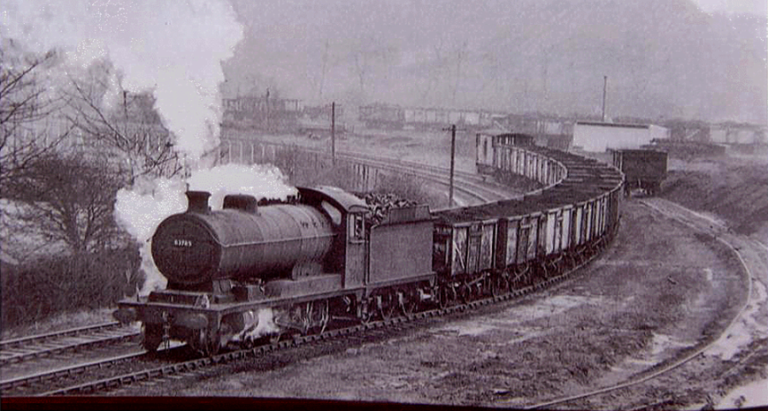
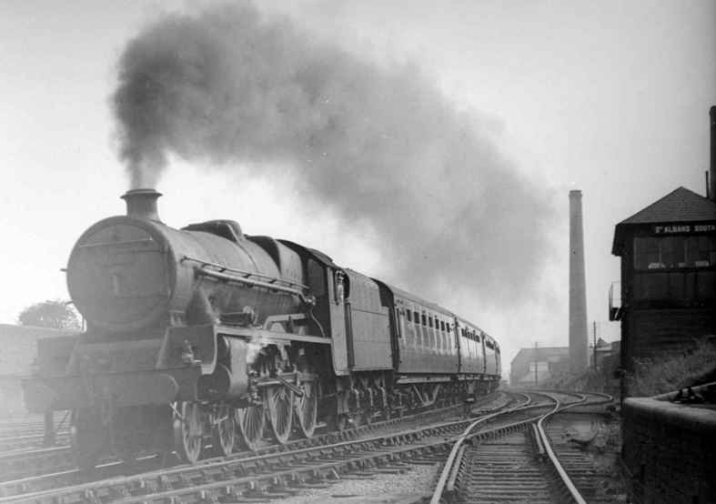
By 1880, it became clear that speedier travel and railway timetables needed the whole country to take up a national standardised time. Before this date people used local time that varied from place to place.
The growth of the shipping industry allowed a huge growth in worldwide trade.
By 1902, the whole British Empire was linked together by a network of telegraph cables called the 'All Red Line'.
Photos of steam trains. One transporting coal and the other for people.

Slide 18
What Impact did the Industrial Revolution have on Britain?
Some of the positive effects of the Industrial Revolution were the massive improvements in manufacturing and distribution processes, allowing more goods to be made and transported more easily.
Before the Industrial Revolution, nearly all goods were made by hand. People worked mostly in their own homes or in small workshops. By the late 1700s, many people could no longer earn their living in the countryside. People moved from farms and villages into bigger towns and cities to find work.
Because of the overcrowding in cities there was not enough housing for everyone. It meant the rents were high and quality of housing was poor. Conditions were cramped. Housing for the poor was often badly built. With earth floors, single brick walls and poor roofing materials, the houses were damp. As houses were built so closely together it was difficult to get fresh air or light into the rooms. Damp and poor ventilation meant that diseases spread more easily.

Slide 19
As it was hard to get water, people found it difficult to wash themselves, their clothing, their bedding and their cooking utensils. Many people had body lice. Food storage was a problem too. These were ideal conditions for killer diseases like typhus, typhoid and diarrhoea to flourish. The cause of cholera was simple – sewage was allowed to come into contact with drinking water and contaminated it. As many people used river water as their source of drinking water, the disease spread with ease. Typhoid was spread by contaminated water.
By the 1860s nearly all workshops and factories were powered by coal-burning steam engines, so the tall chimneys belched out smoke all day, every day. Coal was also used for heating houses and for cooking. This household smoke made the air pollution even worse. London, a main area of the Industrial Revolution became notorious for smog, a chemical compound of smoke and fog, which was constantly present in the skies. In 1873 approximately 700 Londoners died from smog inhalation in one day. In many towns there was no effective system for collecting rubbish. The piles of rotting rubbish in courtyards and streets were breeding grounds for diseases.

Slide 20
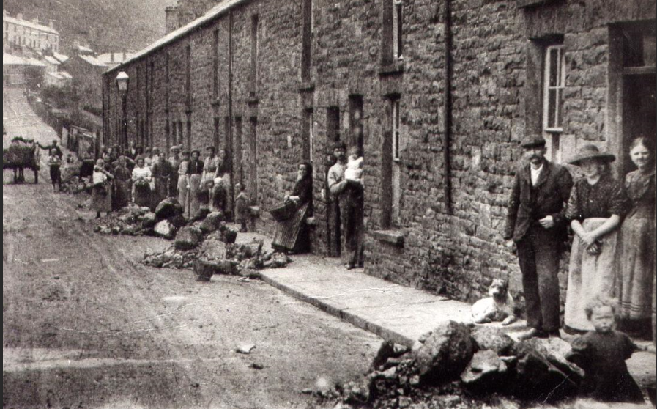
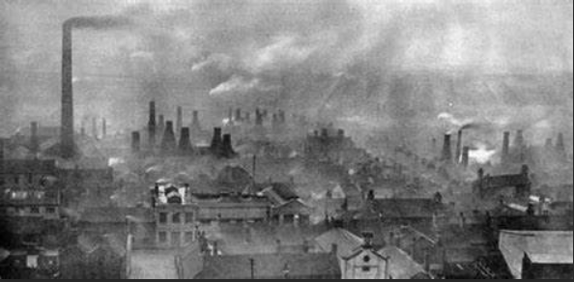
This photo shows how many people lived together in houses and the rubbish outside on the streets.
The photo on the right shows the factories pumping out smoke from the coal they were burning. Imagine breathing in this smoke everyday – not nice!!!

Slide 21
The Industrial Revolution was a time for changes in the way products are made. During the Industrial Revolution, many factories were built. Labourers began making large numbers of things using machines powered by engines.
Although the machines made the work easier in some ways, factory work created many problems for the workers. They were able to make more. This meant that products were cheaper to make and also cheaper to buy. Factory owners grew rich. Factory employees, however, did not earn much, and the work was often dangerous. Many worked 12 to 14 hours a day. Men, women, and even small children worked in factories.
Workers sought to win improved conditions and wages through labour unions. These organizations helped create laws that protected the workers. They limited the number of hours they had to work and guaranteed that they would be paid a certain amount.
The Industrial Revolution soon spread to all kinds of production. Farmers, for instance, began to invent new machines to plough fields and plant crops.
People needed a way to bring in raw materials to make the products. They also wanted to be able to send their products to customers. This led to improvements in transportation.

Slide 22
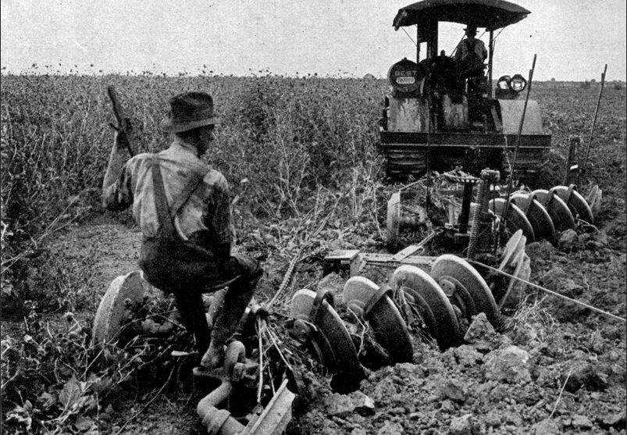
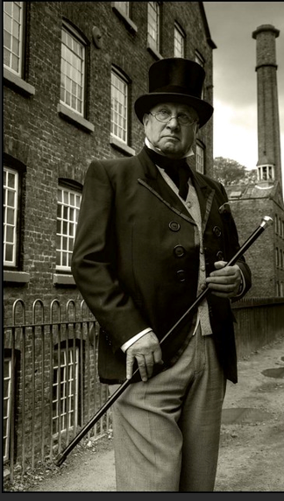
Farmers using new machines to plough fields and plant crops.
A rich factory owner outside a cotton mill

Slide 23
The Government introduced a Factory Act in 1833. This meant that any child who worked in a factory had to be given two hours of schooling each day. It also stated that children under the age of nine were not allowed to work in factories.
Before the 1800s, education was not free and poor children got what education they could in Dame schools or Sunday Schools.
In 1833, the government passed the Factory Act making two hours of education a day compulsory for children working in factories. The government also granted money to charities to help schools for the first time.
In 1844, the Ragged Schools Union was set up to give schooling to very poor children.
The Public Schools Act (1868) reformed Britain's public schools, such as Eton and Harrow.
In 1870, Forster's Act set up state-funded board schools for primary education.
In 1880, the Education Act made school attendance compulsory for children up to the age of 10.
The 1902 Education Act established a system of secondary schools.
Some historians say the improvements were made because the public were beginning to complain about the lack of education and support for young children who worked long, hard days in factories. These historians also believe that the government wanted to educate people so that they could make more money for the country.

Slide 24
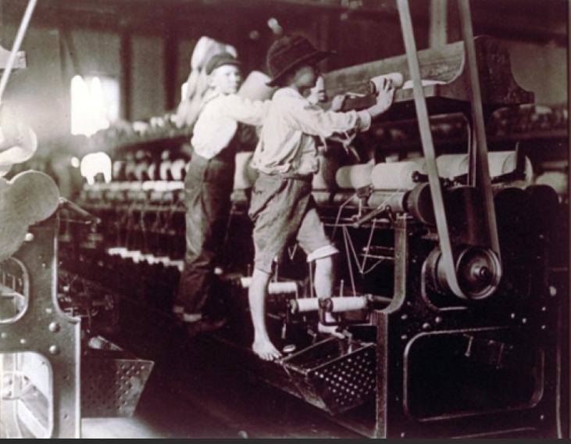
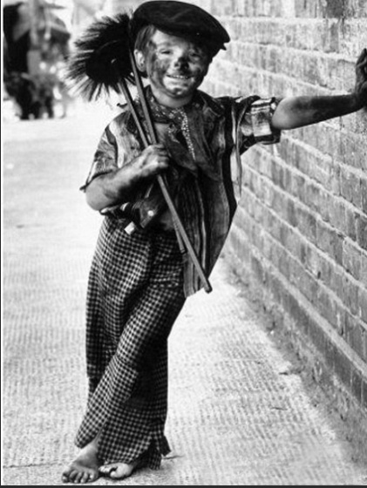
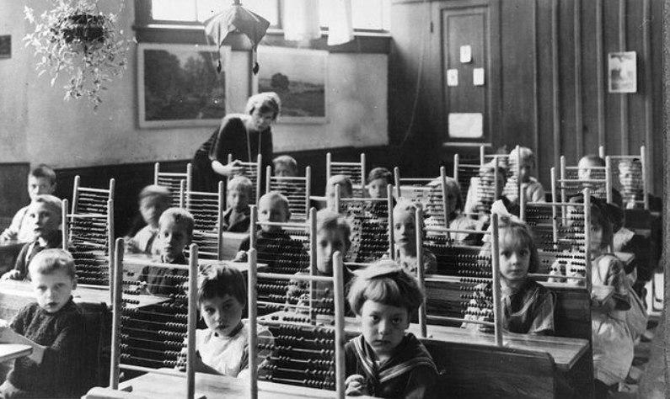
These photos show some children working in the Industrial Revolution. The jobs were dirty and extremely dangerous and there were often injuries and even death.
This picture shows some of the children that were lucky enough to get some schooling during the Industrial Revolution

Slide 25
The End

