Slide 1
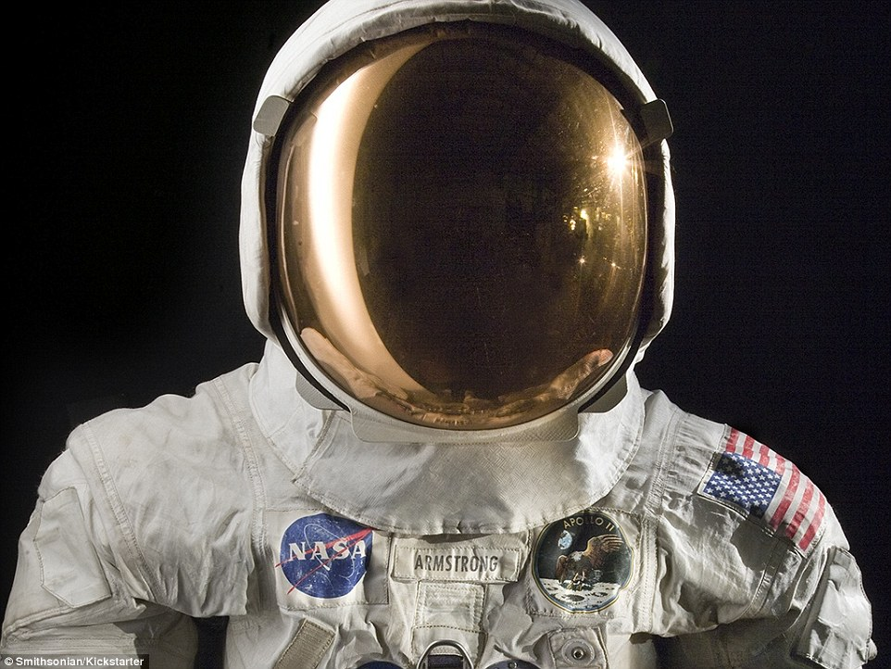
Space suits
By jack Blamire

Slide 2
Introduction
A space suit is necessary because it helps you breath in space. A space suit is a suit with oxygen tanks strapped onto the back of the suit which is what makes you survive.

Slide 3
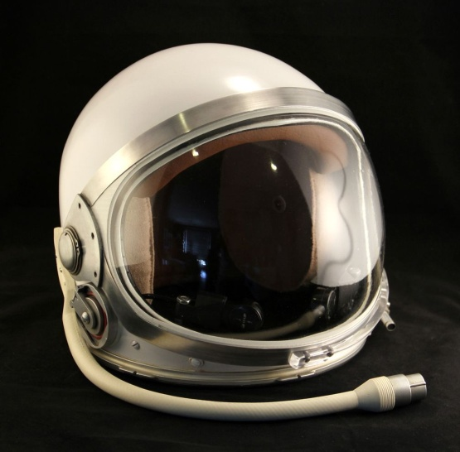
Head protection
US astronaut Buzz Aldrin wore a space helmet on the Moon. Other spacesuits have a separate piece of headgear that is worn under the helmet. This additional piece is called the Communications Carrier Assembly in NASA suits, and has been nicknamed the “snoopy cap” in popular culture.
The space helmet is one of the most important parts of a space suit, and is required for survival in the harsh conditions of outer space. The space helmet fulfills three primary purposes and many smaller ones. First, it allows pressure to be maintained around the wearer’s head while in the vacuum of space.

Slide 4
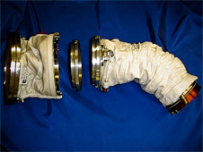
Hand and arm protection
Spacewalkers do not wear custom-made suits. Different sizes of arm assembly parts are available. Sizing rings can make the parts longer or shorter.
Astronauts must be able to work with and pick up objects while wearing spacesuit gloves. EVA gloves are made to protect astronauts from the space environment. They are also made so spacewalkers can move their fingers as easily as possible. The fingers are the part of the body that gets coldest in space. These gloves have heaters in the fingertips. A piece called a bearing connects the glove to the sleeve. The bearing allows the wrist to turn.

Slide 5
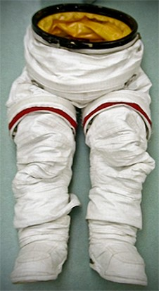
Upper torso and lower torso protection
Fiberglass is the primary material for the hard upper torso segment. Lithium hydroxide is used in making the filter which removes carbon dioxide and water vapor during a space walk. A silver zinc blend comprises the battery that powers the suit.
The lower torso has D-rings to attach tethers. Tethers are the cords that attach to the spacecraft so spacewalkers will not float away. Some suits are plain white; some have red stripes; and others have candy cane stripes.

Slide 6
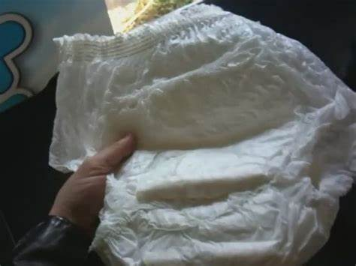
Space nappies
NASA says this is not a space diaper, but it is. They call it the Maximum Absorbency Garment. Some people call it the Space Pooper. But why do astronauts use them?
Quite simply, when astronauts are sitting in the Space Shuttle, strapped to their seats and ready to go, they may experience very long delays. Sometimes even hours. And when that happens, they just can't get off their seats to go to the toilet. They just have to do it, as Alan Shepard discovered while waiting inside his Mercury capsule on May 5, 1961, waiting for the freedom 7 mission launch. He was the first American to reach Space and the first astronaut to pee inside his suit. Quite simply, when astronauts are sitting in the Space Shuttle, strapped to their seats and ready to go, they may experience very long delays. Sometimes even hours. And when that happens, they just can't get off their seats to go to the toilet. They just have to do it, as Alan Shepard discovered while waiting inside his Mercury capsule on May 5, 1961, waiting for the freedom 7 mission launch. He was the first American to reach Space and the first astronaut to pee inside his suit.

Slide 7
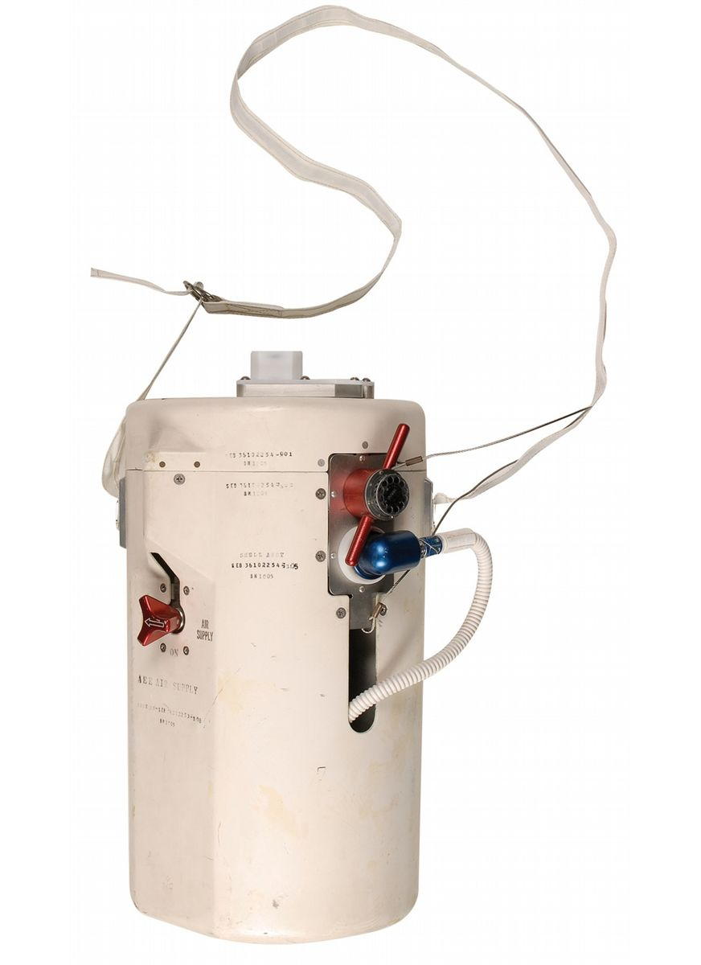
Oxygen supply
So, most space suits provide a pure oxygen atmosphere for breathing. Space suits get the oxygen either from a spacecraft via an umbilical cord or from a backpack life support system that the astronaut wears. May 8 2019
Oxygen. Space suits cannot use normal air -- 78 percent nitrogen, 21 percent oxygen and 1 percent other gases -- because the low pressure would cause dangerously low oxygen concentrations in the lungs and blood, much like climbing Mt. Everest does. So, most space suits provide a pure oxygen atmosphere for breathing.

Slide 8
Foot protection
so, to protect you from these dangers, a space suit must:
Have a pressurized atmosphere
Give you oxygen and remove carbon dioxide
Maintain a comfortable temperature despite strenuous work and movement into and out of sunlit areas
Protect you from micrometeoroids and from radiation to some degree
Allow you to see clearly, move easily inside the space suit and outside of the spacecraft
Astronauts who wear space suits for extra-vehicular activities (EVAs) don't walk. They hover and float, or their feet are placed into foot restraints so they don't drift away. In the future, however, astronauts may go to Mars as part of NASA's new vision. And they'll need very different boots to walk on the planet's surface or drive a rover.

Slide 9

Thanks for reading my facts on a space suit

