Slide 1
Space suit
By henry crowe

Slide 2
Intro
A space suit is made to protect the astronaut . From the atmosphere. Or if the seal on the space ship is not right it gives them oxygen.

Slide 3
Features of a space suit
Spacesuits help astronauts in many ways. The suits protect astronauts from getting too hot or cold. Spacesuits also give astronauts oxygen to breathe while they are working in space. The suits hold water to drink. They also keep astronauts from getting hurt by space dust. Space dust may not sound very dangerous. But when it moves faster than a bullet, the dust can hurt someone. The suits even have special gold-lined visors to protect eyes from bright sunlight.

Slide 4
Extra
A spacesuit is made up of many parts. One part covers the astronaut's chest. Another part covers the arms and connects to the gloves. The helmet protects the head. And the last part covers the astronaut's legs and feet. Some parts of the suit are made of many layers of material. Each layer does something different. Some keep oxygen in the suit while others protect astronauts from space dust.
Under the suit, astronauts wear another piece of clothing. It covers their body except for the head, hands and feet. Tubes are woven into it. Water flows through the tubes to keep the astronaut cool.

Slide 5
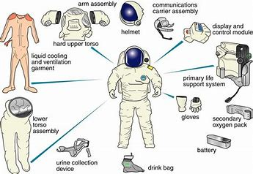
diagram

Slide 6
Fun facts
NASA's first spacesuits were made for the Mercury program. Mercury was the first time NASA astronauts flew into space. The Mercury suits were worn only inside the spacecraft.
NASA's first spacewalks took place during the Gemini program.
Spacesuits for the Apollo program had boots made to walk on rocky ground. The Apollo suits also had a life support system. The astronauts could go far away from the lunar lander because they weren't connected to it by a hose.
Spacesuits like the Apollo suits were used on the Skylab space station missions. Like the Gemini suits, these suits connected to Skylab with a hose.
Astronauts wear orange spacesuits called "launch and entry suits" during launch and landing of the space shuttle. In space, these suits can be worn only inside the shuttle.
An EVA is a spacewalk that takes place outside of a spacecraft. EVA stands for "extravehicular activity."
The first EVA (extravehicular activity, or spacewalk) took place on March 18, 1965, during the Soviet Union's Voskhod 2 orbital mission when cosmonaut Alexei Leonov first departed the spacecraft in Earth orbit to test the concept

