Slide 1
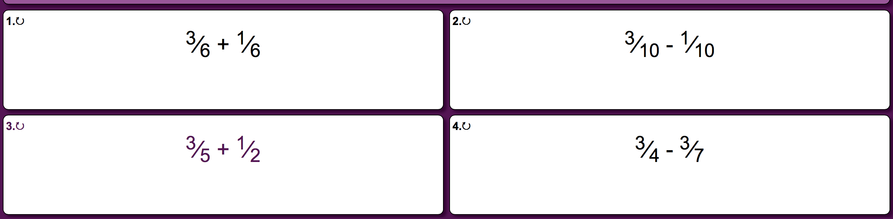
Monday - Questions

Slide 2
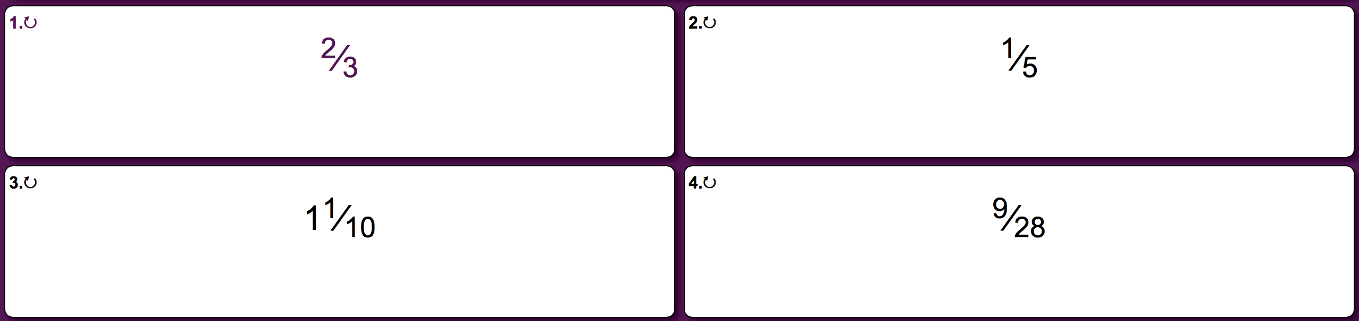
Monday - Questions

Slide 3
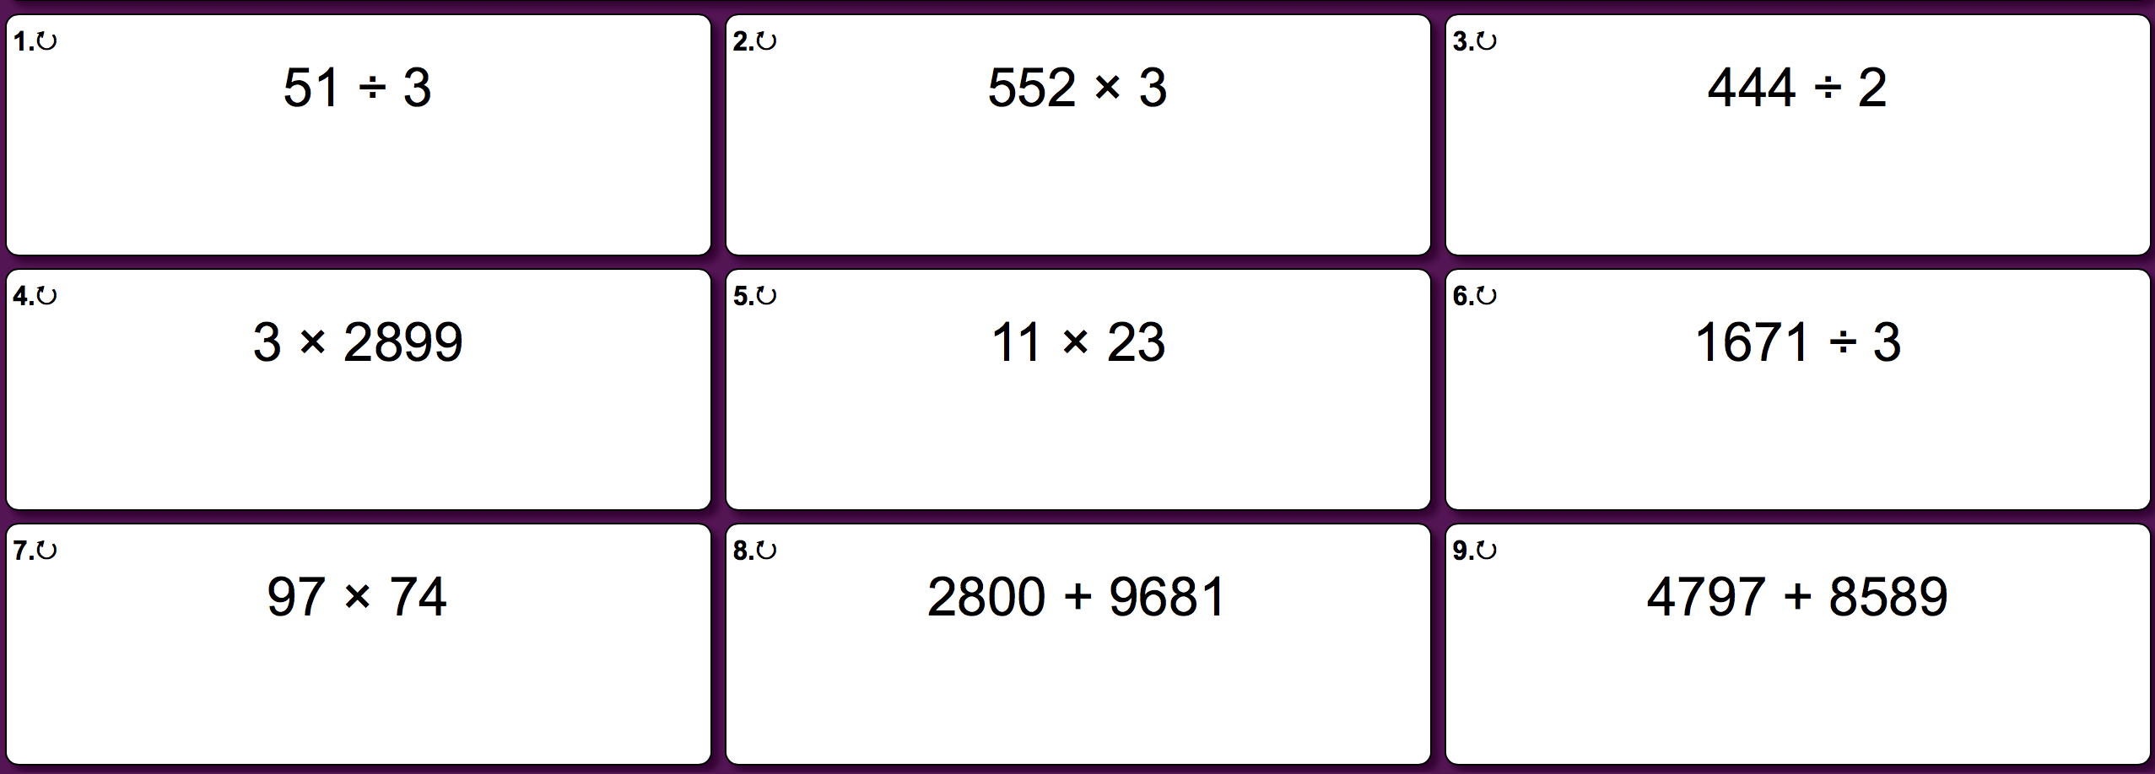
Tuesday - Questions

Slide 4
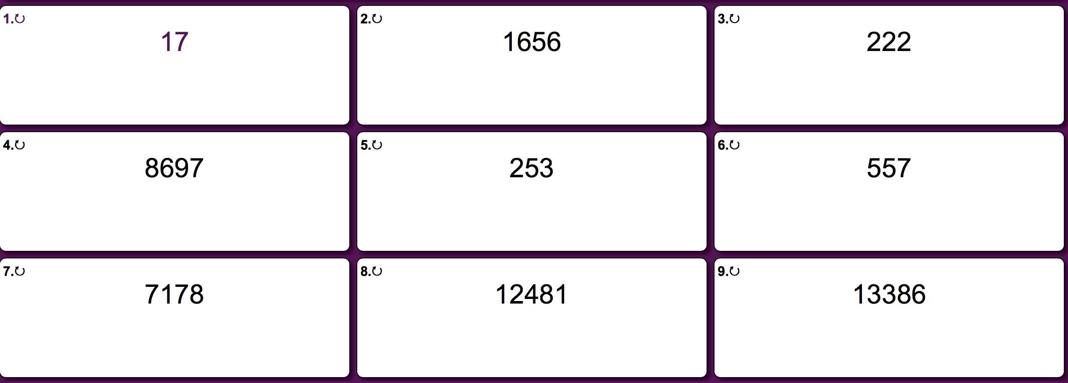
Tuesday - Answers

Slide 5
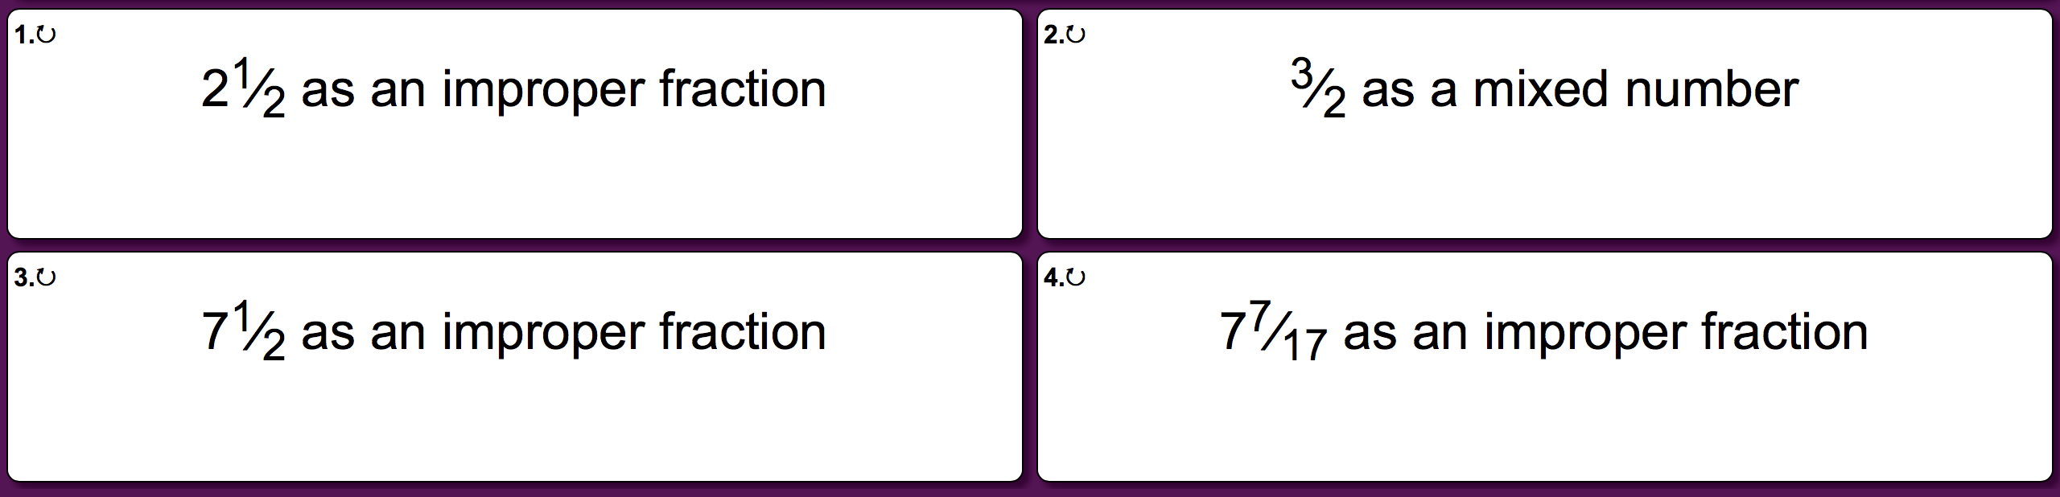
Wednesday - Questions

Slide 6
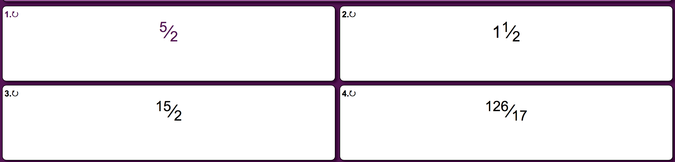
Wednesday - Answers

Slide 7
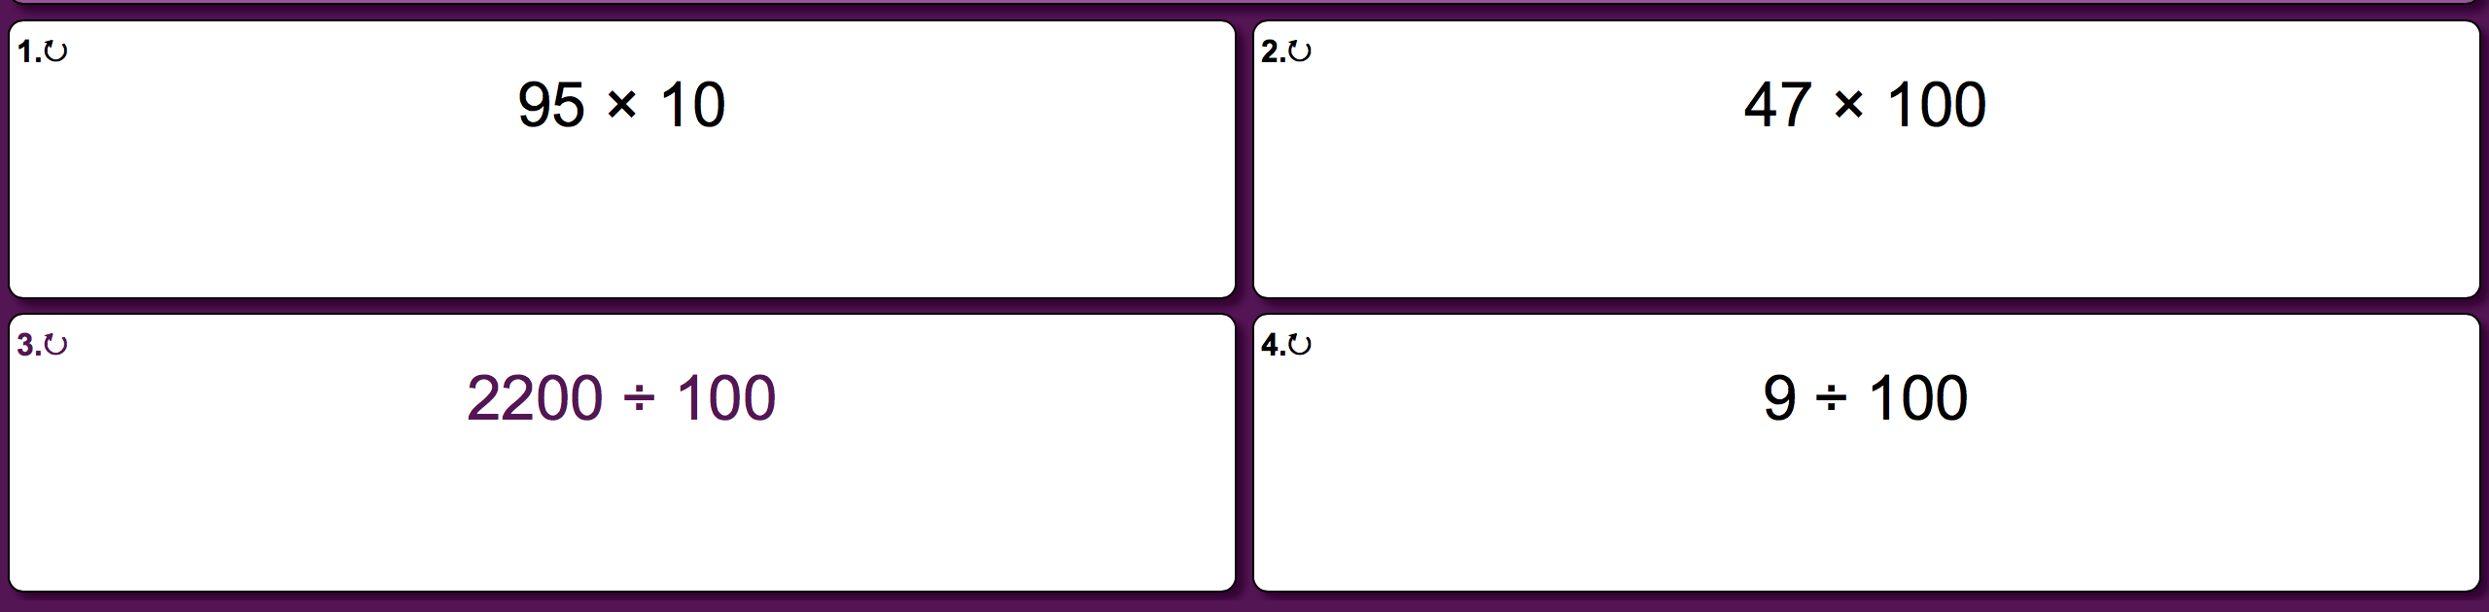
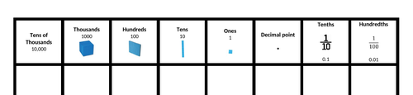
Thursday - Questions
Remember -
Division
Multiply

Slide 8
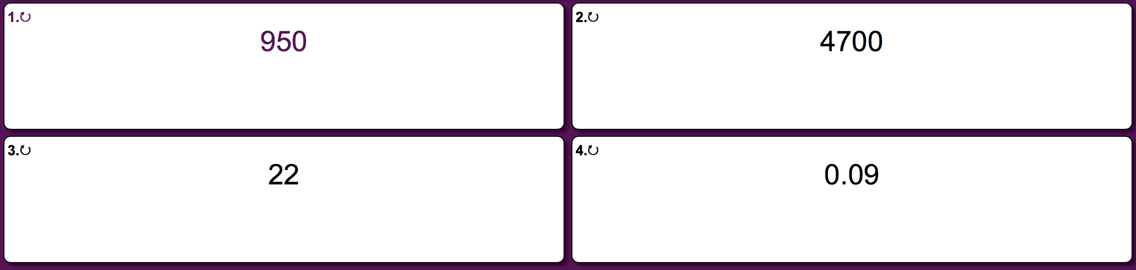
Thursday - Answers

