Slide 1

Year 2 – Information technology around us Lesson 3 – Where have we seen information technology in the world? | Activity handout Save a copy
Sorting IT
Move to the next page for the sorting activity.
This resource is available online at ncce.io/csn2-3-a2-r. Resources are updated regularly — please check that you are using the latest version.
This resource is licensed under the Open Government Licence, version 3. For more information on this licence, see ncce.io/ogl.
Notes:
Last updated: 01-07-20

Slide 2
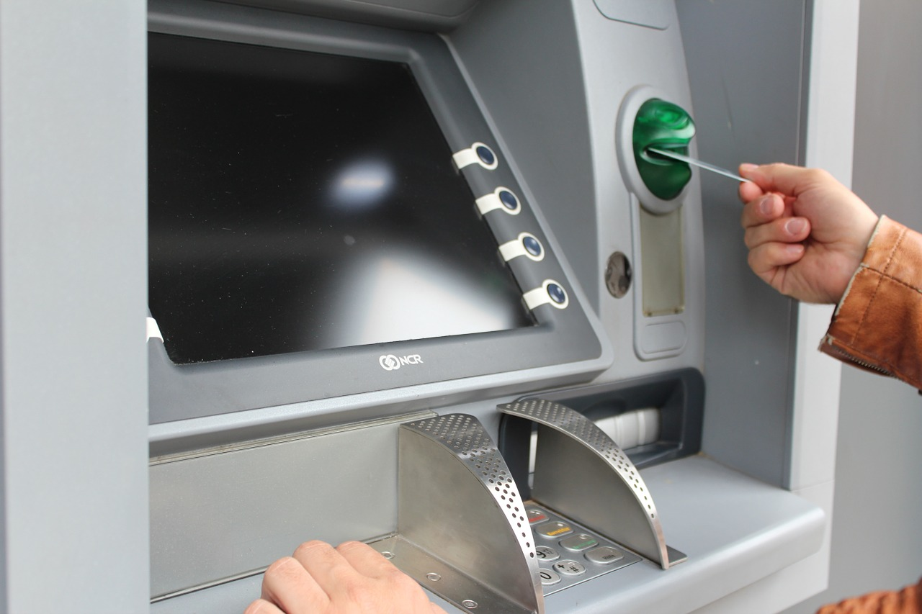
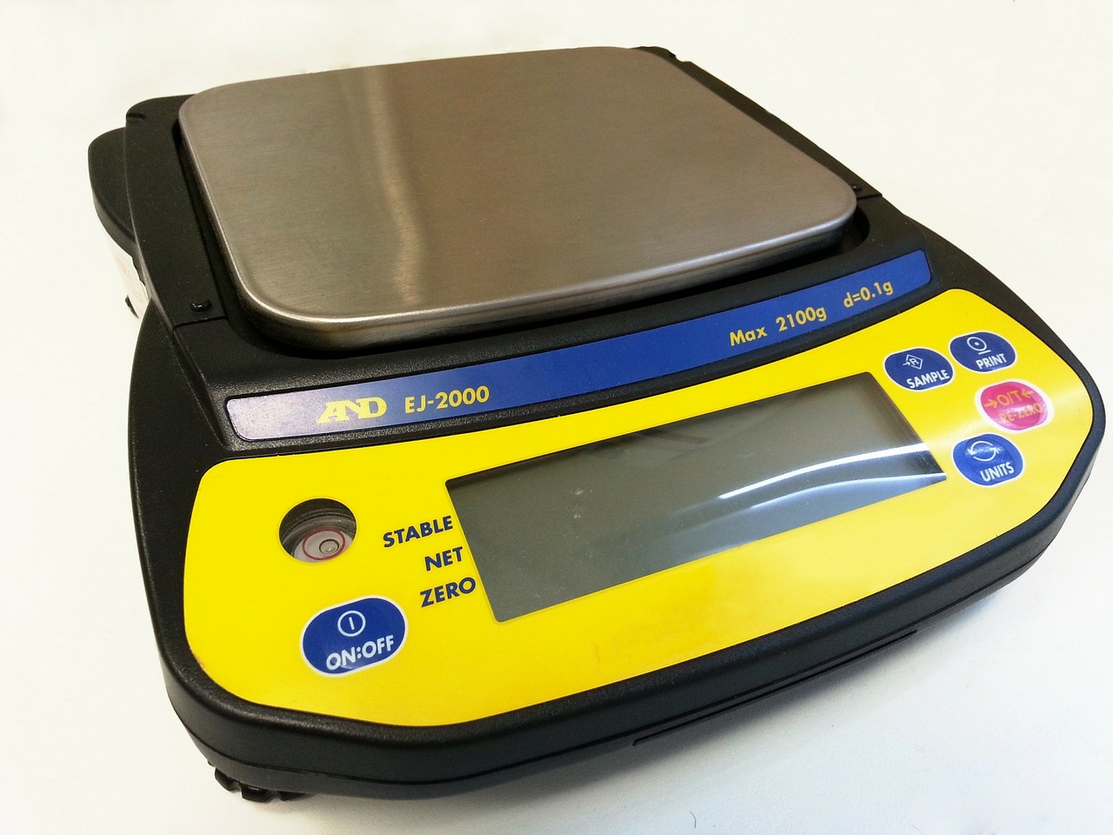
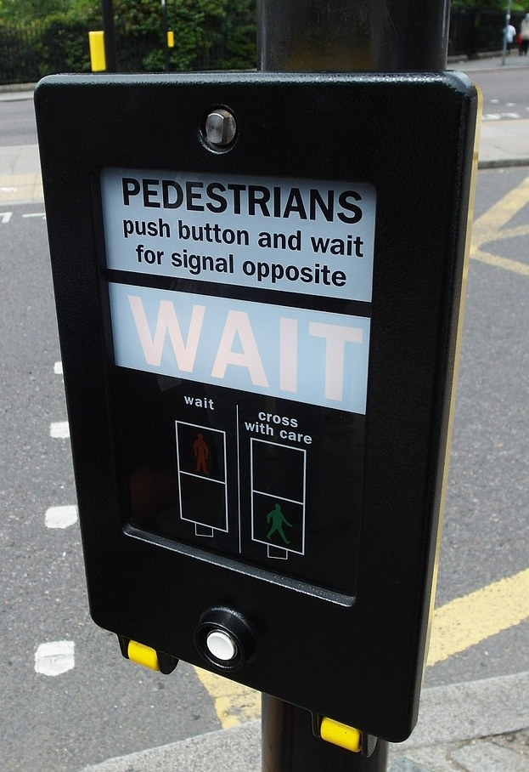
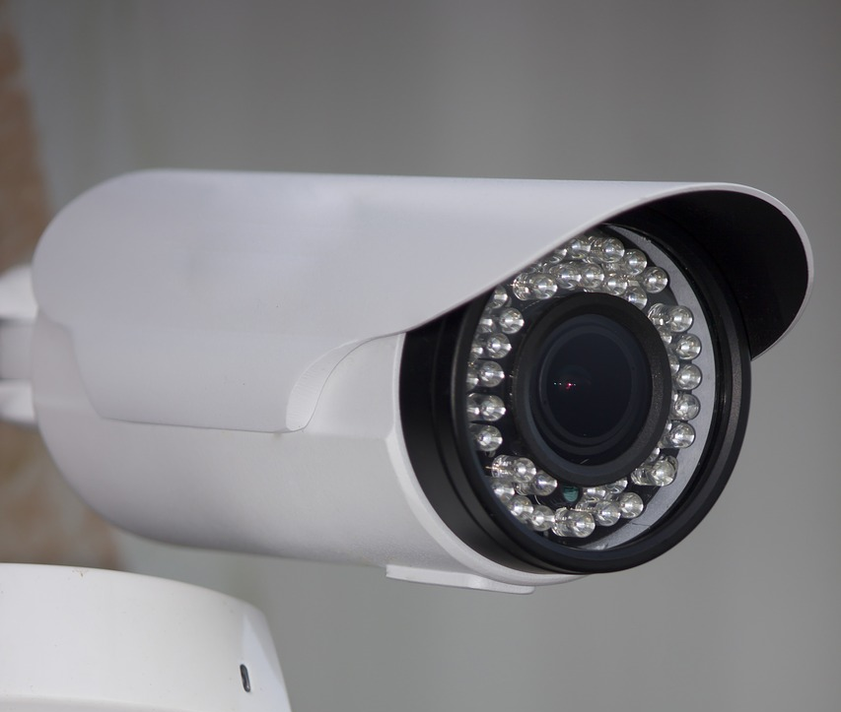
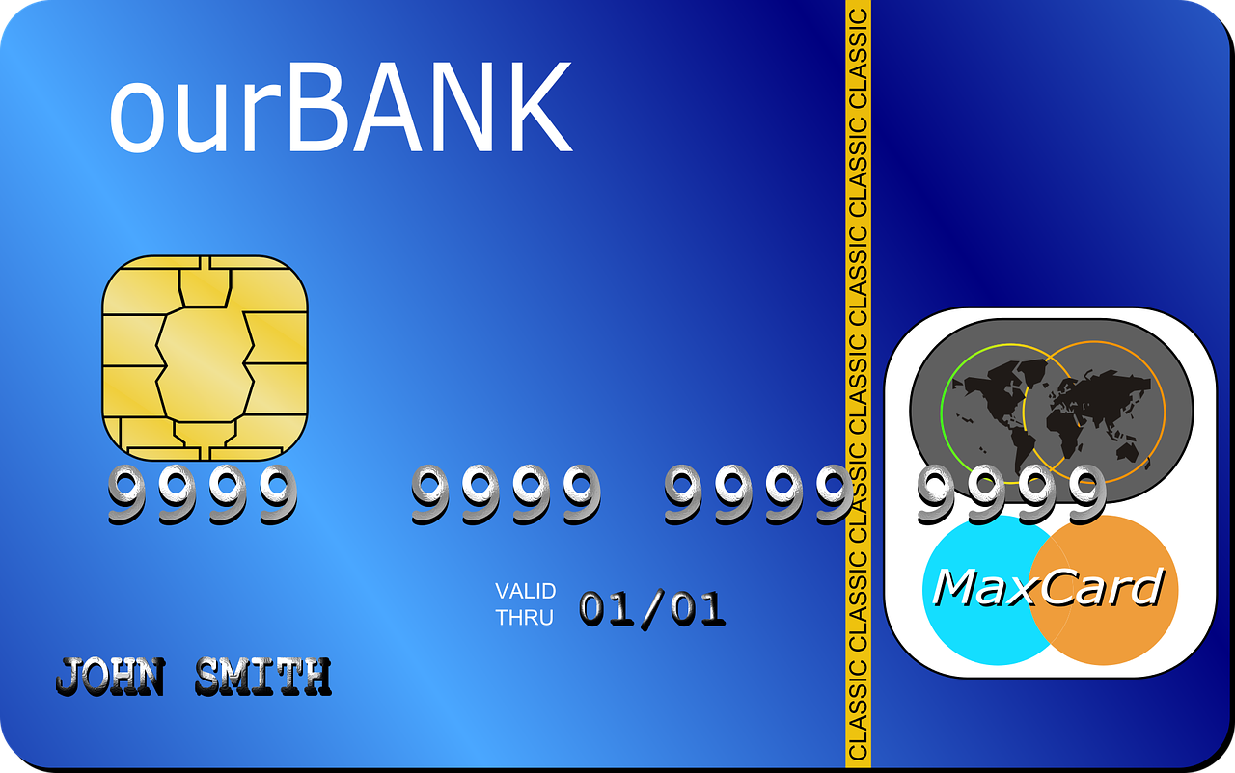


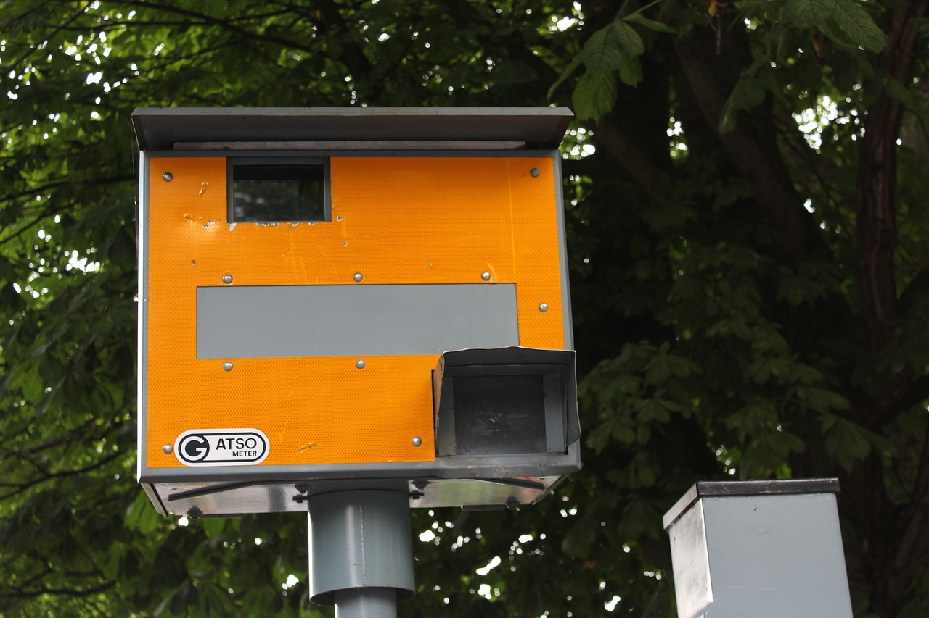
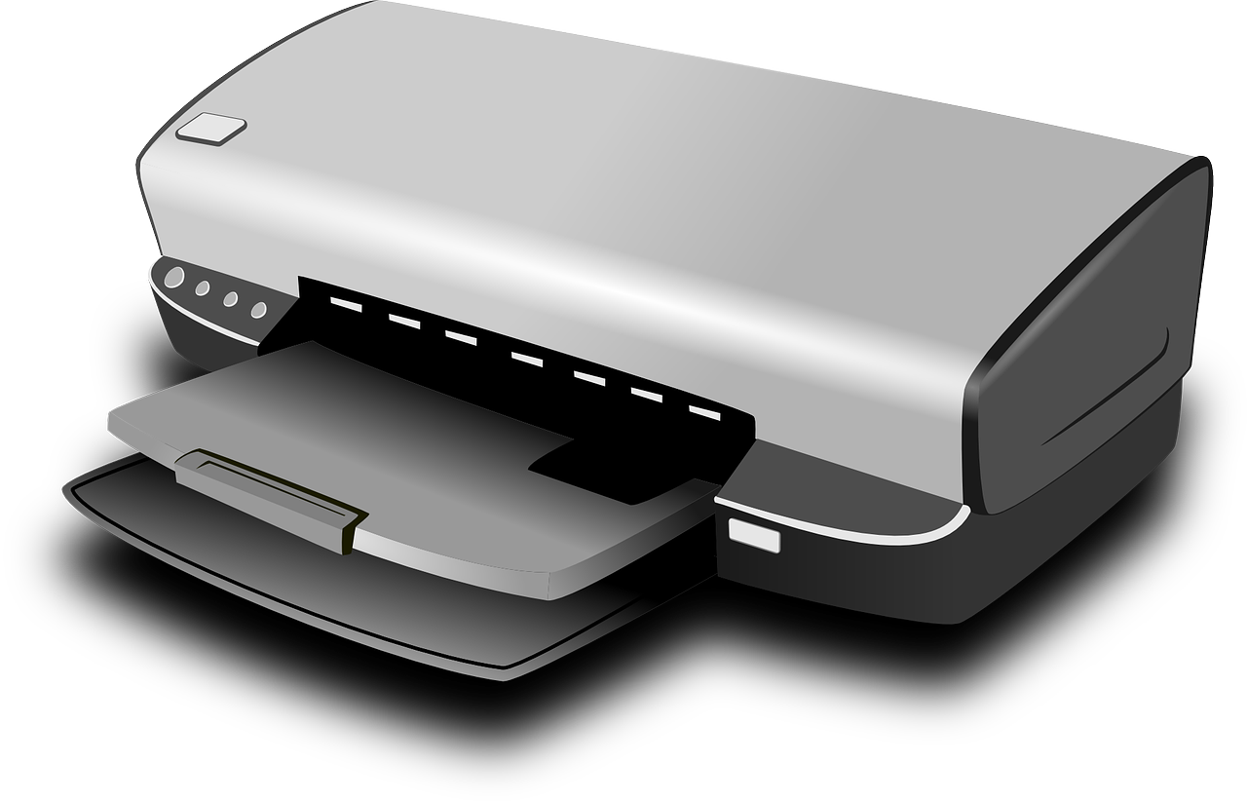
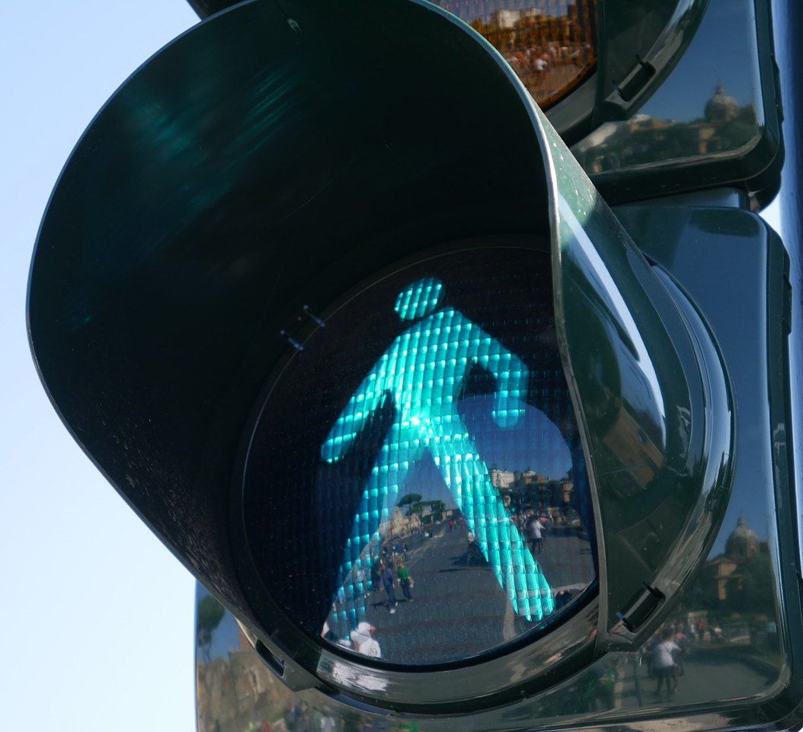
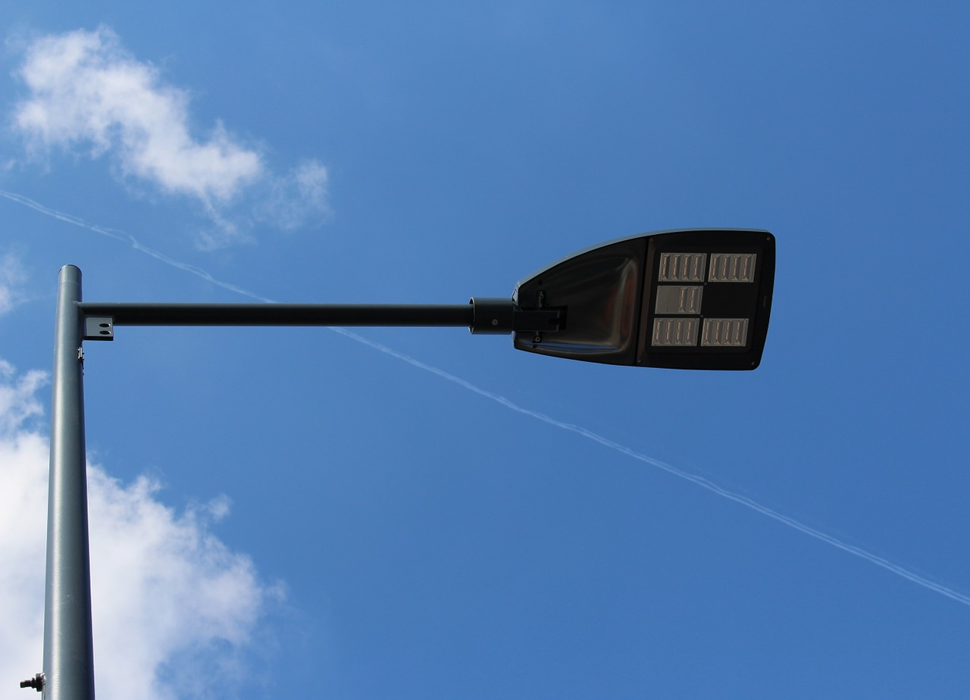


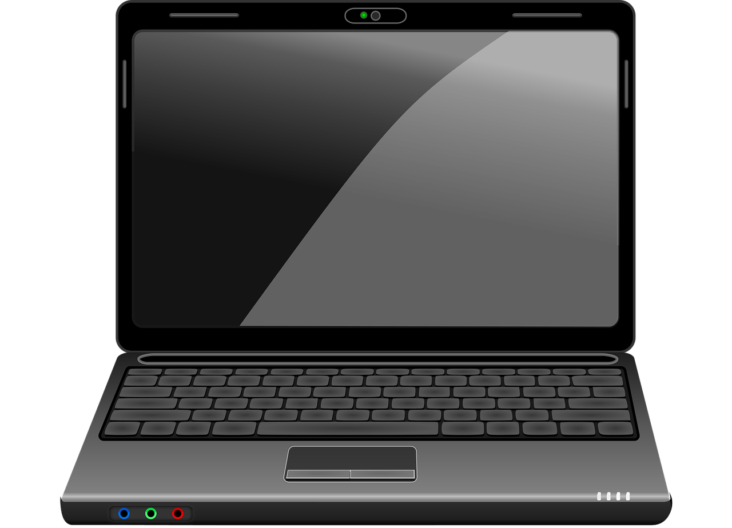

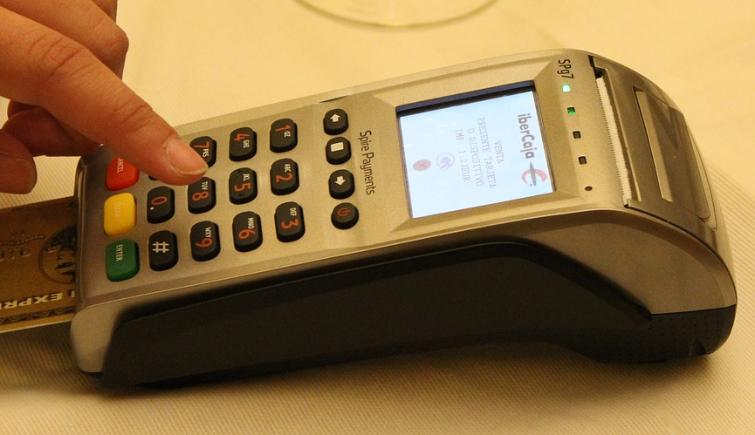
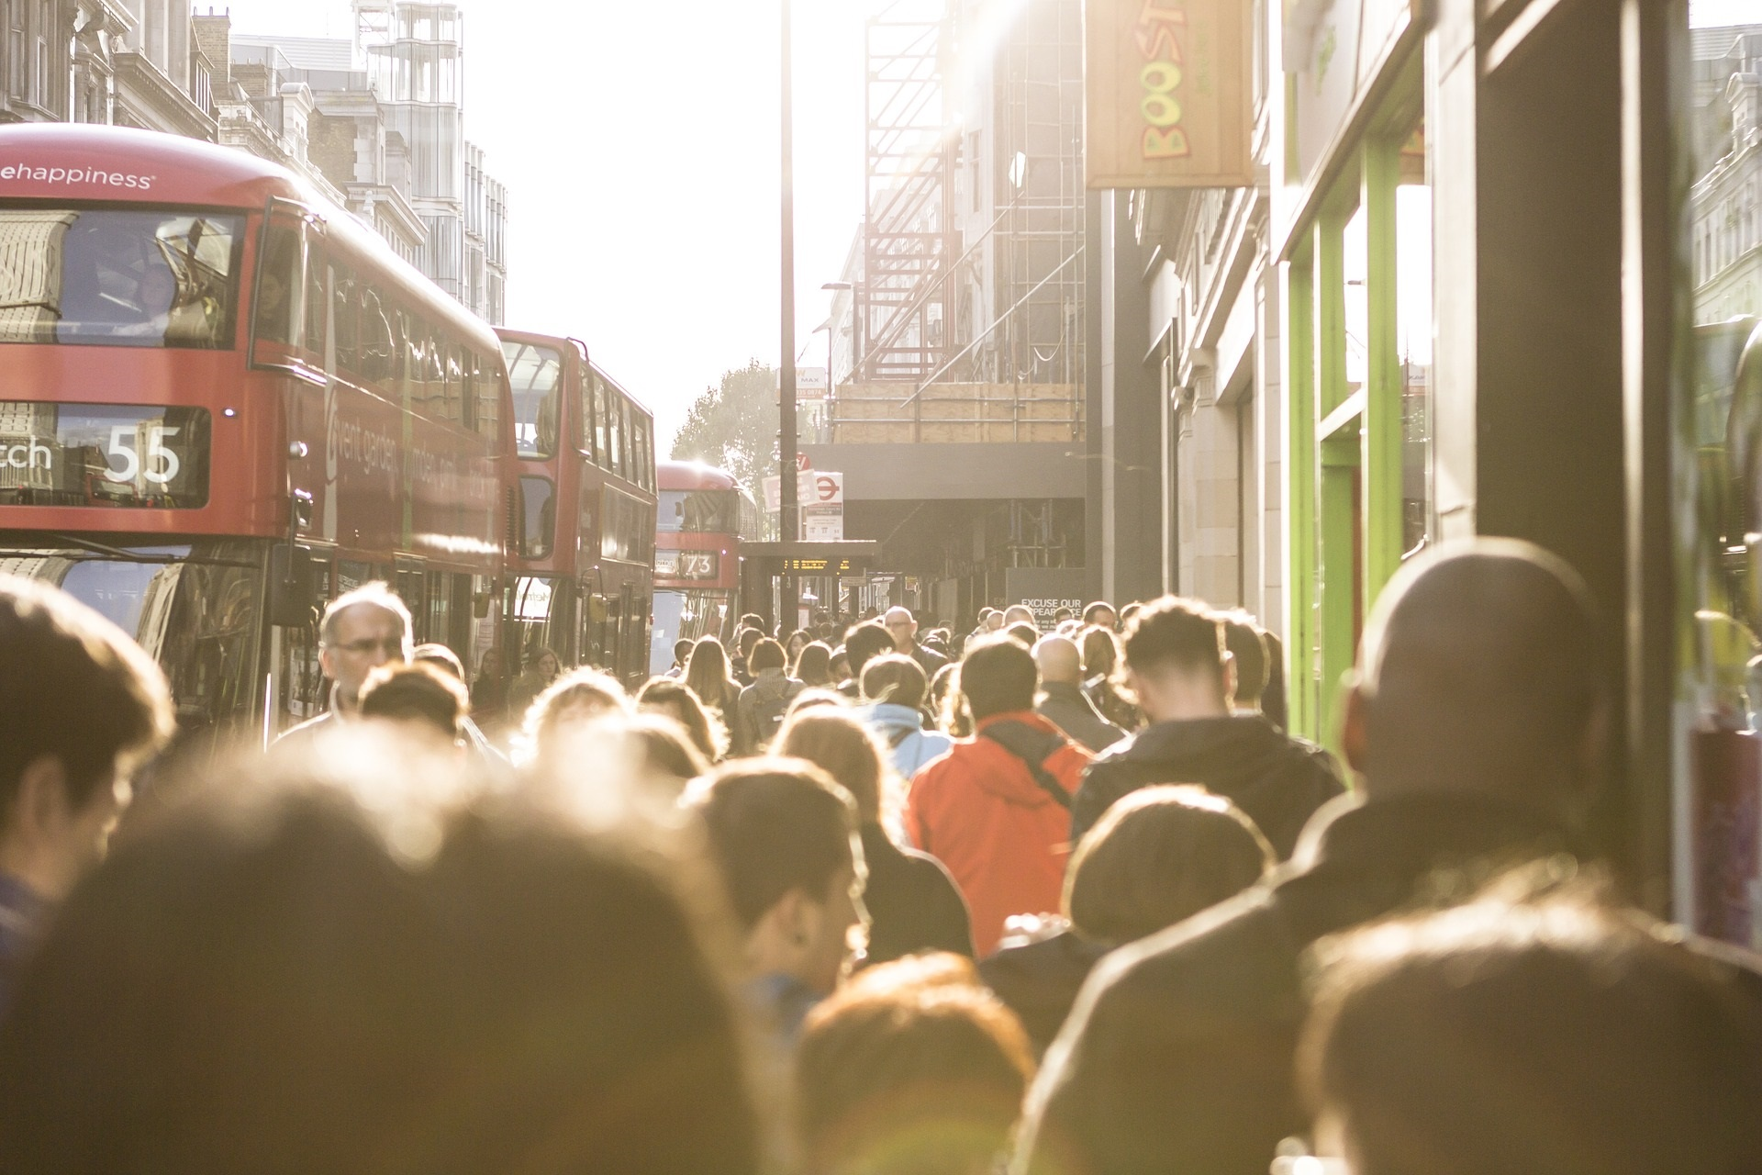
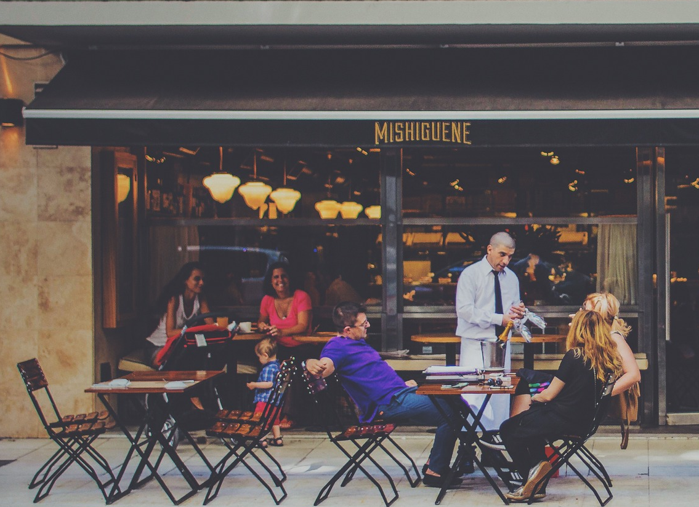
Activity 2
Outside
Inside
Drag the pictures at the top of the page to the place that you think they will be found in

Slide 3
Activity 2
Drag together the things that work with each other

