Slide 1
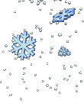

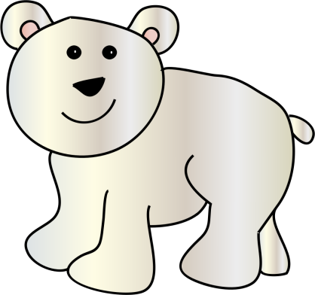
The Polar Regions

Slide 2
L.0 – To be able to create a fact file based on the Polar Regions
Success Criteria
I can write at least 5 key facts about the polar regions.
I can use the correct tense when writing about current information.
I can write in my neatest handwriting.

Slide 3

Talk to your partner
What information do you already know about the polar regions?
Where?
Animals?
Weather?

Slide 4
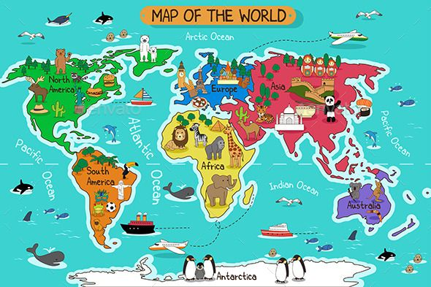
Where?
The Polar Regions are located at the very top (North) and very bottom (South) of the earth.
The Northern Polar Region is called the… Arctic.
The South Polar Region is called… Antarctica

Slide 5
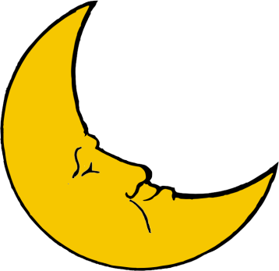

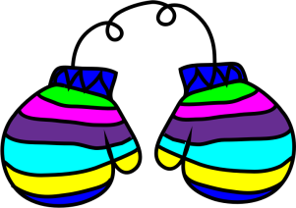
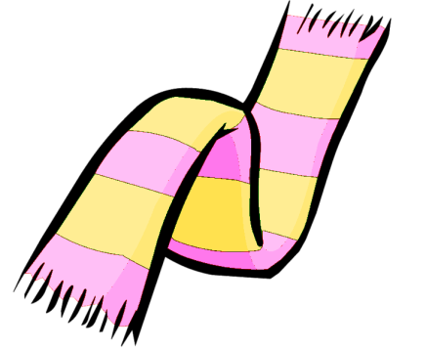
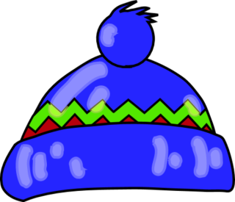

Weather
Two seasons – Summer and Winter.
In the summer, it is light for 24 hours a day – the sun doesn’t set for 6 whole months.
In the winter it is dark for 24 hours a day.
The Regions are cold, windy and have lots of snow and ice. It is too cold for trees to grow.
It can get as cold as -50°C in the Arctic, and temperatures in Antarctica have been as cold as -89°C.

Slide 6
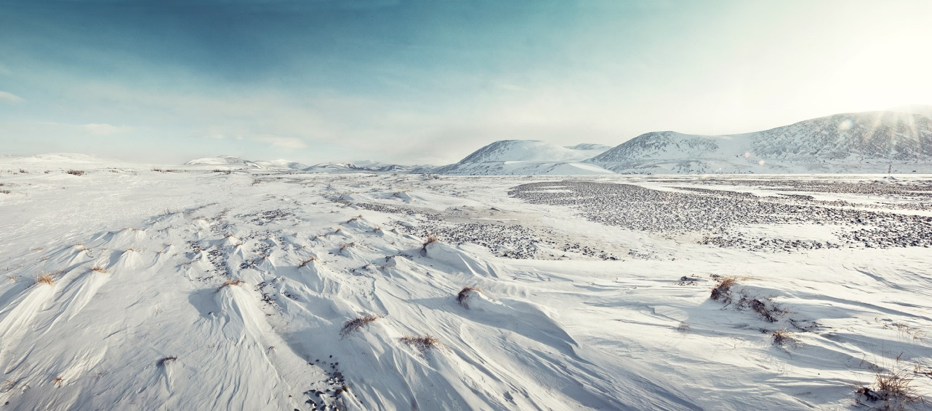
Tundra
Polar habitats have tundra, which is ground that is nearly always frozen.
The very top of it will thaw in the summer months so grasses and mosses can grow, but tree roots can’t go as far down into the ground as they need to because it is frozen.

Slide 7




Arctic Animals

Slide 8
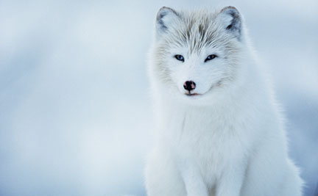
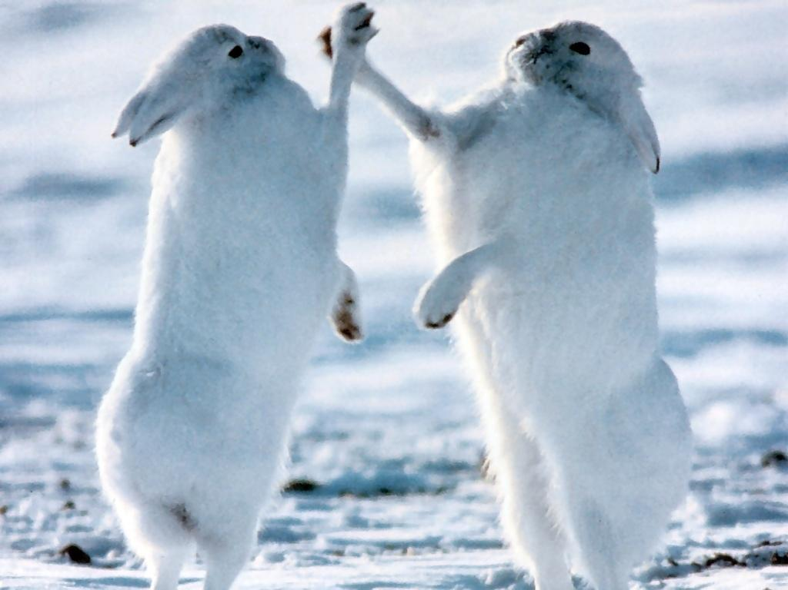
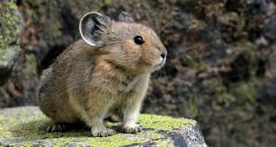
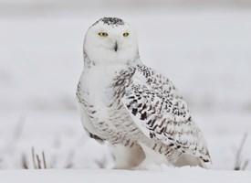
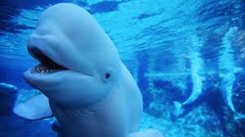
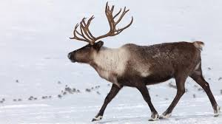
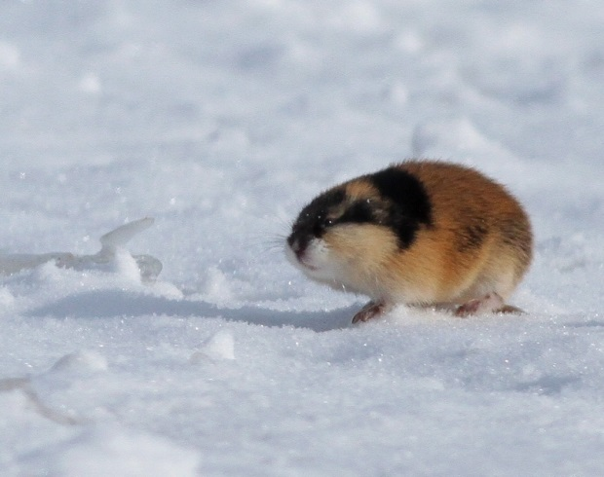
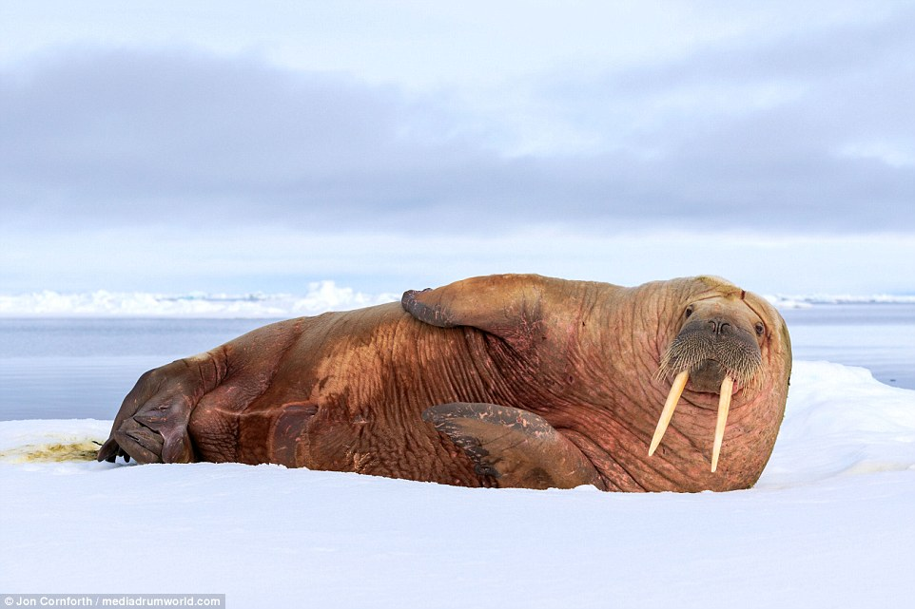
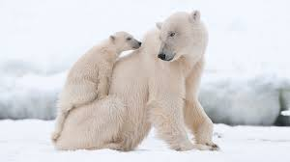
Arctic Fox
Pika
Arctic Hare
Snowy Owl
Beluga Whale
Lemming
Caribou
Walrus
Polar bear

Slide 9
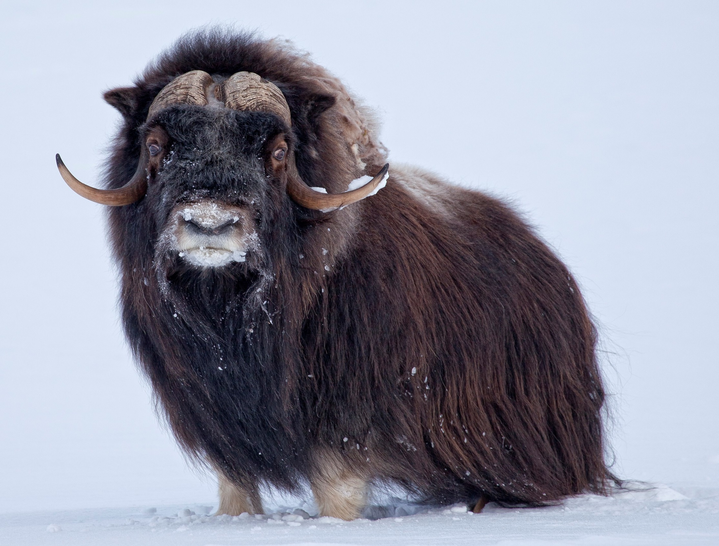
Muskox

Slide 10
Antarctic Animals

Slide 11
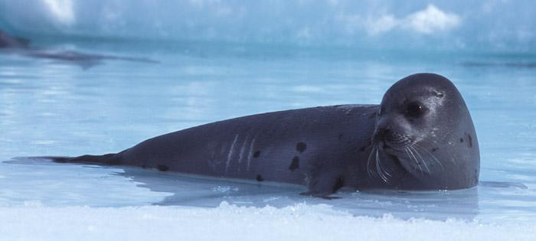
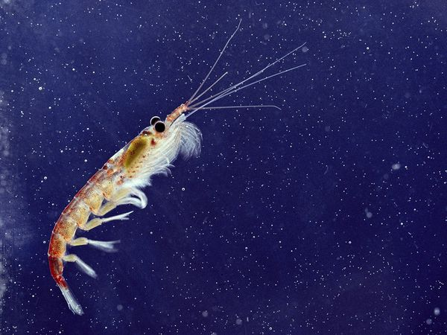
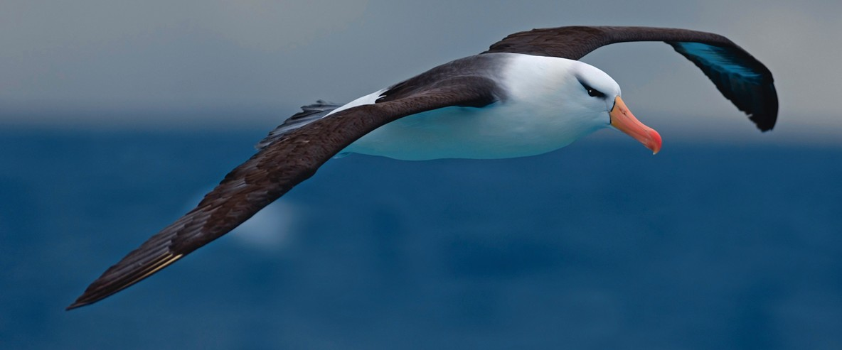
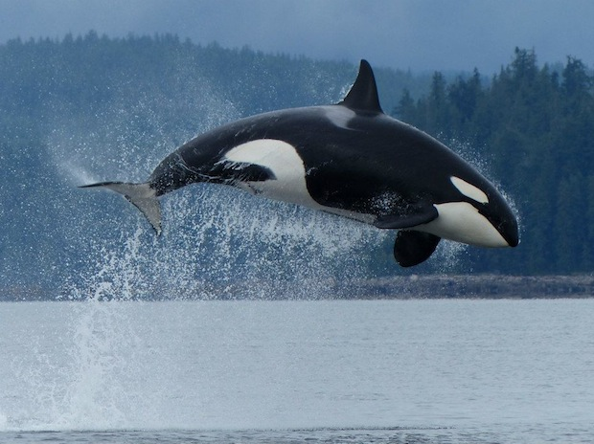
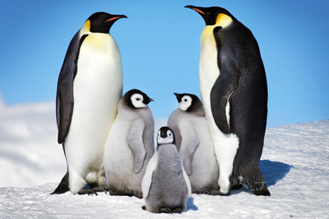
Seal
Krill
Albatross
Orca
Penguins

Slide 12

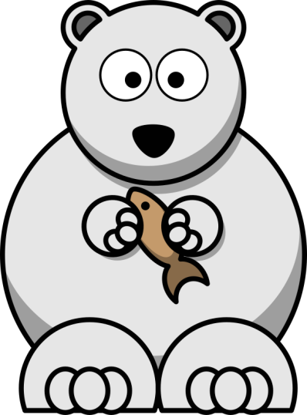
Animals
Animals who live in the Polar Regions have thick fur or feathers.
They can blend in with the white snow – Why?
Some animals hibernate in the coldest winter months.
The animals hunt for fish or other animals rather than relying on plants. Most of the animals are carnivores.
Because it is too cold for trees to grow in arctic habitats, animals find other places to live such as holes in the ground, or in caves made from snow.
Animals such as the polar bear, beluga whale, walrus and the arctic fox are becoming endangered.

Slide 13

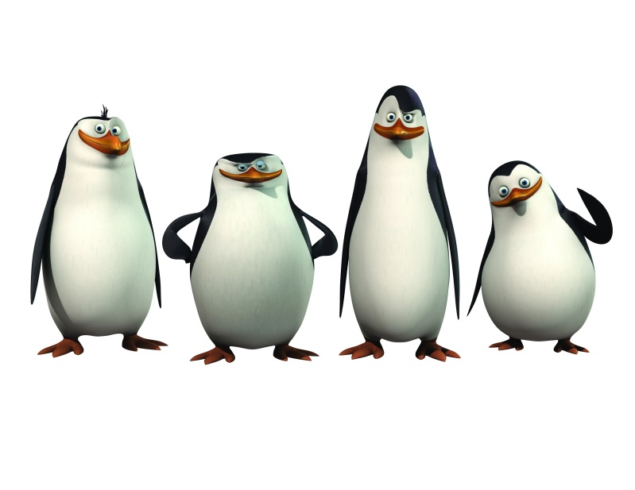
Watch
http://www.bbc.co.uk/education/clips/zktvcdm
http://www.bbc.co.uk/education/clips/z6gd2hv

Slide 14
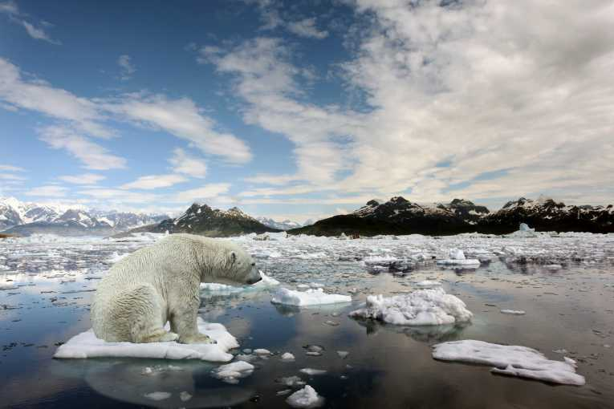
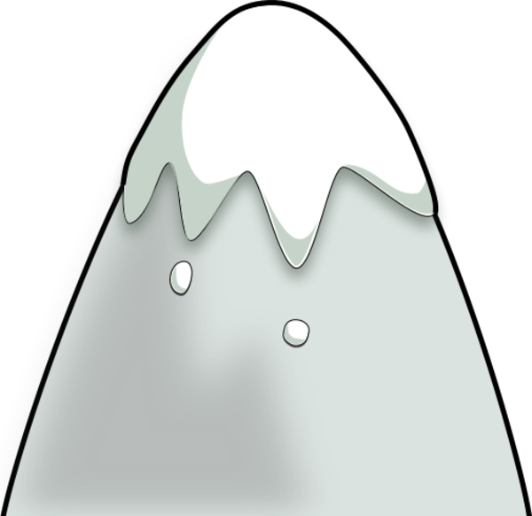
Ice Caps
Some parts of polar regions are always frozen, all year round. These are called ice caps, and they are located in the very centre of the Arctic and Antarctica.
The size of the ice cap changes when bits on the edge of it melt during the summer months.

Slide 15

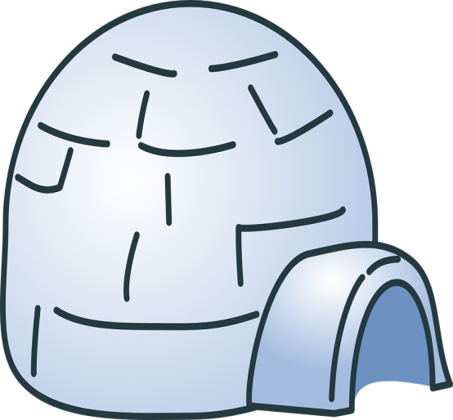
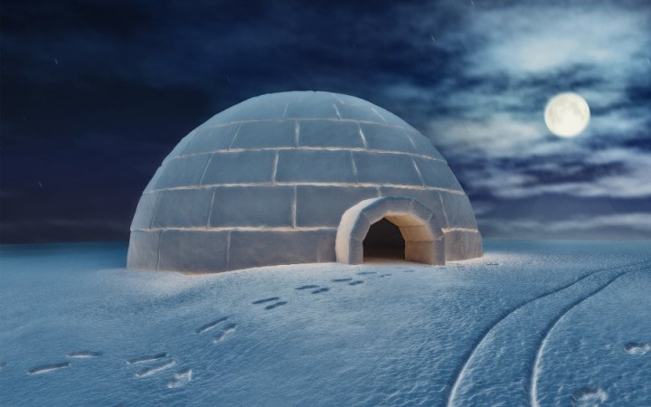
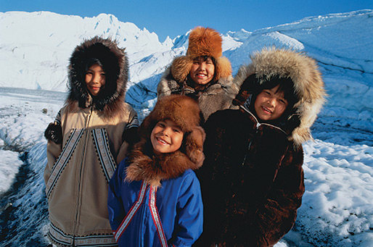
Home
Despite the freezing-cold temperatures, approximately four million people call this wintery wonderland home!
The Inuit people, also known as Eskimos, live in houses made of snow and ice, called igloos.

