Slide 1
2D Shapes

Slide 2
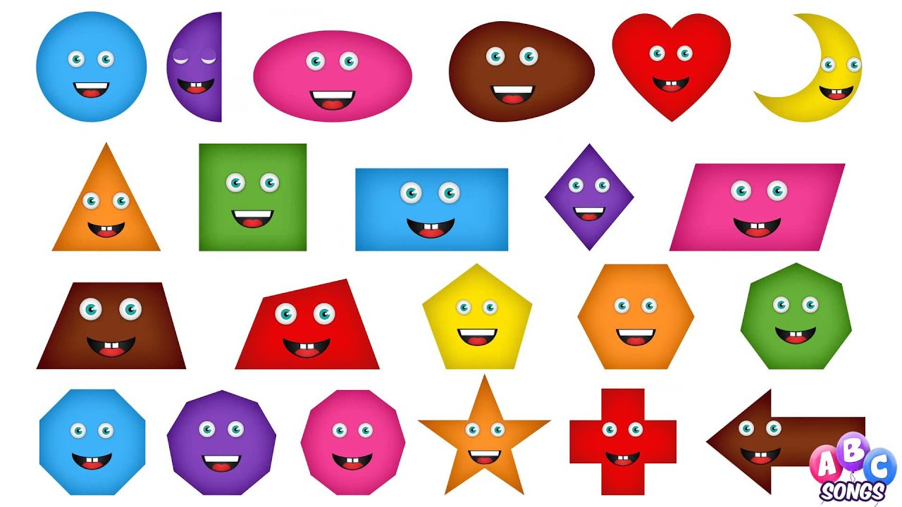
2D shapes
2D shapes are flat.
We can easily draw them on paper.

Slide 3
What shape am I?
Hello, I am a square.
What do you know about me?
I have 4 sides that are all the same length.
I have 4 corners.

Slide 4
What shape am I?
Hello, I am a circle.
What do you know about me?
I have 1 curved side.
I have 0 corners.

Slide 5
What shape am I?
Hello, I am a triangle.
What do you know about me?
I have 3 sides.
I have 3 corners.

Slide 6
What shape am I?
Hello, I am a rectangle.
What do you know about me?
I have 4 corners.
I have 4 sides.
2 long sides and 2 short sides.

Slide 7
What shape am I?
Hello, I am a pentagon.
What do you know about me?
I have 5 corners.
I have 5 sides.

Slide 8
What shape am I?
Hello, I am a pentagon.
What do you know about me?
I have 6 corners.
I have 6 sides.

