Slide 1

Day 4 igh

Slide 2
revisit
Can you remember these sounds from Phase 2?
s a t p i n m d
g o c k e u r b
f l ff ll ss ck
j v w

Slide 3
revisit
Can you remember these tricky words?
the
no
I
to
go

Slide 4

Todays sound is made up of three graphemes (letters), two consonants and one vowel. We call it a trigraph.
trigraph
This is short for the word ‘grapheme’. This is the way we write down the sound.
‘tri’ means three, think of ‘triangle’ and ‘tricycle’.

Slide 5
Note: This grapheme is often used when the ‘igh’ sound is in the middle of a word.
igh

Slide 6





igh
fright
sight
night
flight
light

Slide 7
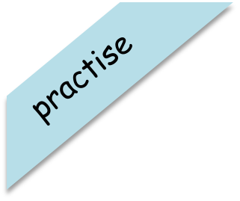
Try and spell out this word (either orally, on whiteboards, with letter fans or magnetic letters)
l
igh
t

Slide 8

Try and spell out this word (either orally, on whiteboards, with letter fans or magnetic letters)
r
igh
t

Slide 9
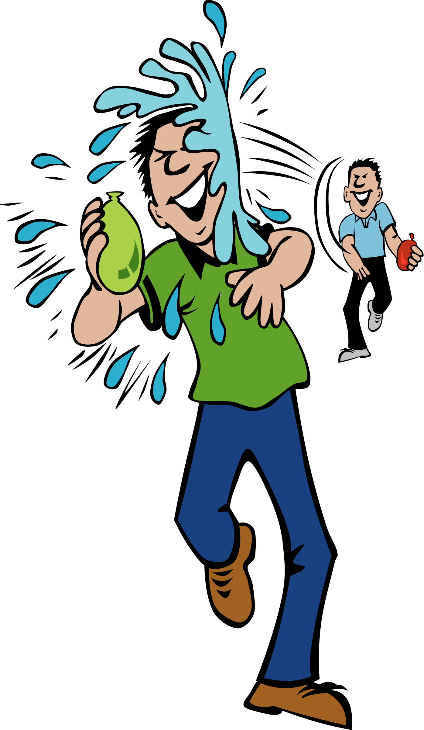
Try and spell out this word (either orally, on whiteboards, with letter fans or magnetic letters)
f
igh
t

Slide 10


Yes/No Questions:
Is it light at night?

Slide 11


Yes/No Questions:
Will it rain tonight?

Slide 12
Day 5 was

Slide 13
revisit
Can you remember these sounds?
s a t p i n m d
g o c k e u r b
f l ff ll ss ck
j v w x

Slide 14
revisit
Can you remember these tricky words?
the
no
I
to
go

Slide 15
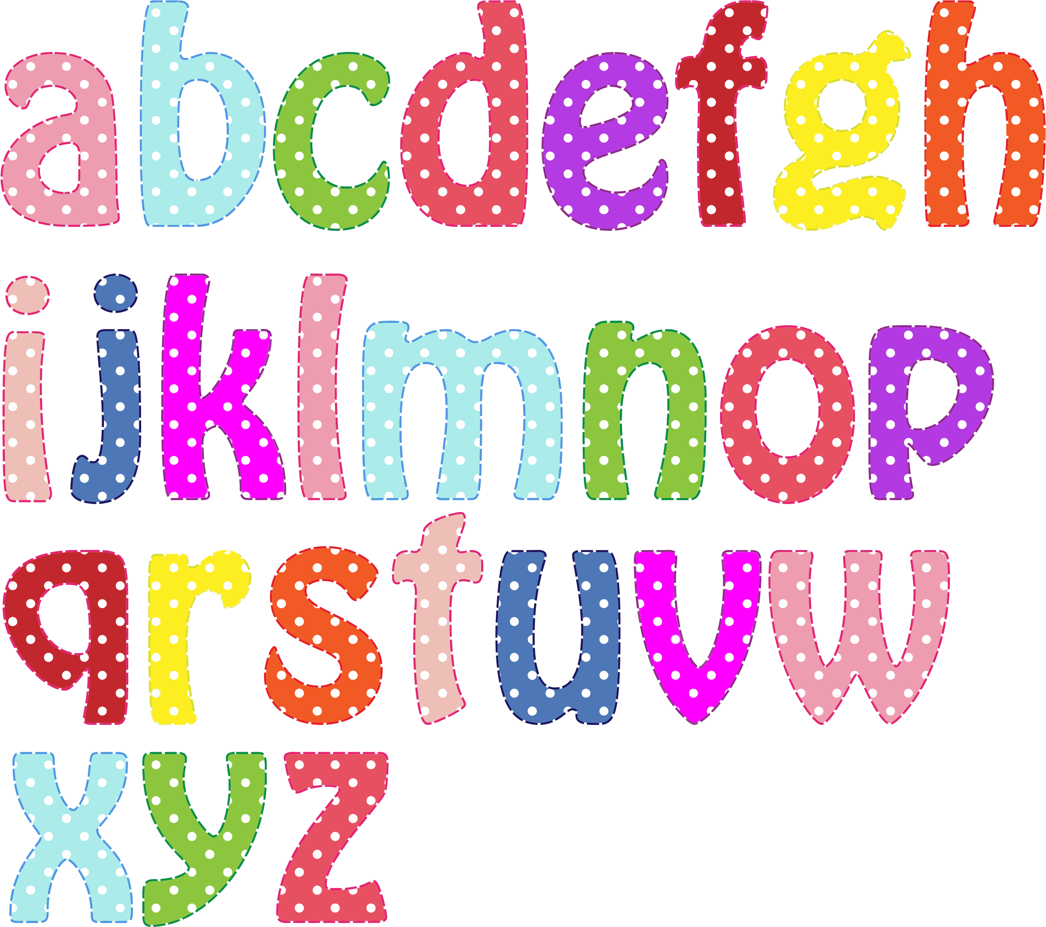
We are going to sing the alphabet song. Point to the correct letters as you sing.

Slide 16
we
Can you remember these tricky words from last week? Remember that vowels sometimes say their ‘sound’ and sometimes say their ‘name’. In these words, the ‘e’ said its name.
be
he
me
she

Slide 17
no
Todays tricky words have ‘o’ in them. ‘o’ is also a vowel and in these words it says its ‘name’.
go

Slide 18
no
Look carefully at the words. When they disappear, have a go at writing them for yourself.
go

Slide 19
was
We are also learning another tricky word. This one is quite tricky – when you have a ‘w’ followed by an ‘a’ it tends to say ‘wo’. The ‘s’ is also tricky as it is making the ‘z’ sound. This is a word we will have to practice reading.

Slide 20

Have a go at reading this sentence.
I was sad.

Slide 21

Have a go at reading this sentence.
He was sad.

Slide 22

Have a go at reading this sentence.
She was sad.

Slide 23
Acknowledgements:
Page borders from: https://www.teacherspayteachers.com/Store/Miss-Giraffe
All clip art images from: openclipart.og

