Slide 1

Day 2 ee

Slide 2
revisit
Can you remember these sounds from Phase 2?
s a t p i n
m d g o c k
e u r b f l
ff ll ss ck j

Slide 3
revisit
Can you remember these tricky words?
the
no
I
to
go

Slide 4


Note: This grapheme is often used when the ‘ee’ sound is in the middle of a word.
I am the first vowel so the sound says my name!
e
e

Slide 5
ee

Slide 6
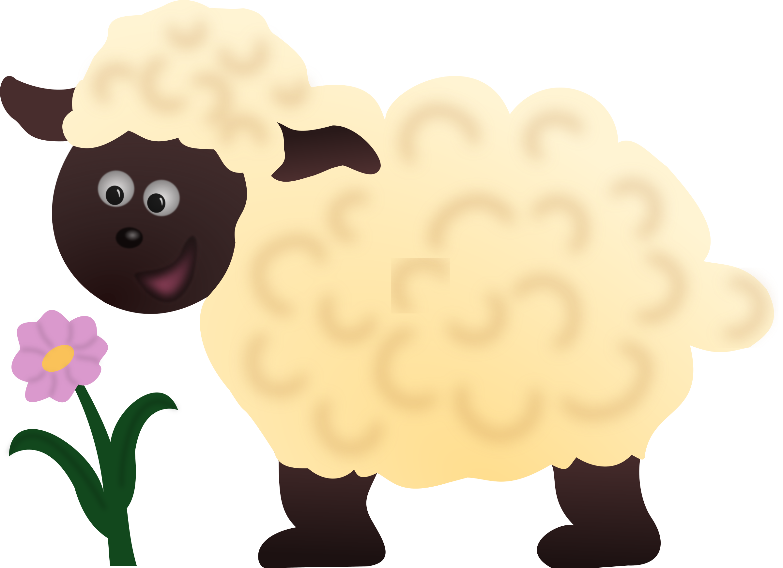




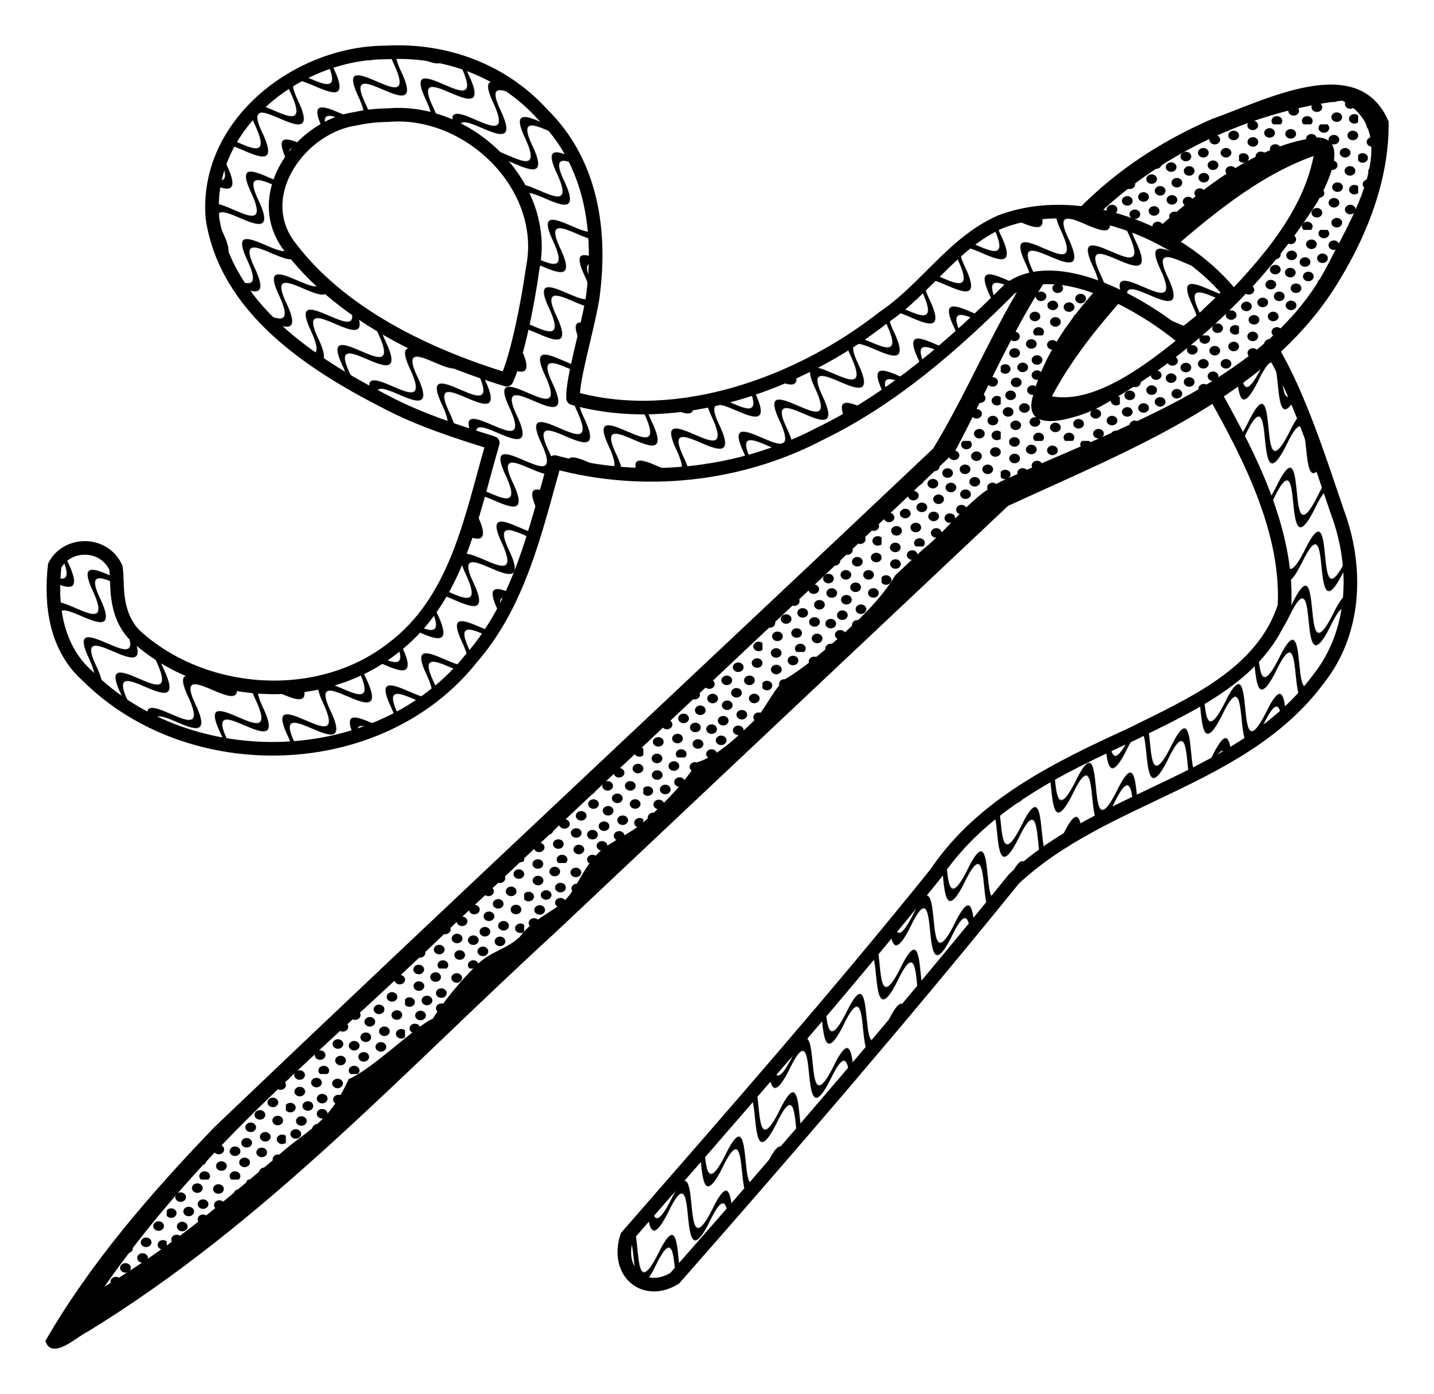
sheep
jeep
ee
green
sleep
needle
feet

Slide 7
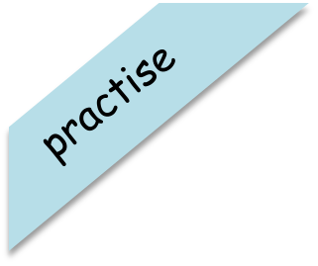

Try and spell out this word (either orally, on whiteboards, with letter fans or magnetic letters)
s
ee

Slide 8
Try and spell out this word (either orally, on whiteboards, with letter fans or magnetic letters)
sh
ee
p

Slide 9
Try and spell out this word (either orally, on whiteboards, with letter fans or magnetic letters)
f
ee
t

Slide 10


Try to read this caption:
Sixteen trees

Slide 11
Day 3 oa

Slide 12
revisit
Can you remember these sounds from Phase 2?
s a t p i n
m d g o c k
e u r b f l j
ff ll ss ck v

Slide 13
revisit
Can you remember these tricky words?
the
no
I
to
go

Slide 14
Note: This grapheme is often used when the ‘oa’ sound is in the middle of a word.
I am the first vowel so the sound says my name!
a
o

Slide 15
oa

Slide 16

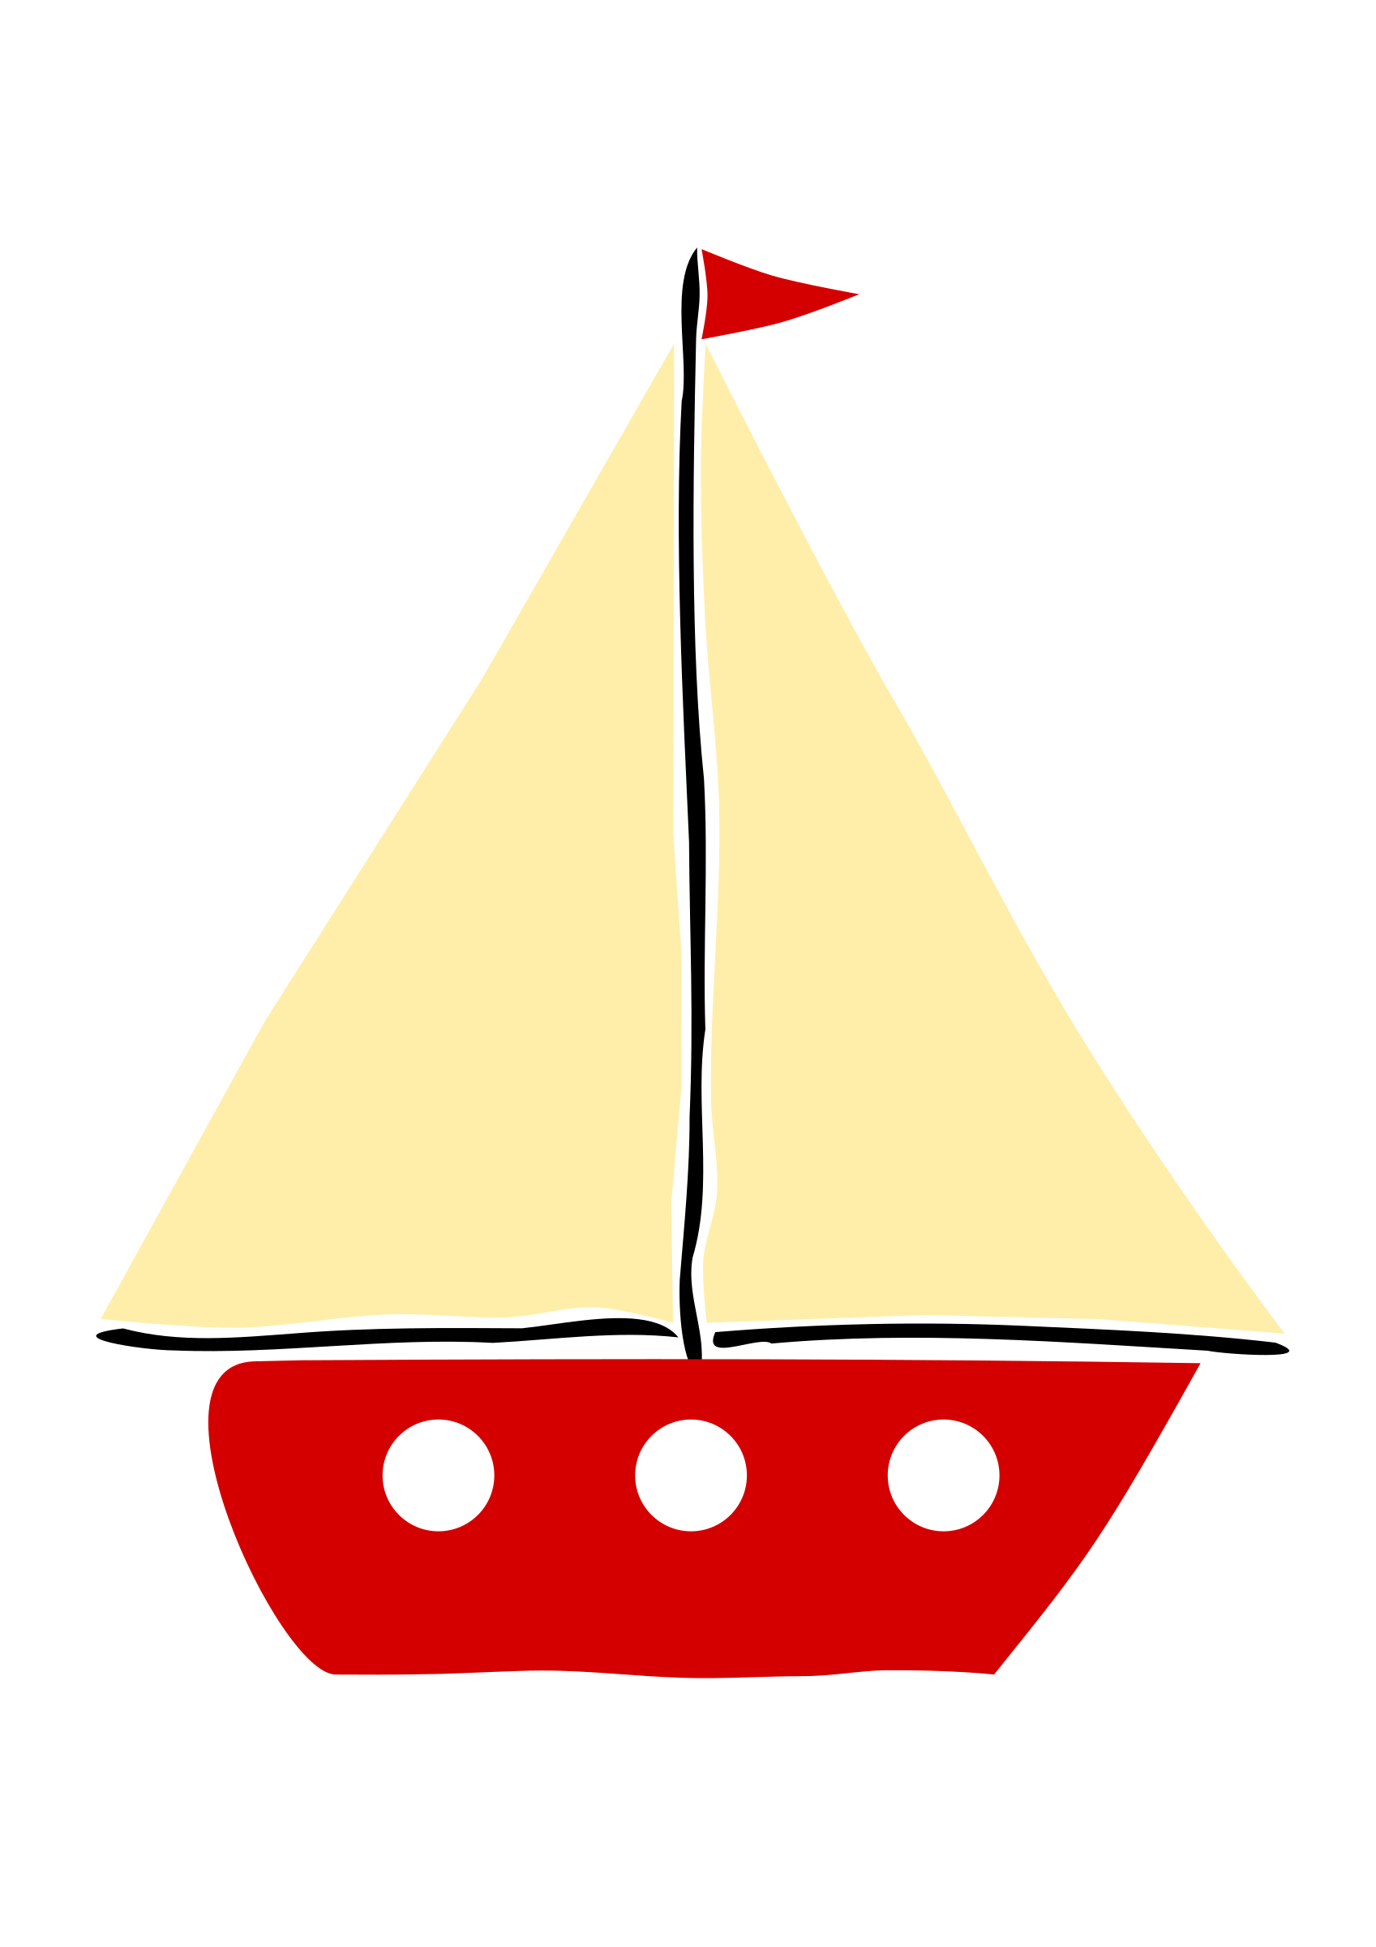

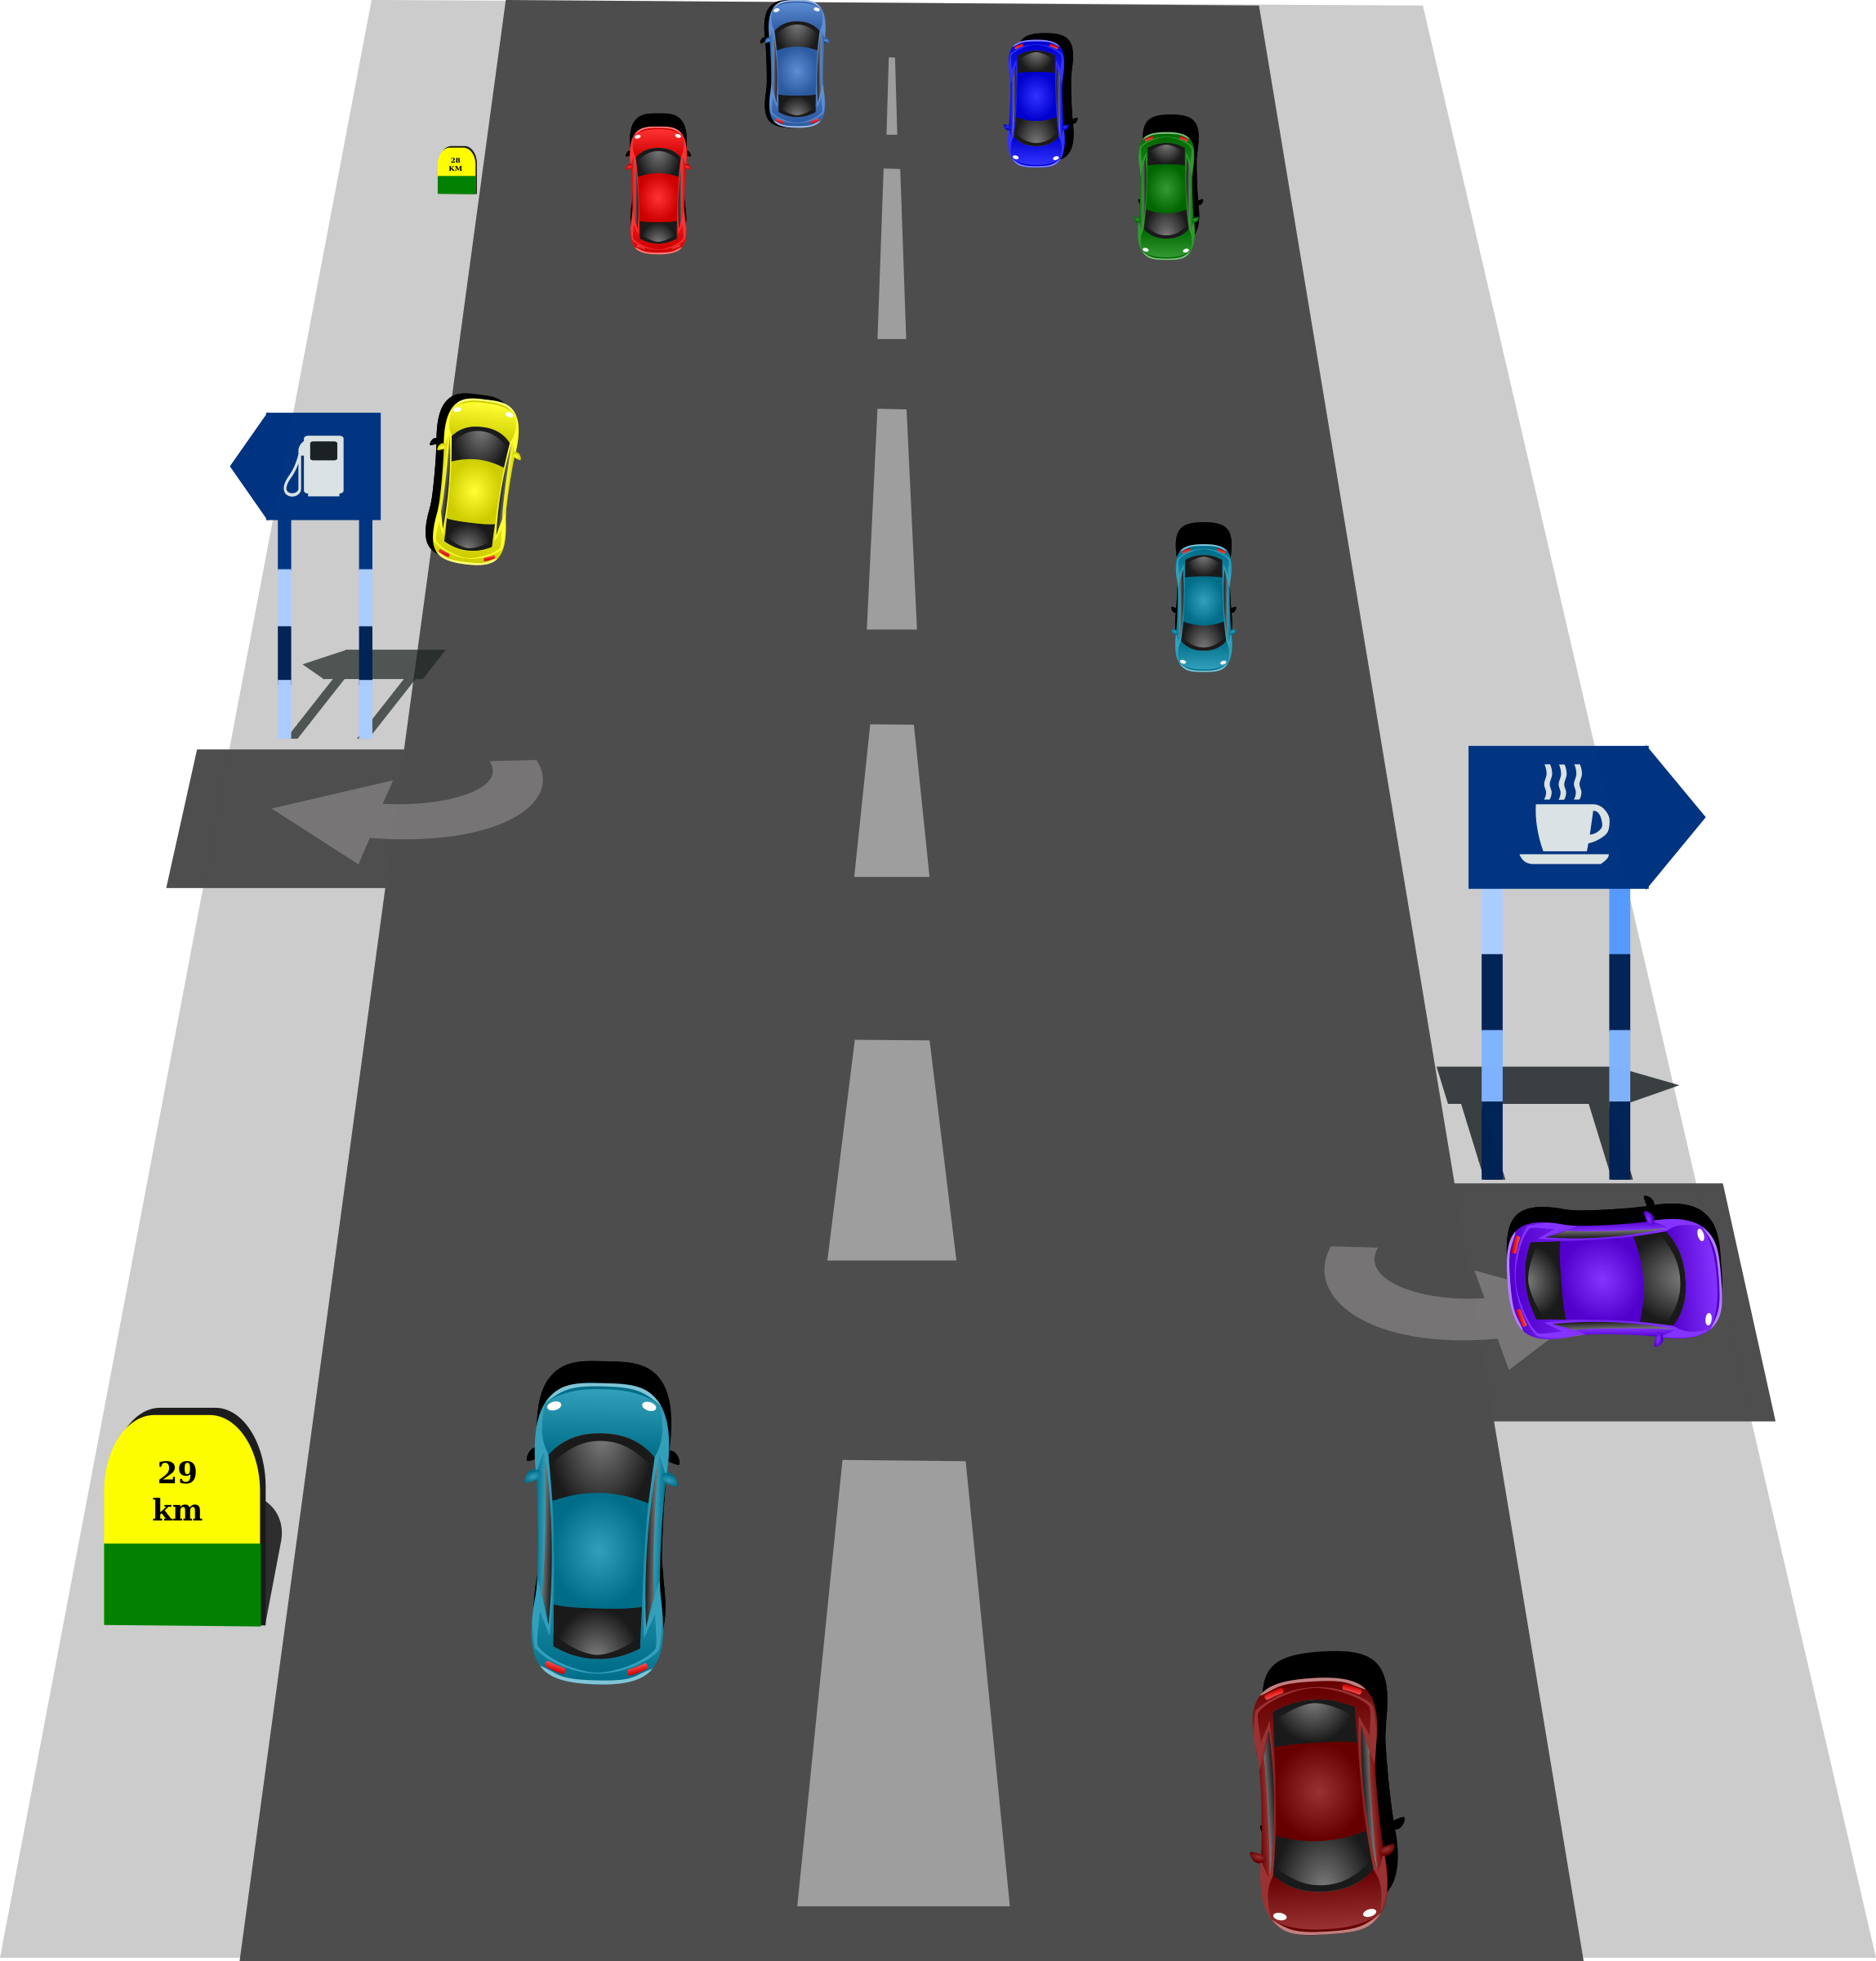


coat
toad
boat
oa
road
goat

Slide 17

Have a go at reading these words. Click to see the picture:
loaf

Slide 18

Have a go at reading these words. Click to see the picture:
boatman

Slide 19
Have a go at reading these words. Click to see the picture:
road

Slide 20

Try to read this caption:
A goat and a sheep.

