Slide 2
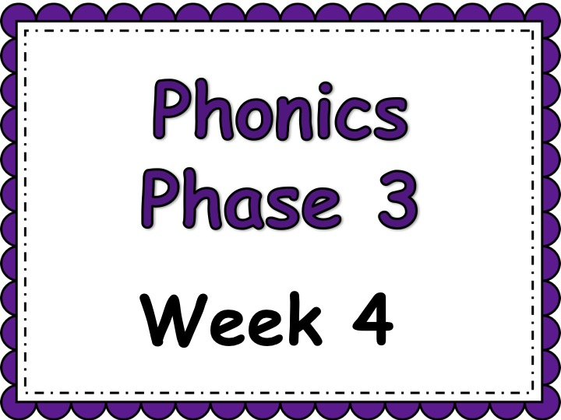

Slide 3

Day 1 ai

Slide 4
revisit
Can you remember these sounds from Phase 2?
s a t p i n m
m d g o c k
e u r b f l
ff ll ss ck

Slide 5
revisit
Can you remember these tricky words?
the
no
I
to
go

Slide 6

These are all the letters of the alphabet. The red letters are called vowels. The rest of the letters are called the consonants.
a b c d e f g
h i j k l m n
o p q r s t u
v w x y z

Slide 7
There is an easy rule to follow when looking at vowel digraphs (note: it doesn’t work for all vowel digraphs but if you are unsure it’s worth a guess!)
When 2 vowels go walking, the first does the talking.
This means that you say the ‘name’ of the first sound.

Slide 8
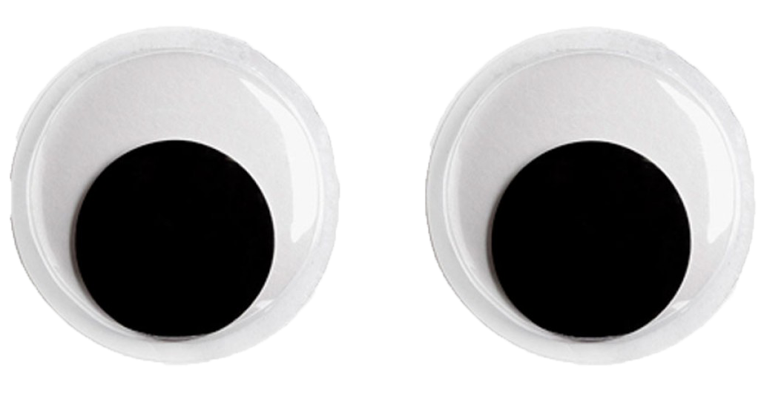
I am the first vowel so the sound says my name!
a
i
Note: This grapheme is often used when the ‘ai’ sound is in the middle of a word.

Slide 9
ai

Slide 10


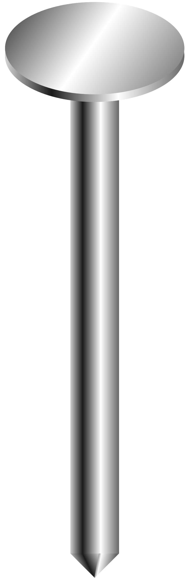
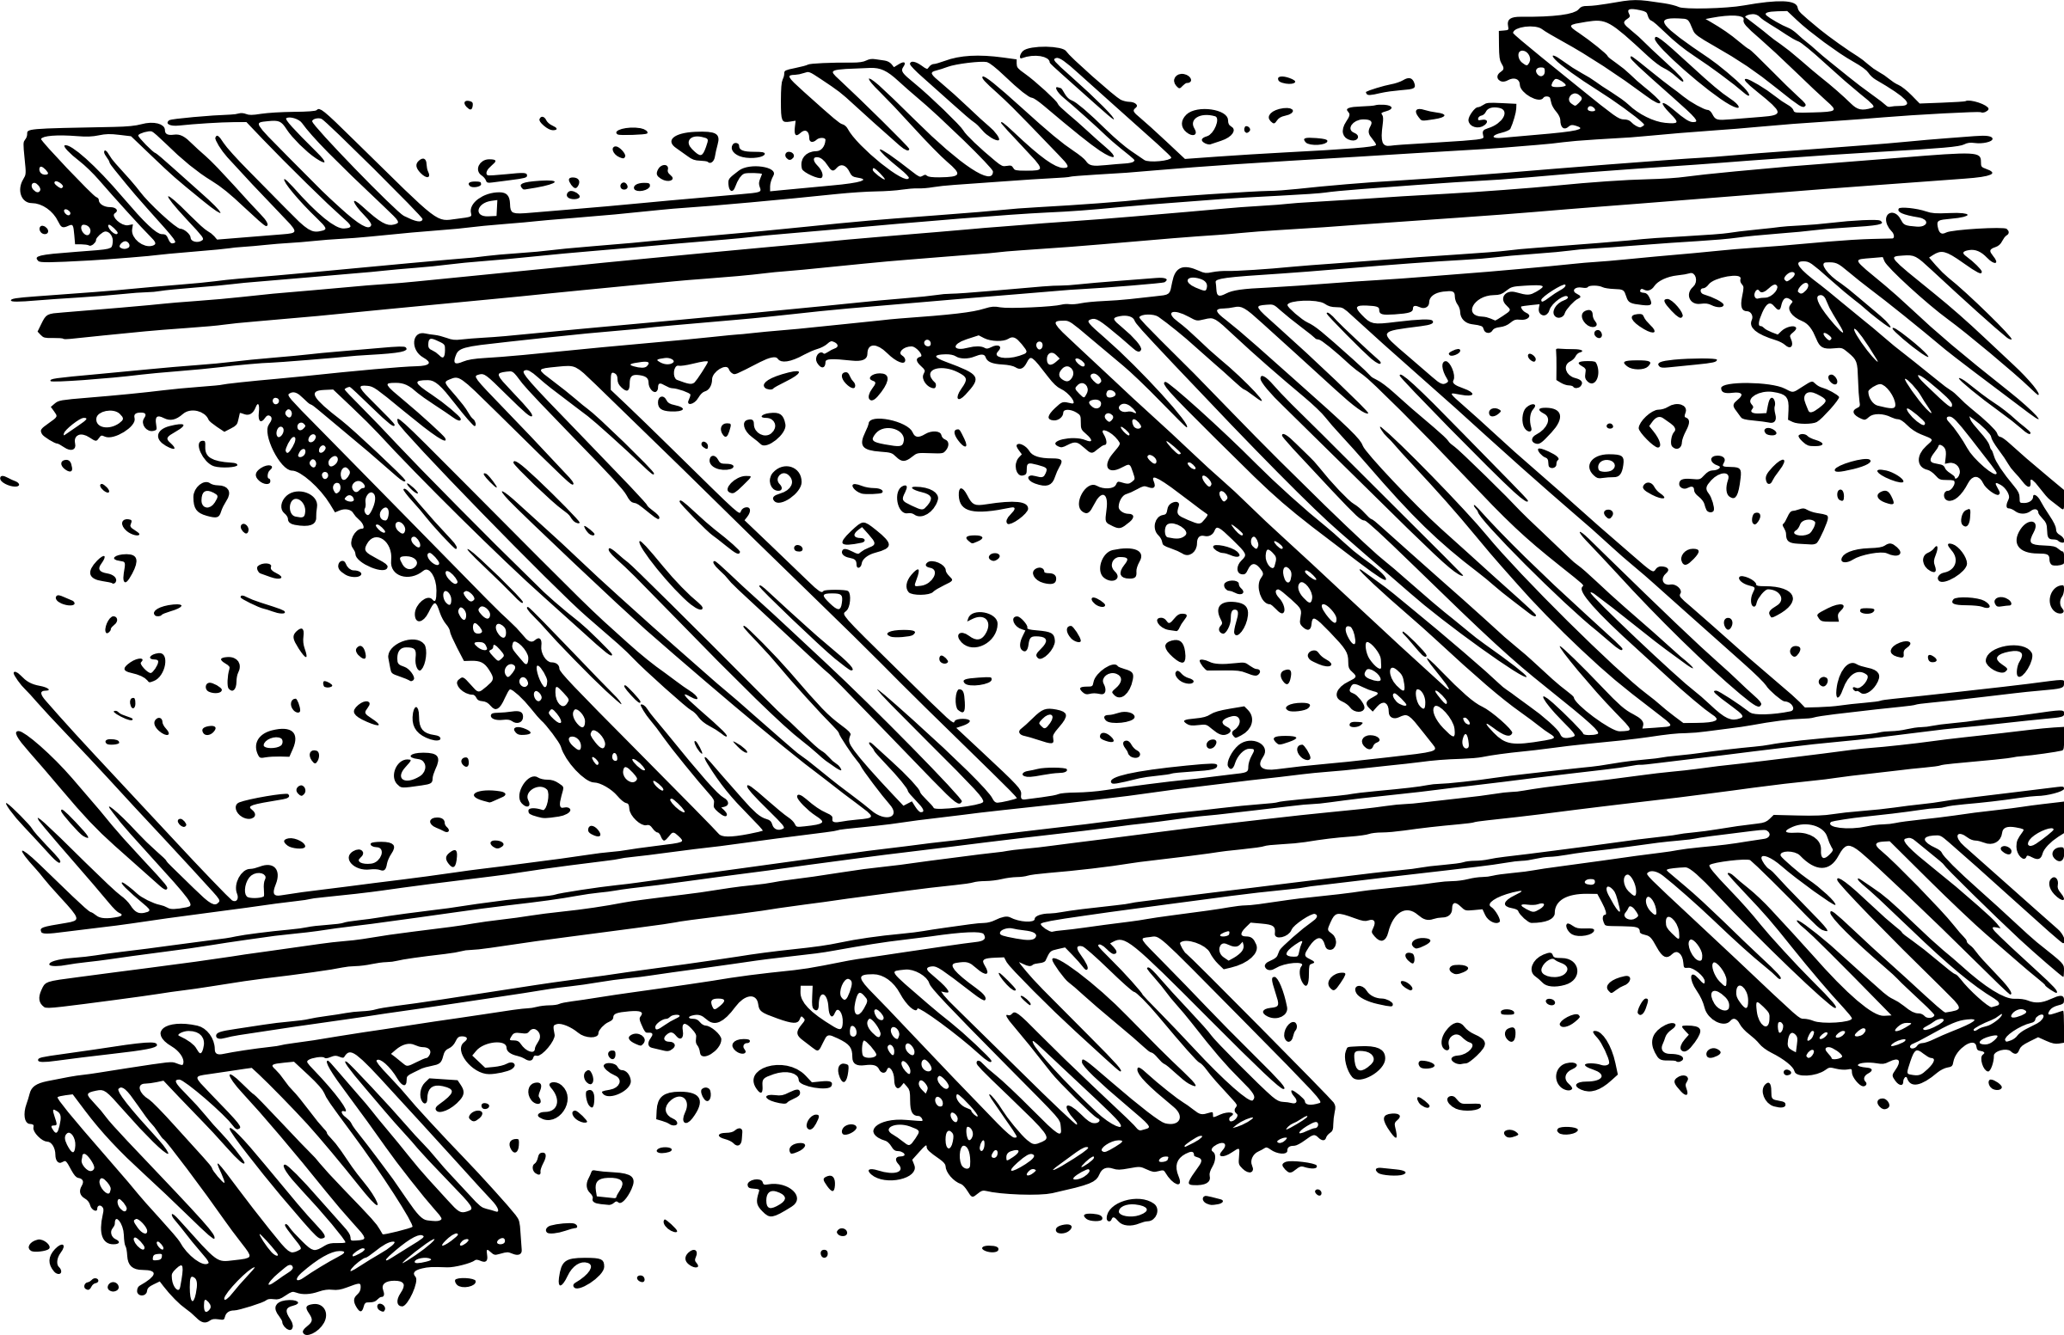

rain
snail
ai
nail
jail
rail

Slide 11
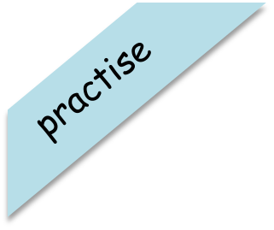
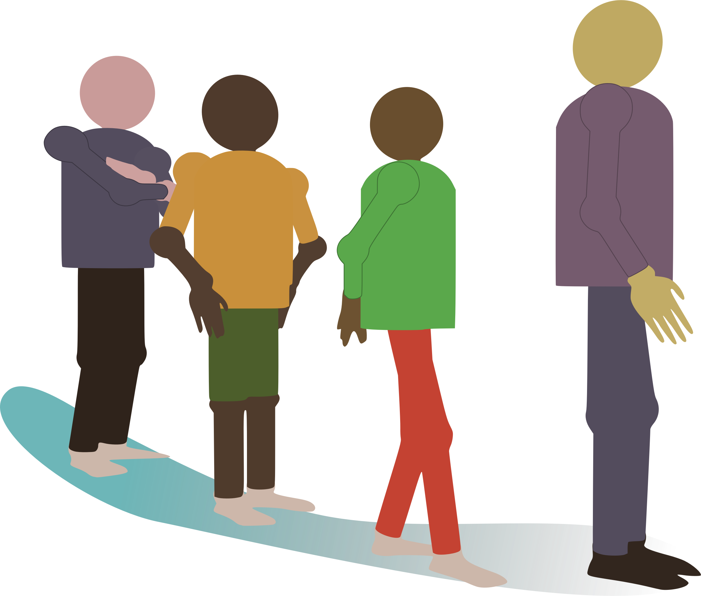
Have a go at reading these words. Click to see the picture:
wait

Slide 12

Have a go at reading these words. Click to see the picture:
pain

Slide 13
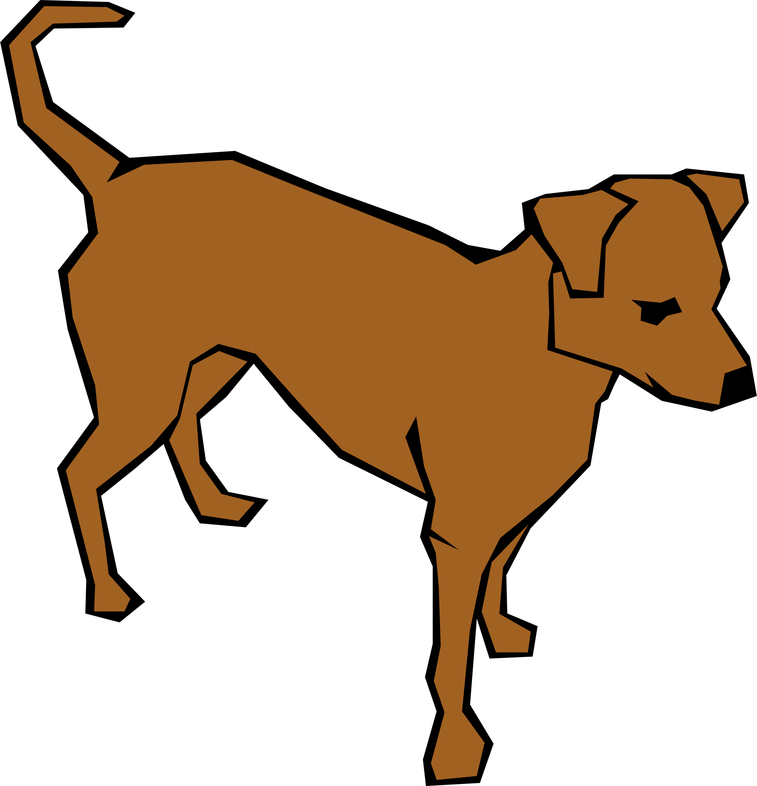
Have a go at reading these words. Click to see the picture:
tail

Slide 14



Write the sentence to go with this picture:
Sam got wet in the rain.

Slide 15


Yes/No Questions:
Is rain wet?

