Slide 1
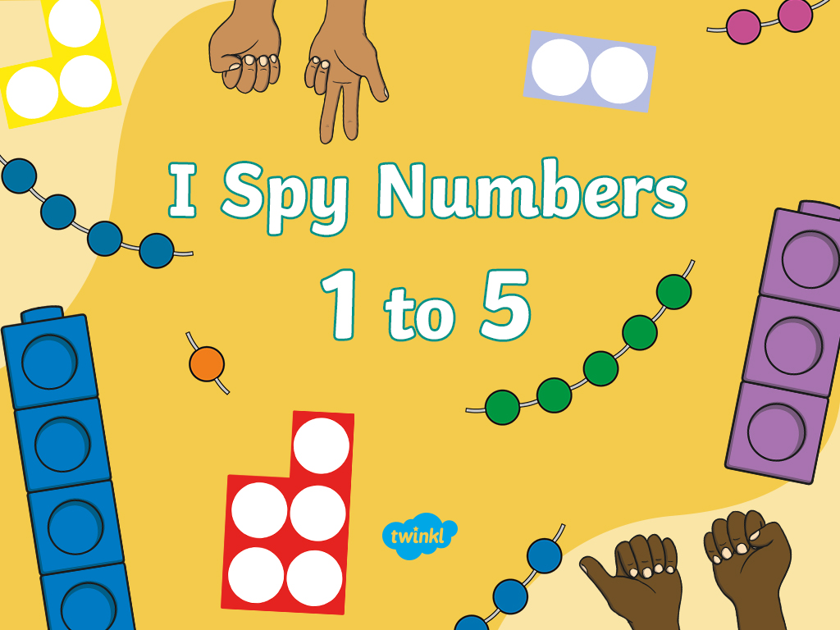

Slide 2


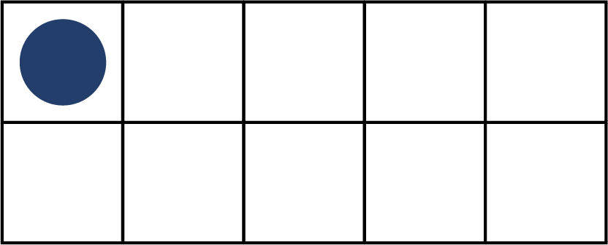






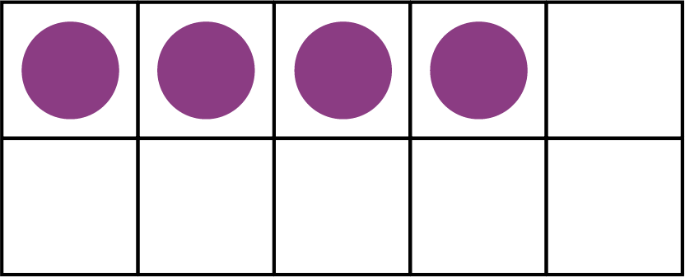


Can you find and click all of the number ones?
1
3
Try again
1
Next number

Slide 3

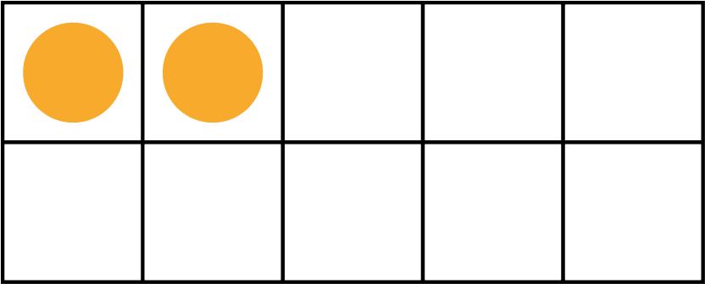


Can you find and click all of the number twos?
2
Try again
2
5
Next number

Slide 4

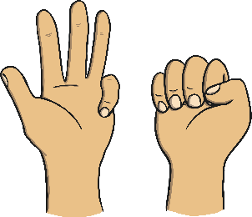
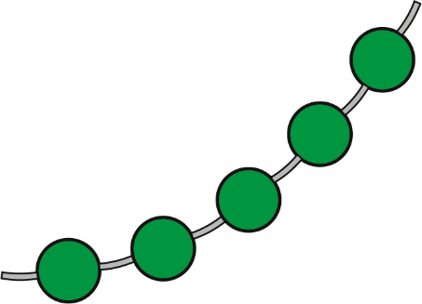




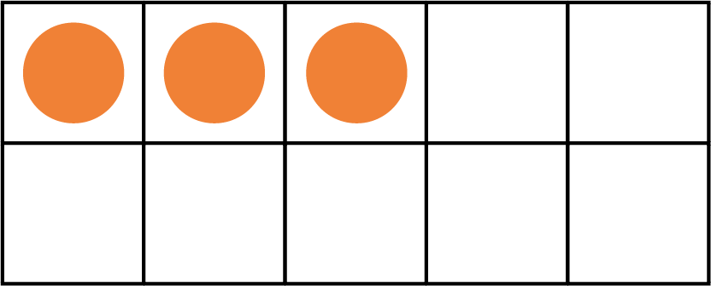
Can you find and click all of the number threes?
3
3
Try again
2
Next number

Slide 5

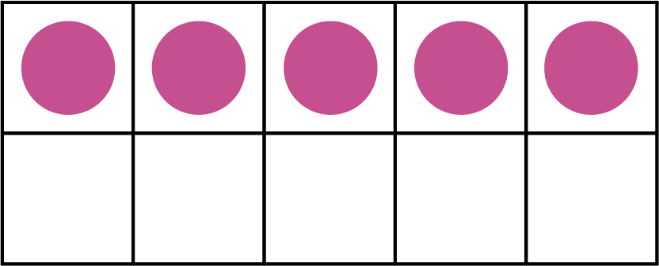

Can you find and click all of the number fours?
4
1
Try again
4
2
Next number

Slide 6

Can you find and click all of the number fives?
5
3
Try again
2
5
End

Slide 7


