Slide 1











Can you hear the initial sound?
Say the name of each picture out loud. What sound do they start with?
Now can you sort them into 4 lists? Draw the pictures under the correct sound.
j
v
w
y

Slide 2

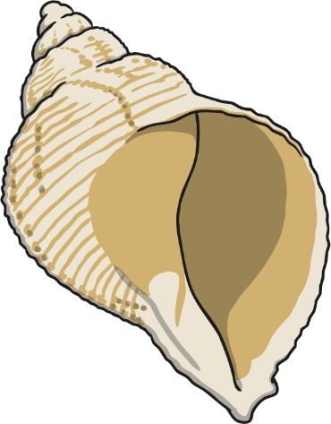


Can you write these words?

Slide 3
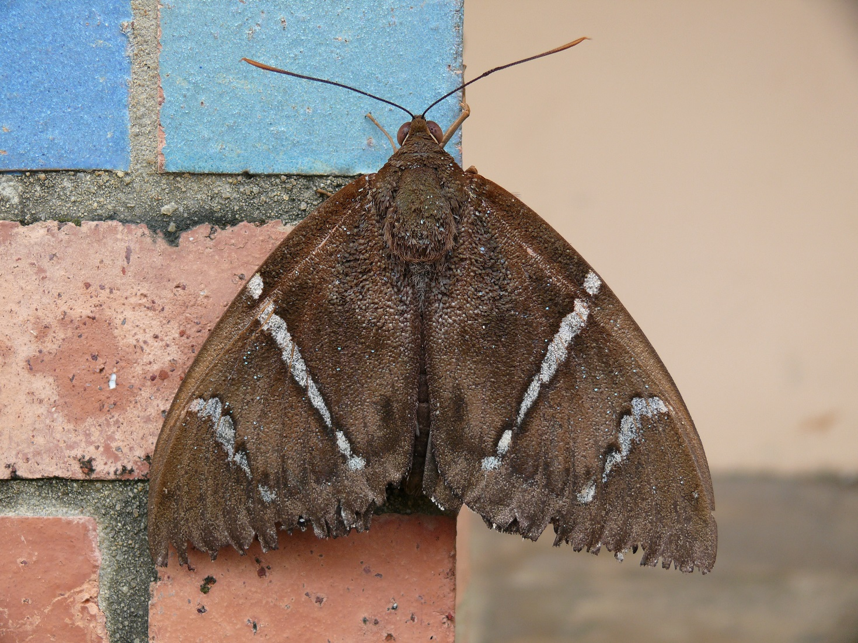
Write a sentence about this picture:

Slide 4


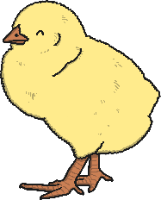





Which sound can you hear in these words?
Say the name of each picture out loud. Which sounds can you hear?
Now can you sort them into 4 lists? Draw the pictures under the correct sound.
ch
sh
ng
th

Slide 5

Read the sentence and draw the picture:
The ship hit the rocks with a thud
and a bang.

Slide 6
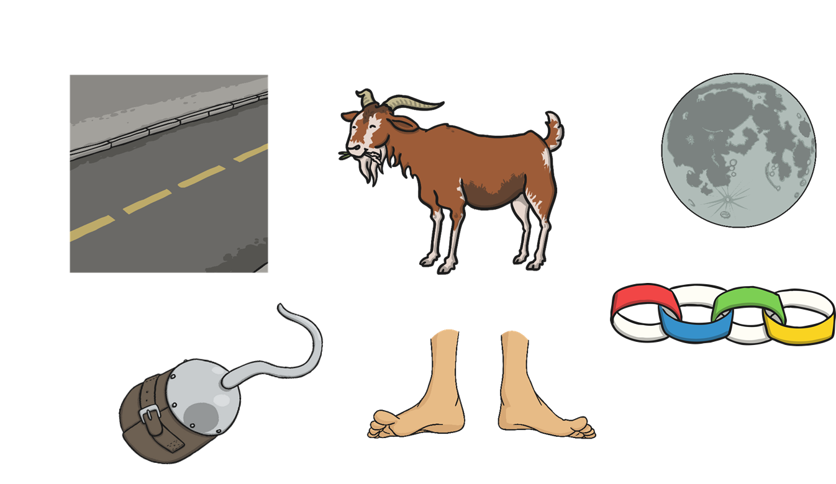
Can you write these words?
Now write a sentence using one of the words.

Slide 7

Write a sentence about this picture:

Slide 8

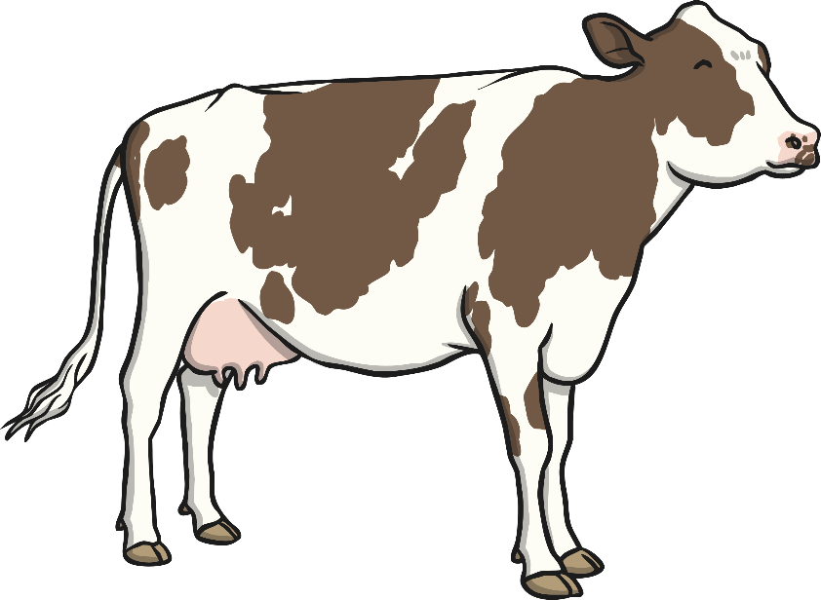


Write a sentence about one of these pictures:

Slide 9















Help Pirate Pete find the treasure!
The real treasure has real
words on it.
The fake treasure has got
made up words on it.
Can you find the real treasure?

Slide 10

Read the sentence and draw the picture:
The man put ten coins
in his jar.

