Slide 1

Day 3 ur

Slide 2
revisit
Can you remember these sounds from Phase 2?
s a t p i n
m d g o c k
e u r b f l j
ff ll ss ck v

Slide 3
revisit
Can you remember these tricky words?
the
no
I
to
go

Slide 4

ur

Slide 5



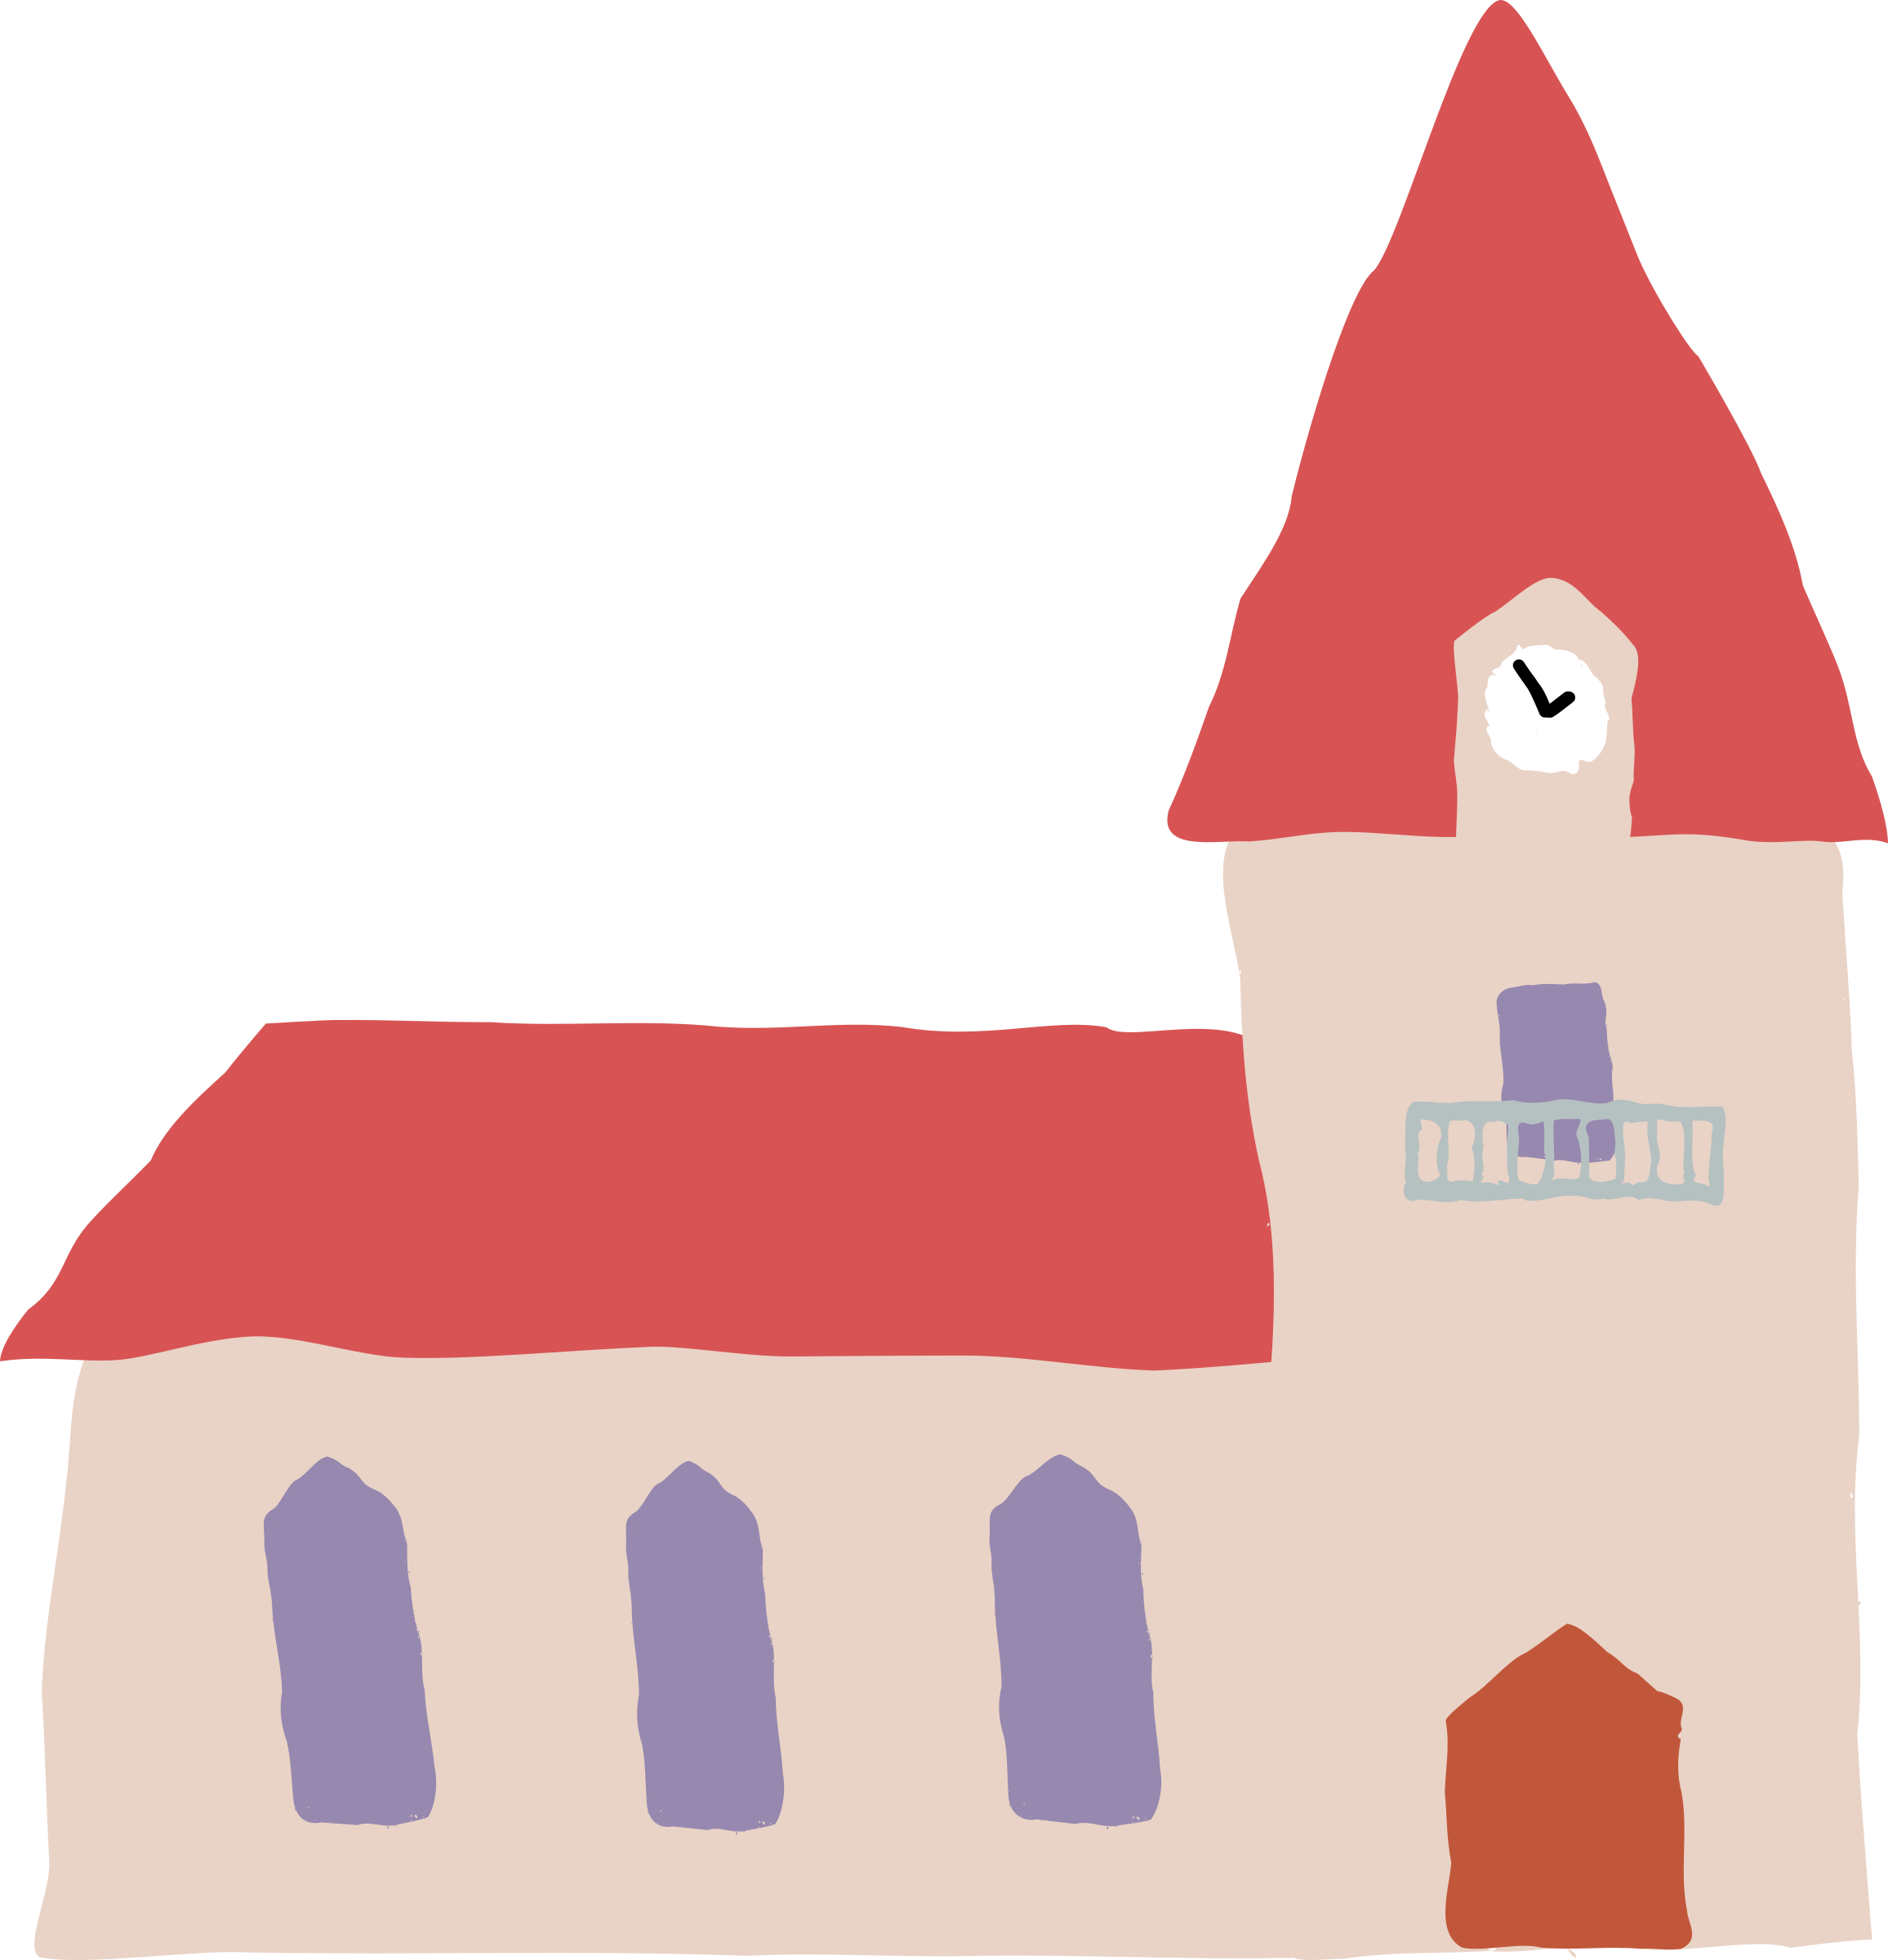
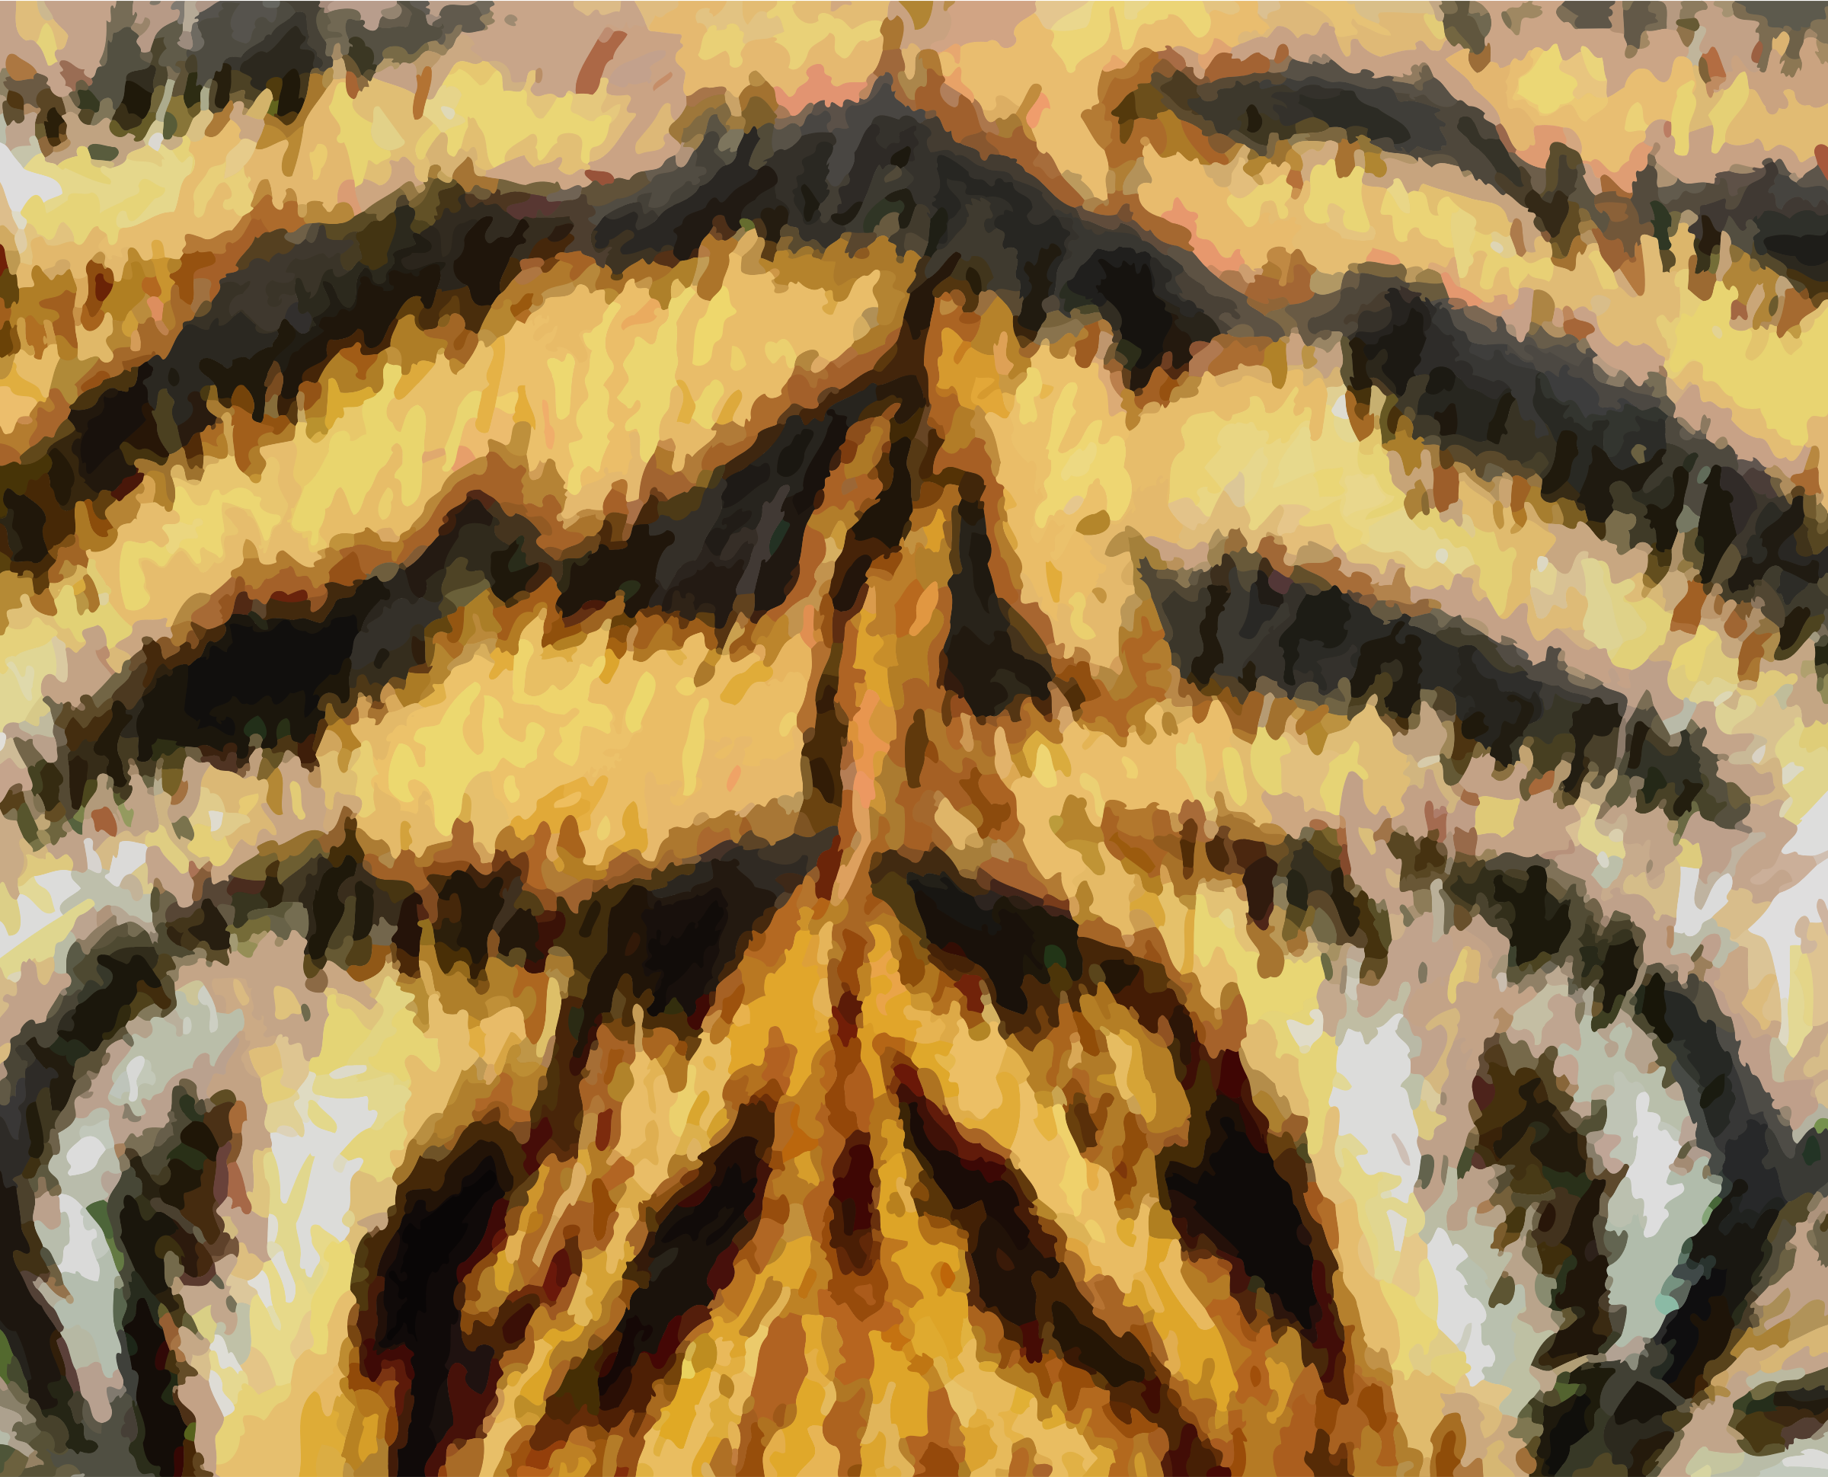
turtle
ur
nurse
curtain
fur
church

Slide 6
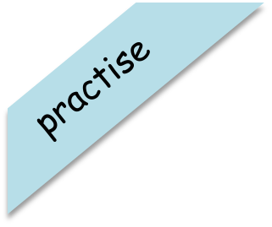

Have a go at reading these words. Click to see the picture:
surf

Slide 7

Have a go at reading these words. Click to see the picture:
curl

Slide 8

Have a go at reading these words. Click to see the picture:
turnip

Slide 9



Yes/No Questions:
Can a burn hurt?

Slide 10
Day 4 er

Slide 11
revisit
Can you remember these sounds from Phase 2?
s a t p i n m d
g o c k e u r b
f l ff ll ss ck
j v w

Slide 12
revisit
Can you remember these tricky words?
the
no
I
to
go

Slide 13
er

Slide 14



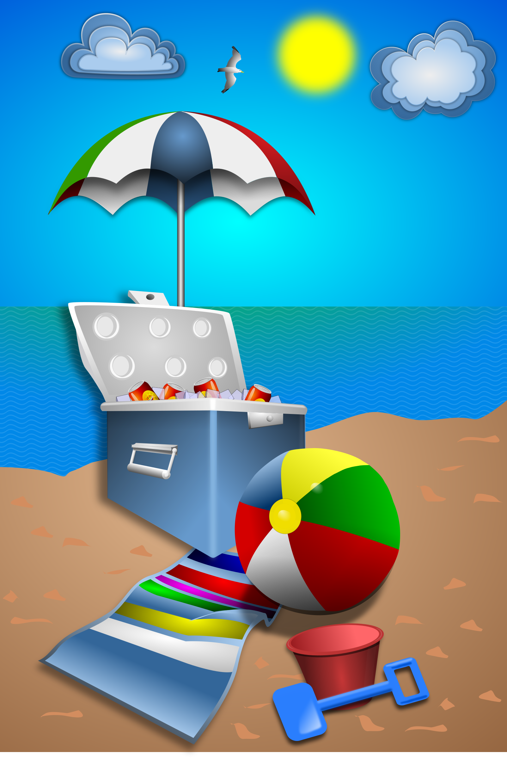
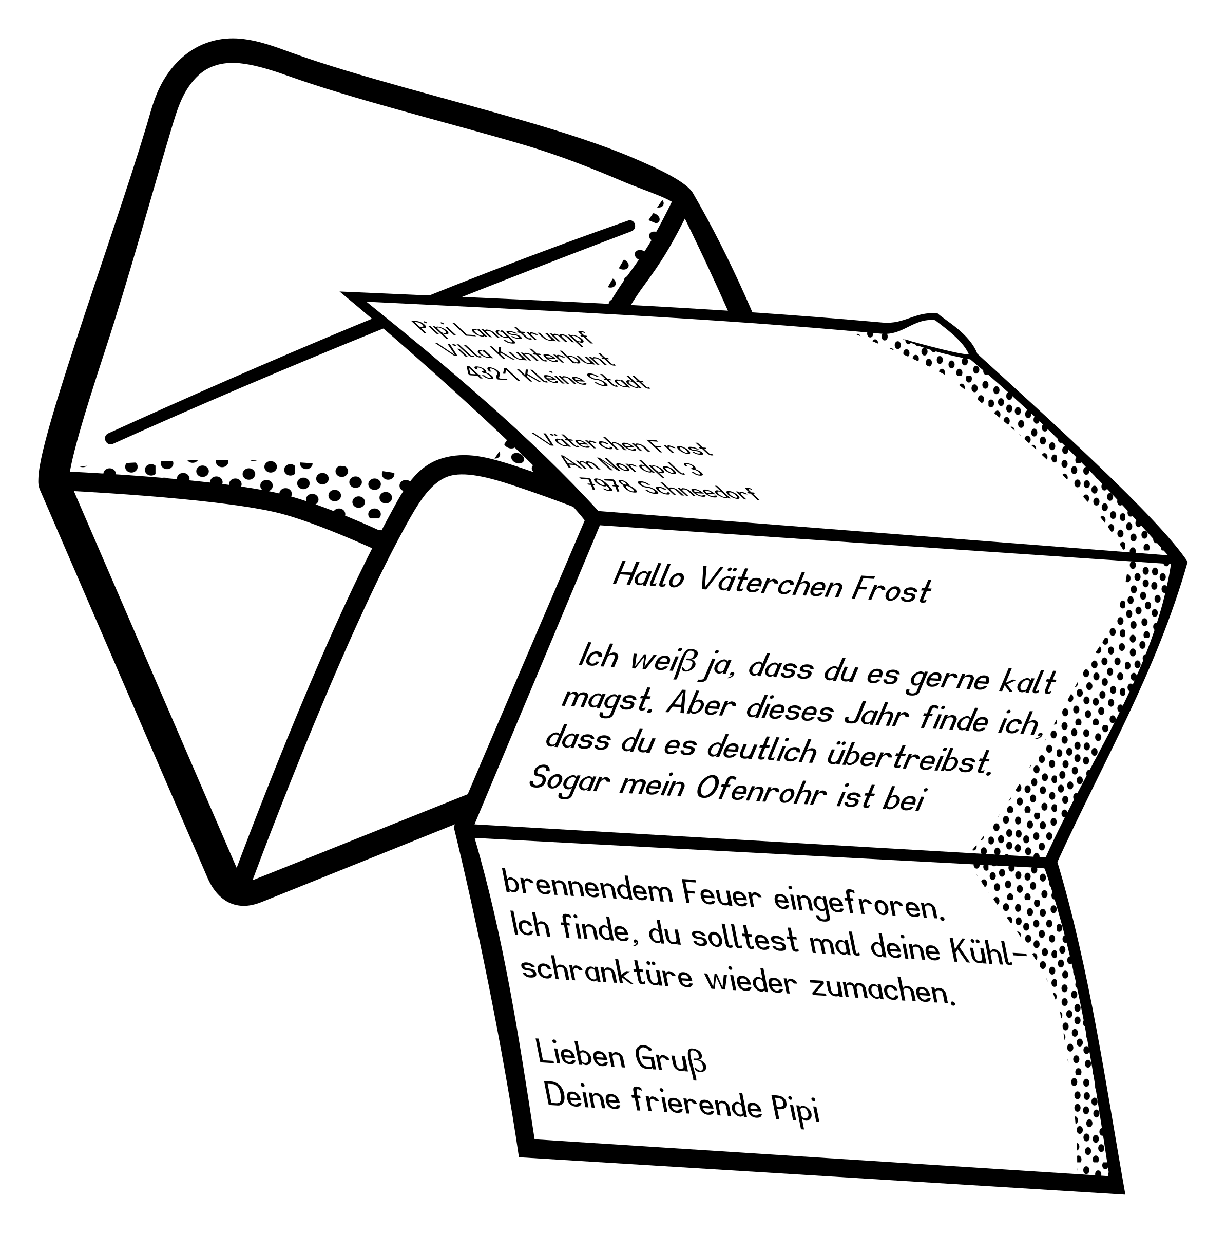

dinner
hammer
er
boxer
ladder
letter
summer

Slide 15
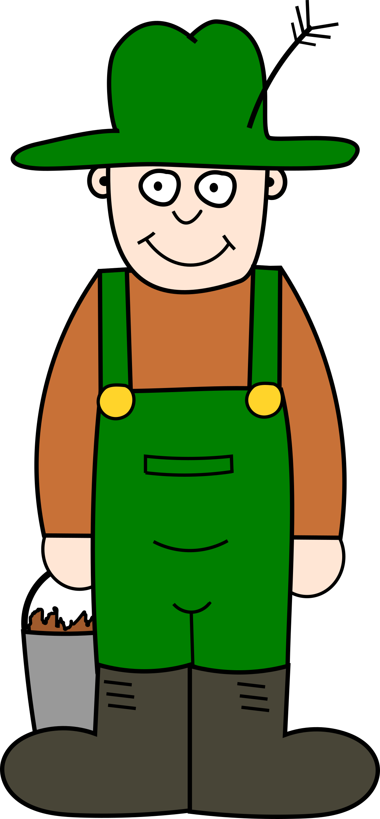
Try and spell out this word (either orally, on whiteboards, with letter fans or magnetic letters)
f
ar
m
er

Slide 16

Try and spell out this word (either orally, on whiteboards, with letter fans or magnetic letters)
h
er
b

Slide 17
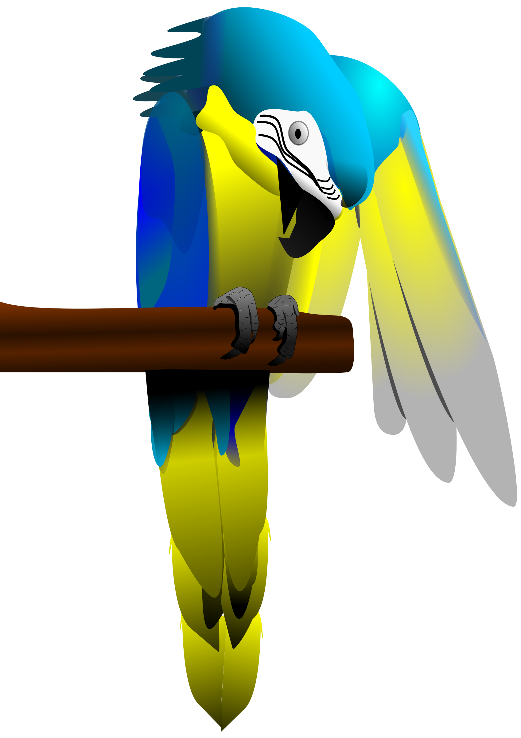
Try and spell out this word (either orally, on whiteboards, with letter fans or magnetic letters)
p
er
ch

Slide 18
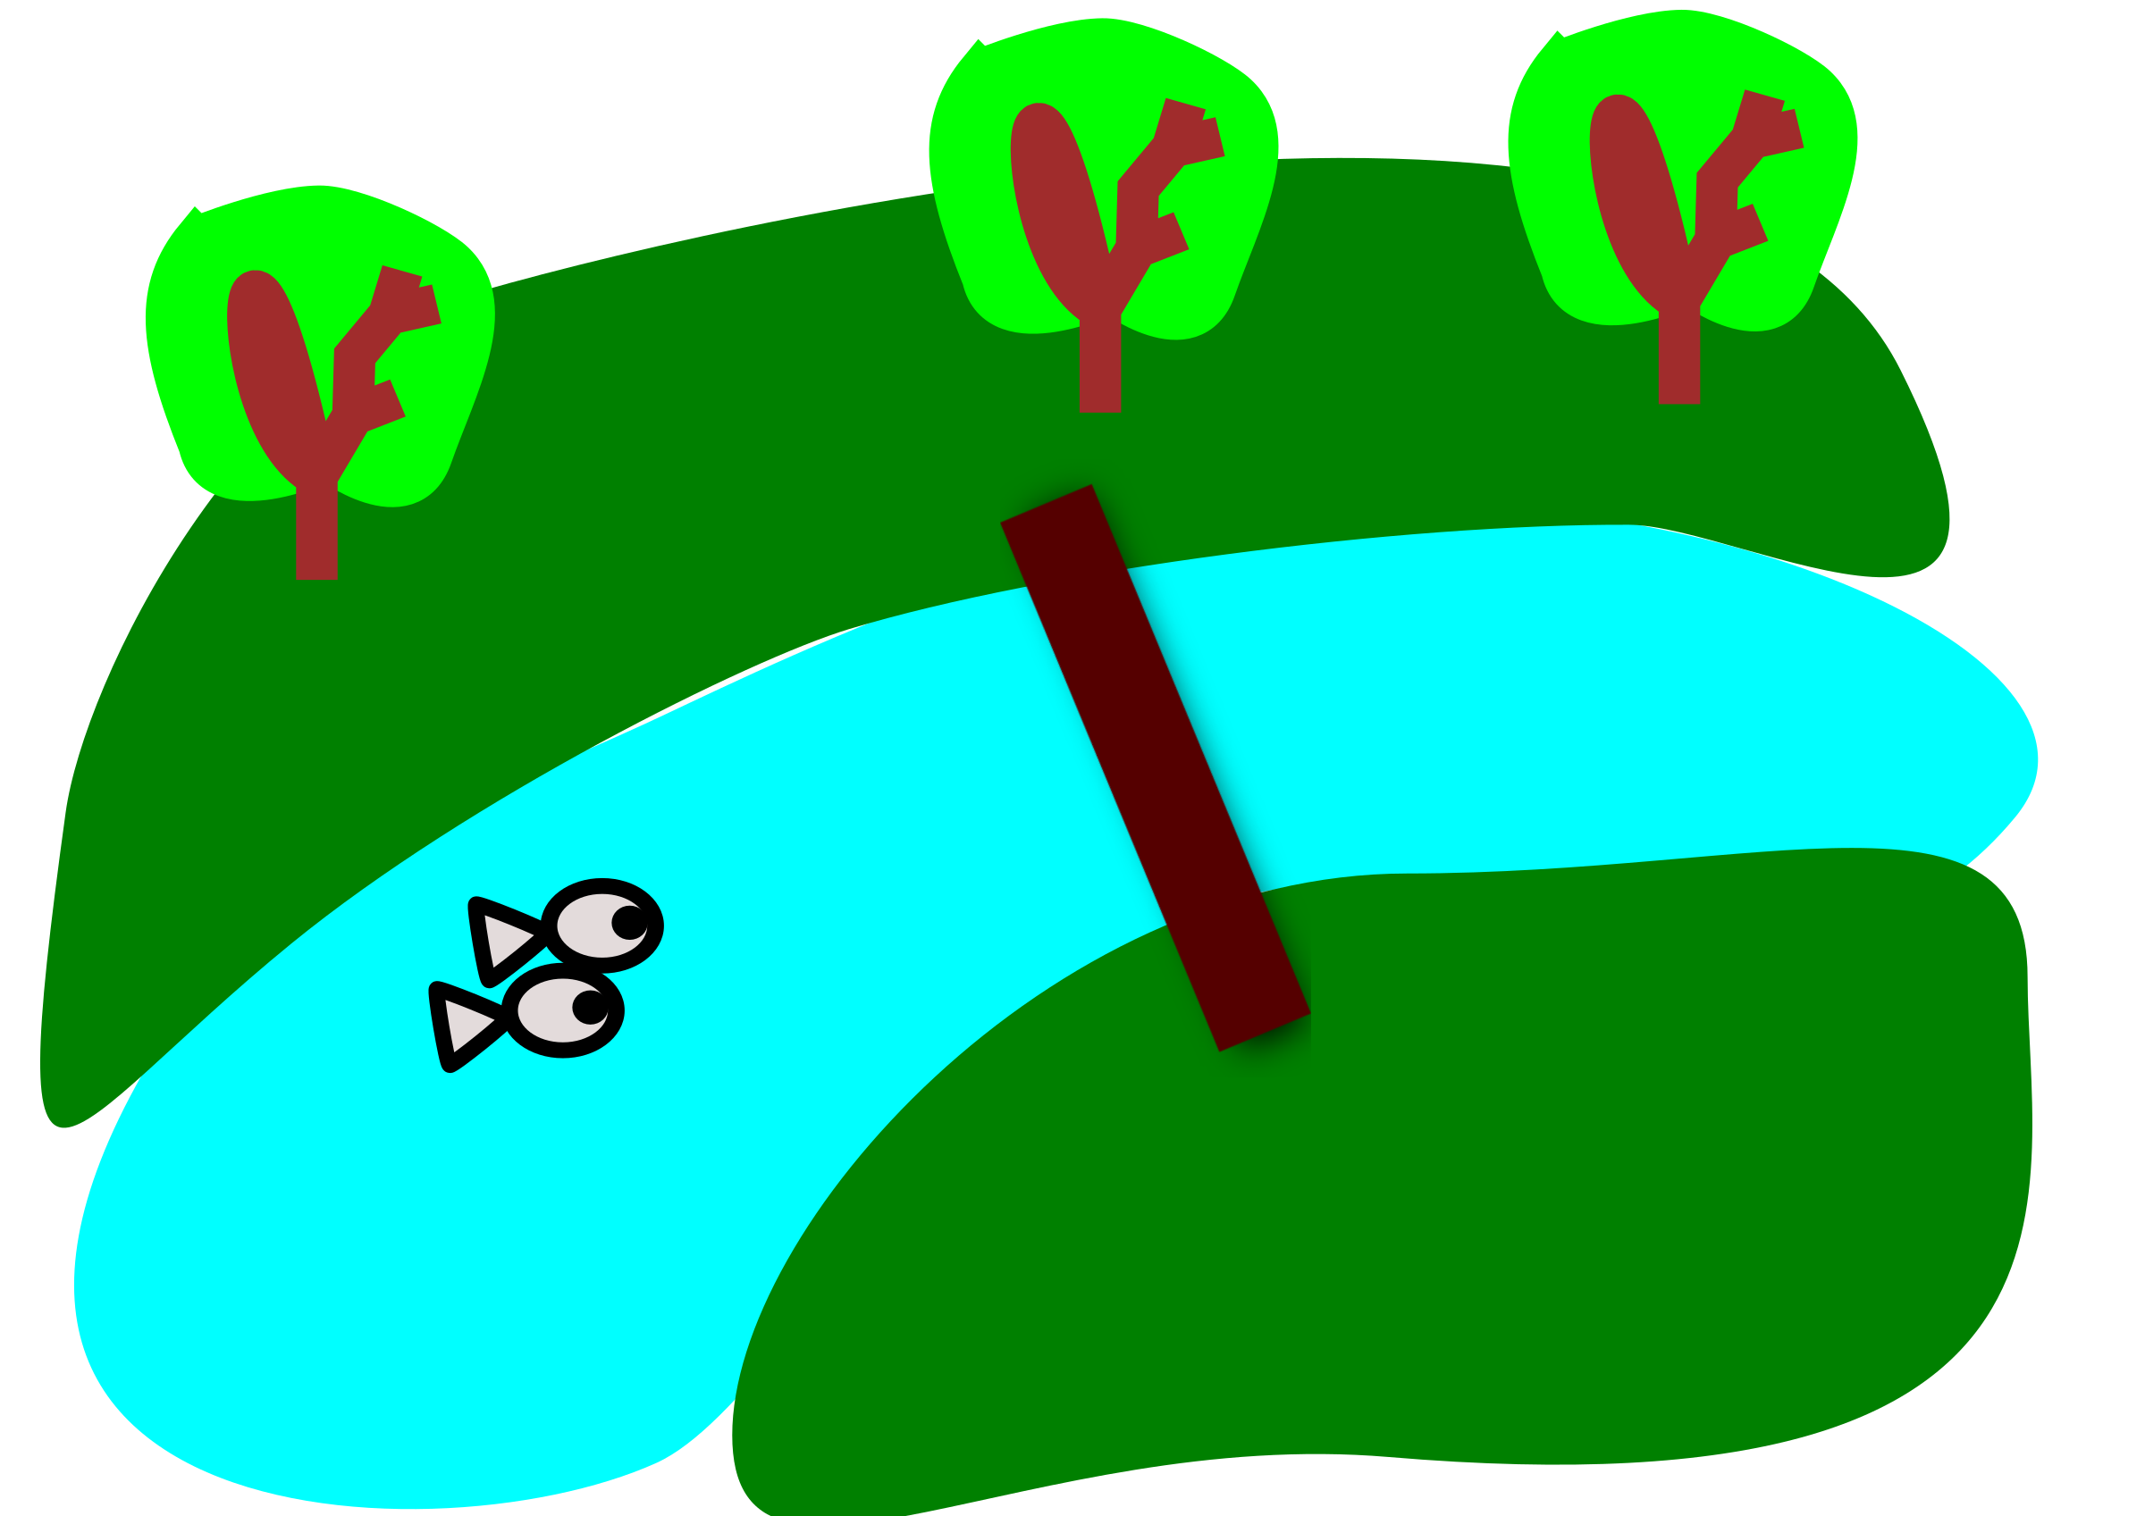

Read the caption:
boats on the river

