Slide 1

Day 1 ar

Slide 2
revisit
Can you remember these sounds from Phase 2?
s a t p i n m
m d g o c k
e u r b f l
ff ll ss ck

Slide 3
revisit
These are the phase 3 sounds learned so far:
j v w x
y z zz qu
ch sh th ng
ai ee igh oa

Slide 4
revisit
Can you remember these tricky words?
the
no
I
to
go

Slide 5
revisit
Phase 3 tricky words we have learned to read:
he
she
we
me
be
was

Slide 6

Can you remember which letters are the vowels?
a b c d e f g
h i j k l m n
o p q r s t u
v w x y z
a b c d e f g
h i j k l m n
o p q r s t u
v w x y z

Slide 7
ar

Slide 8
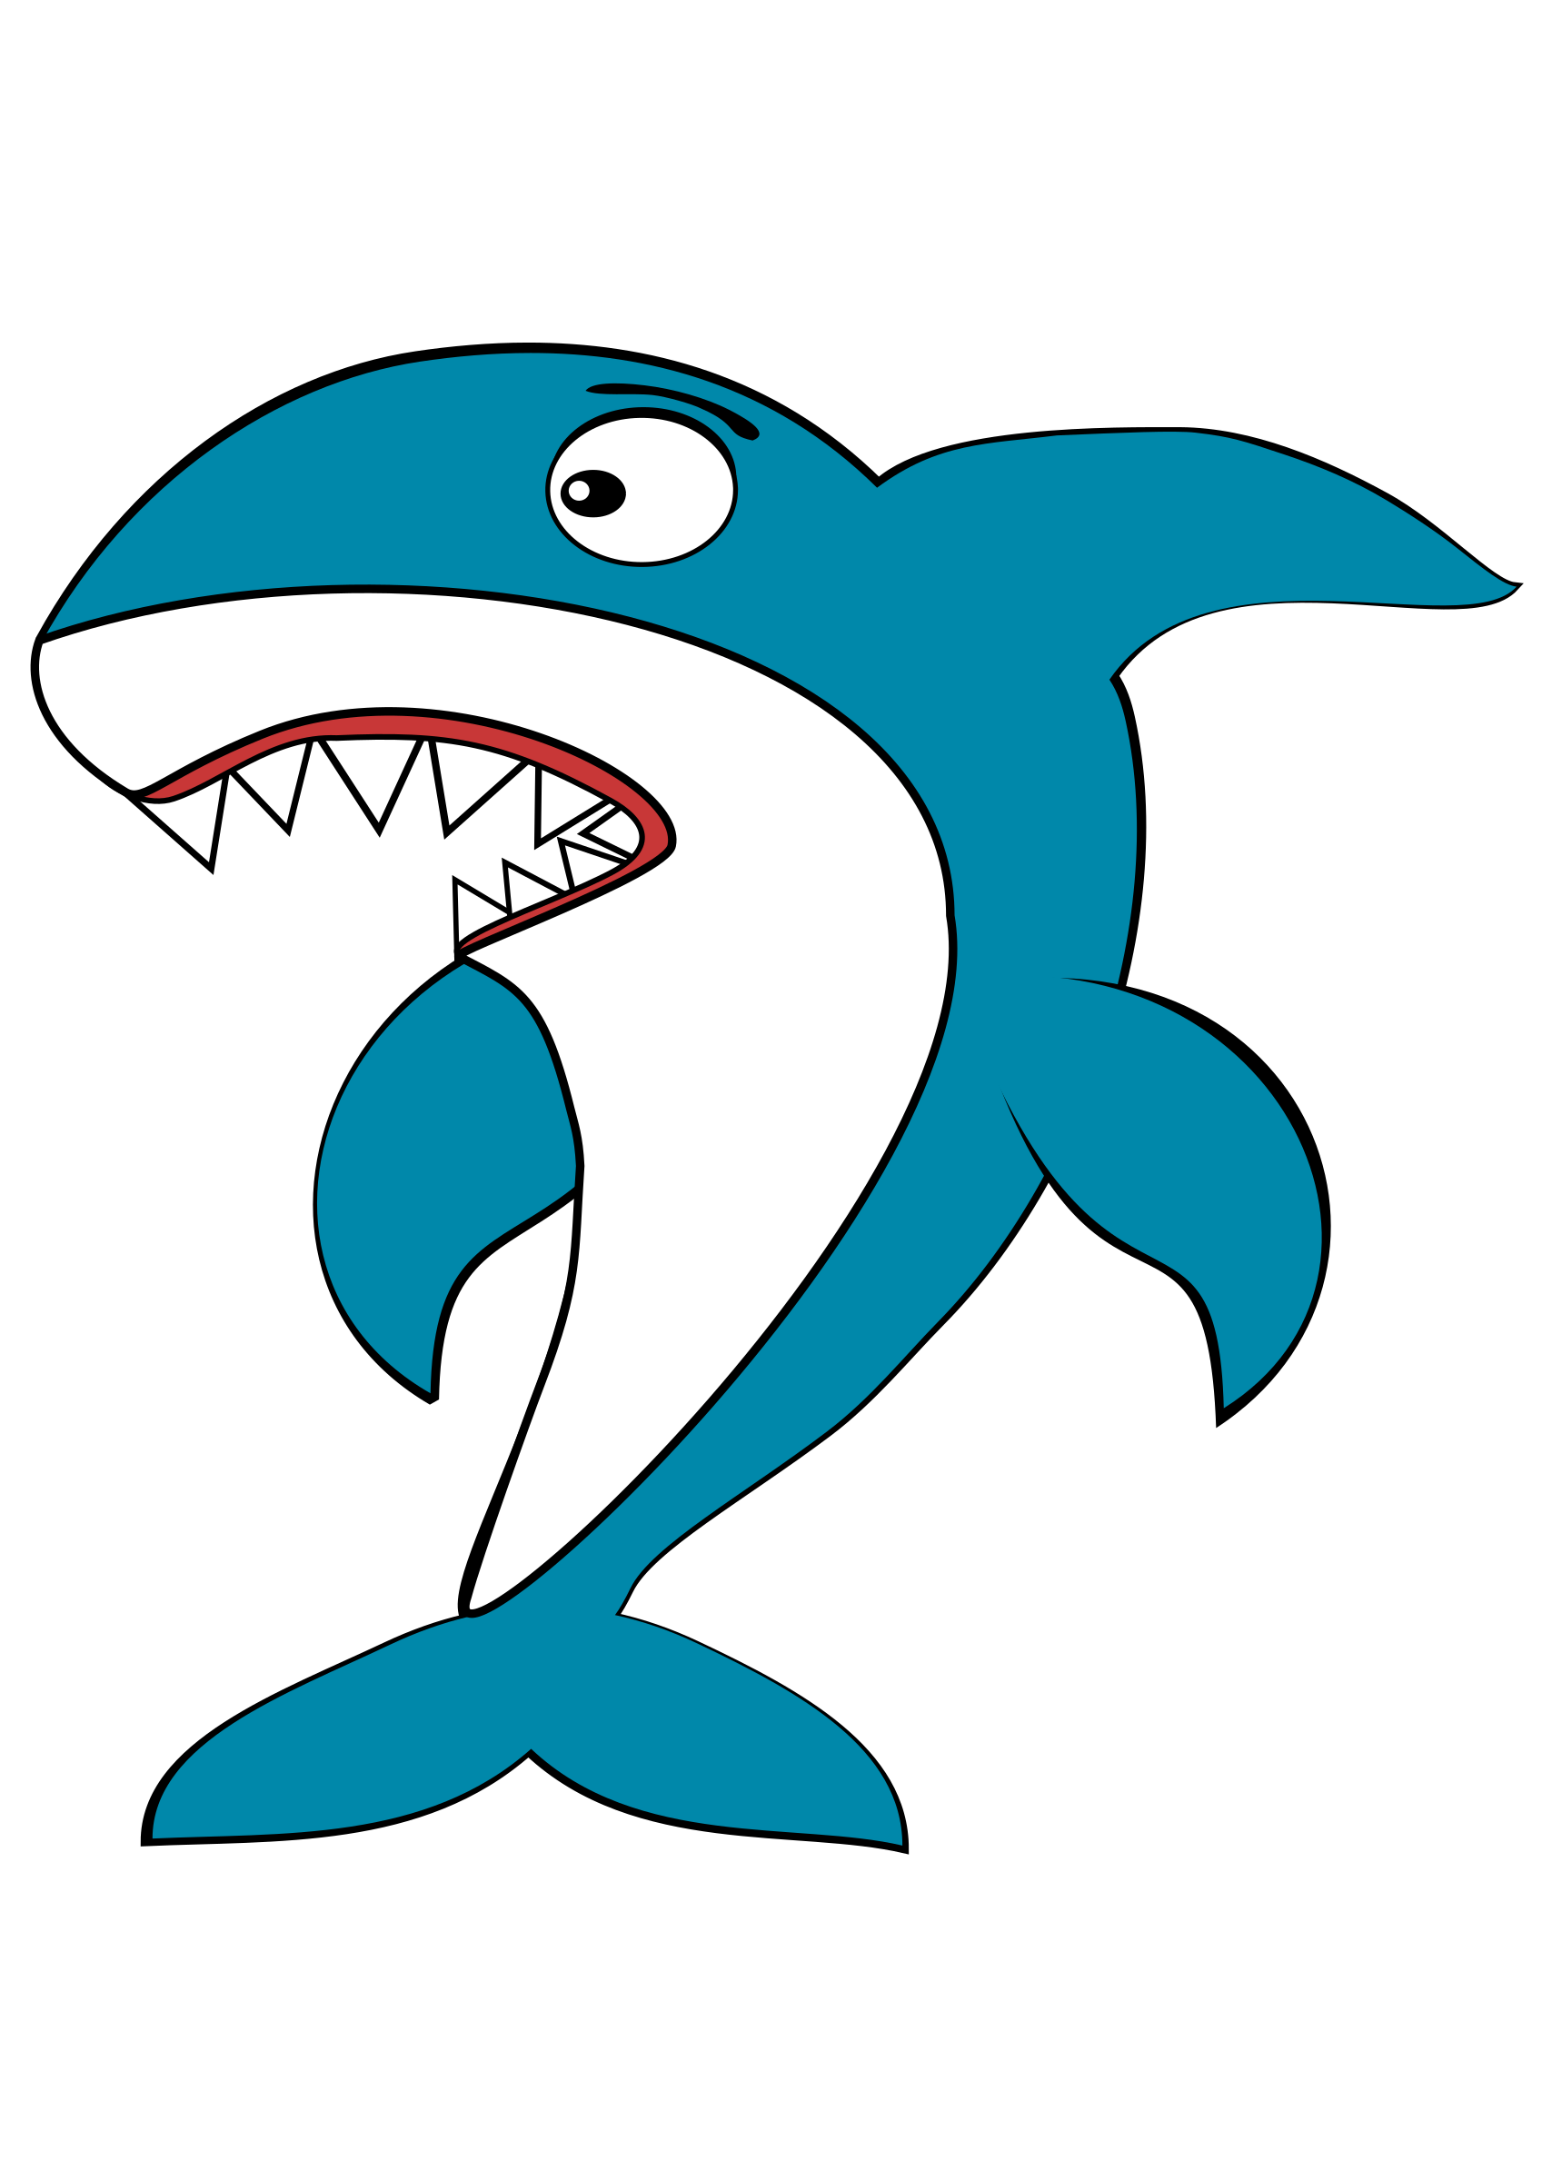
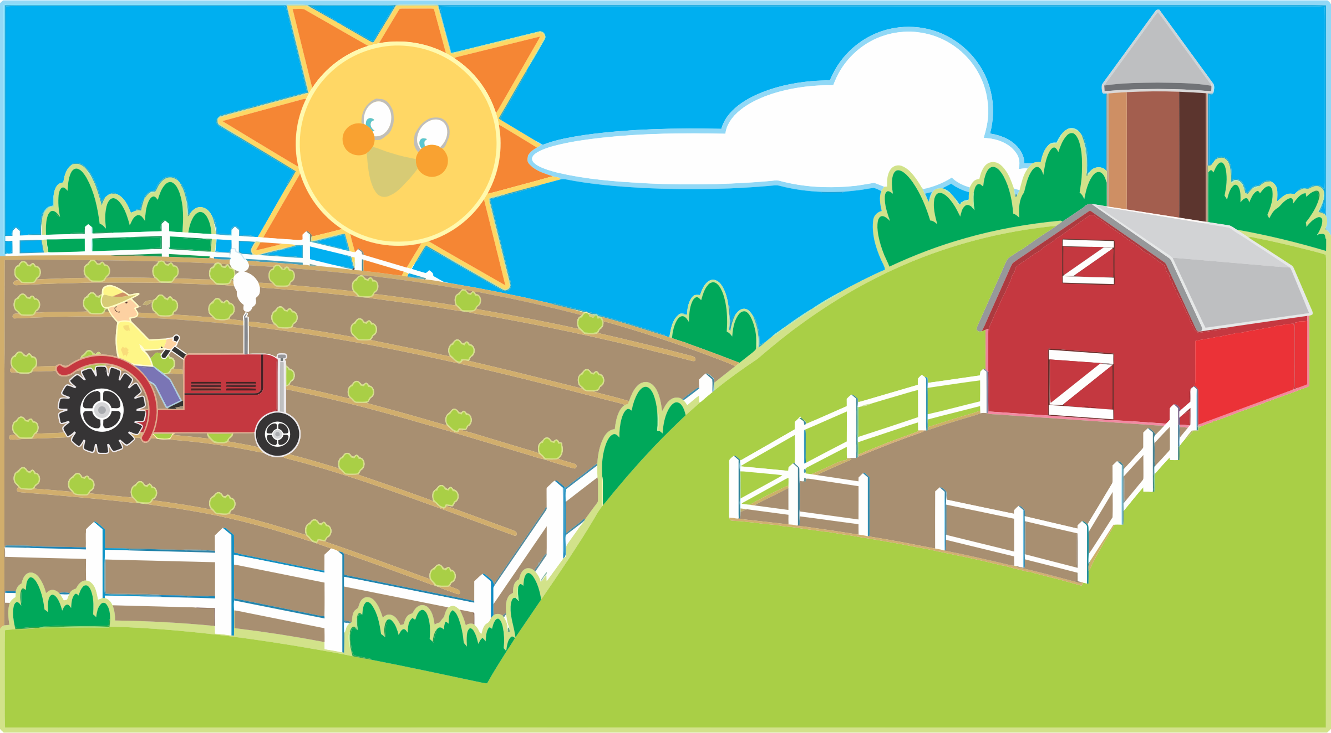
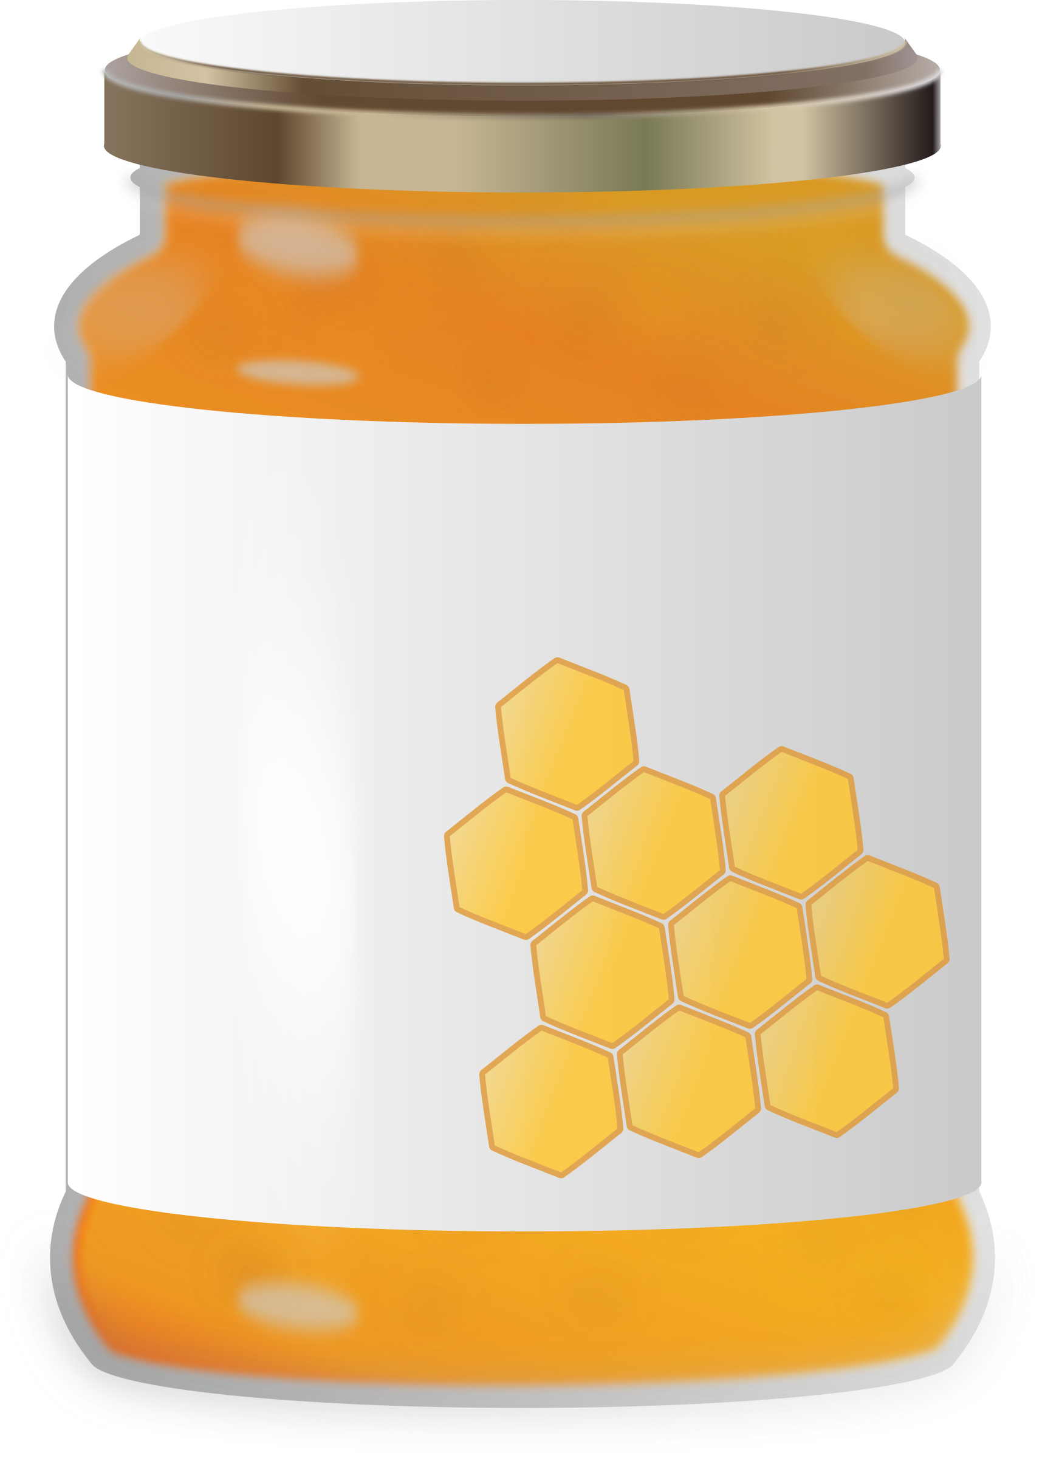
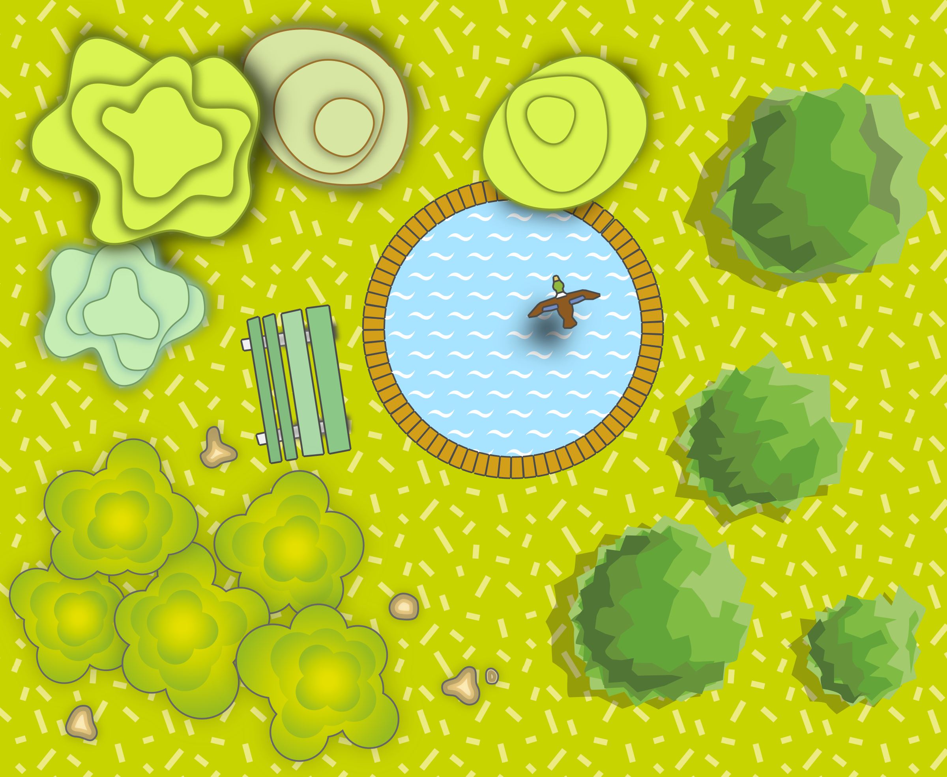


farm
jar
shark
ar
garden
car
star

Slide 9
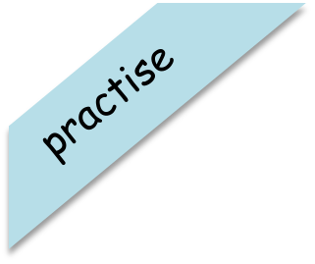
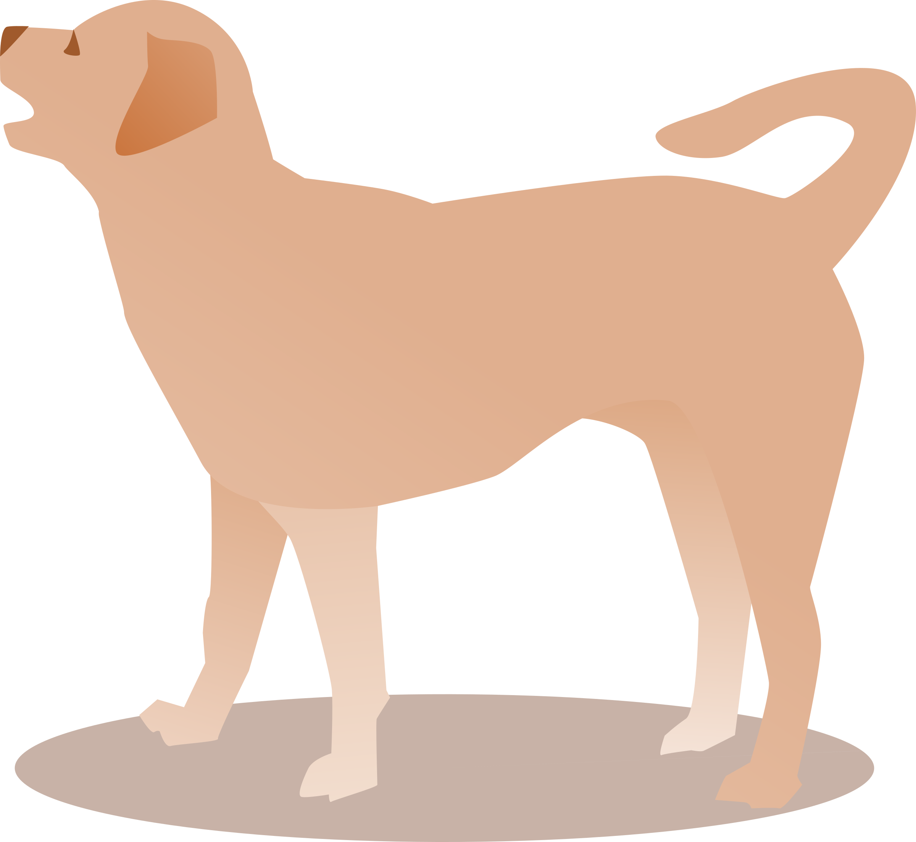
Have a go at reading these words. Click to see the picture:
bark

Slide 10
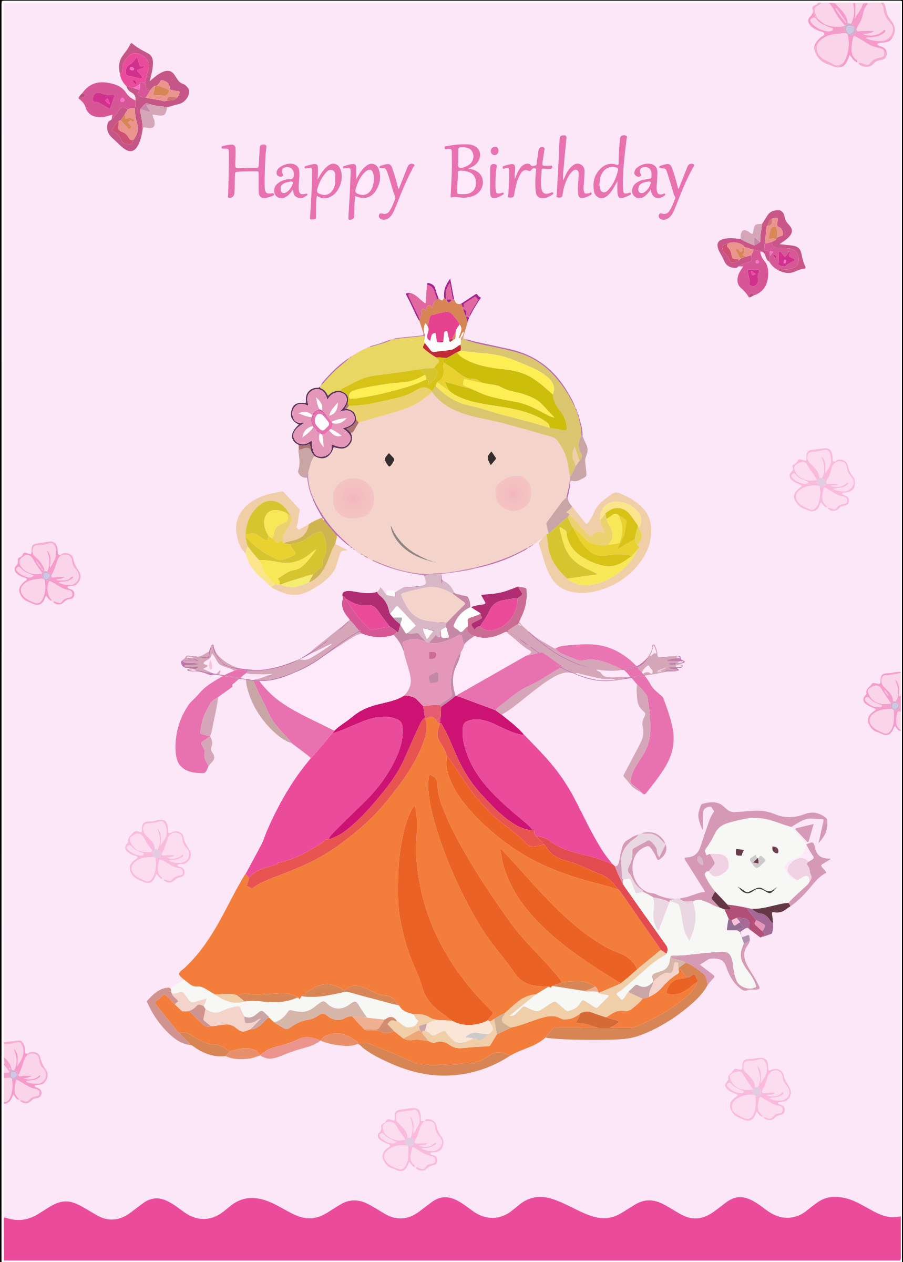
Have a go at reading these words. Click to see the picture:
card

Slide 11
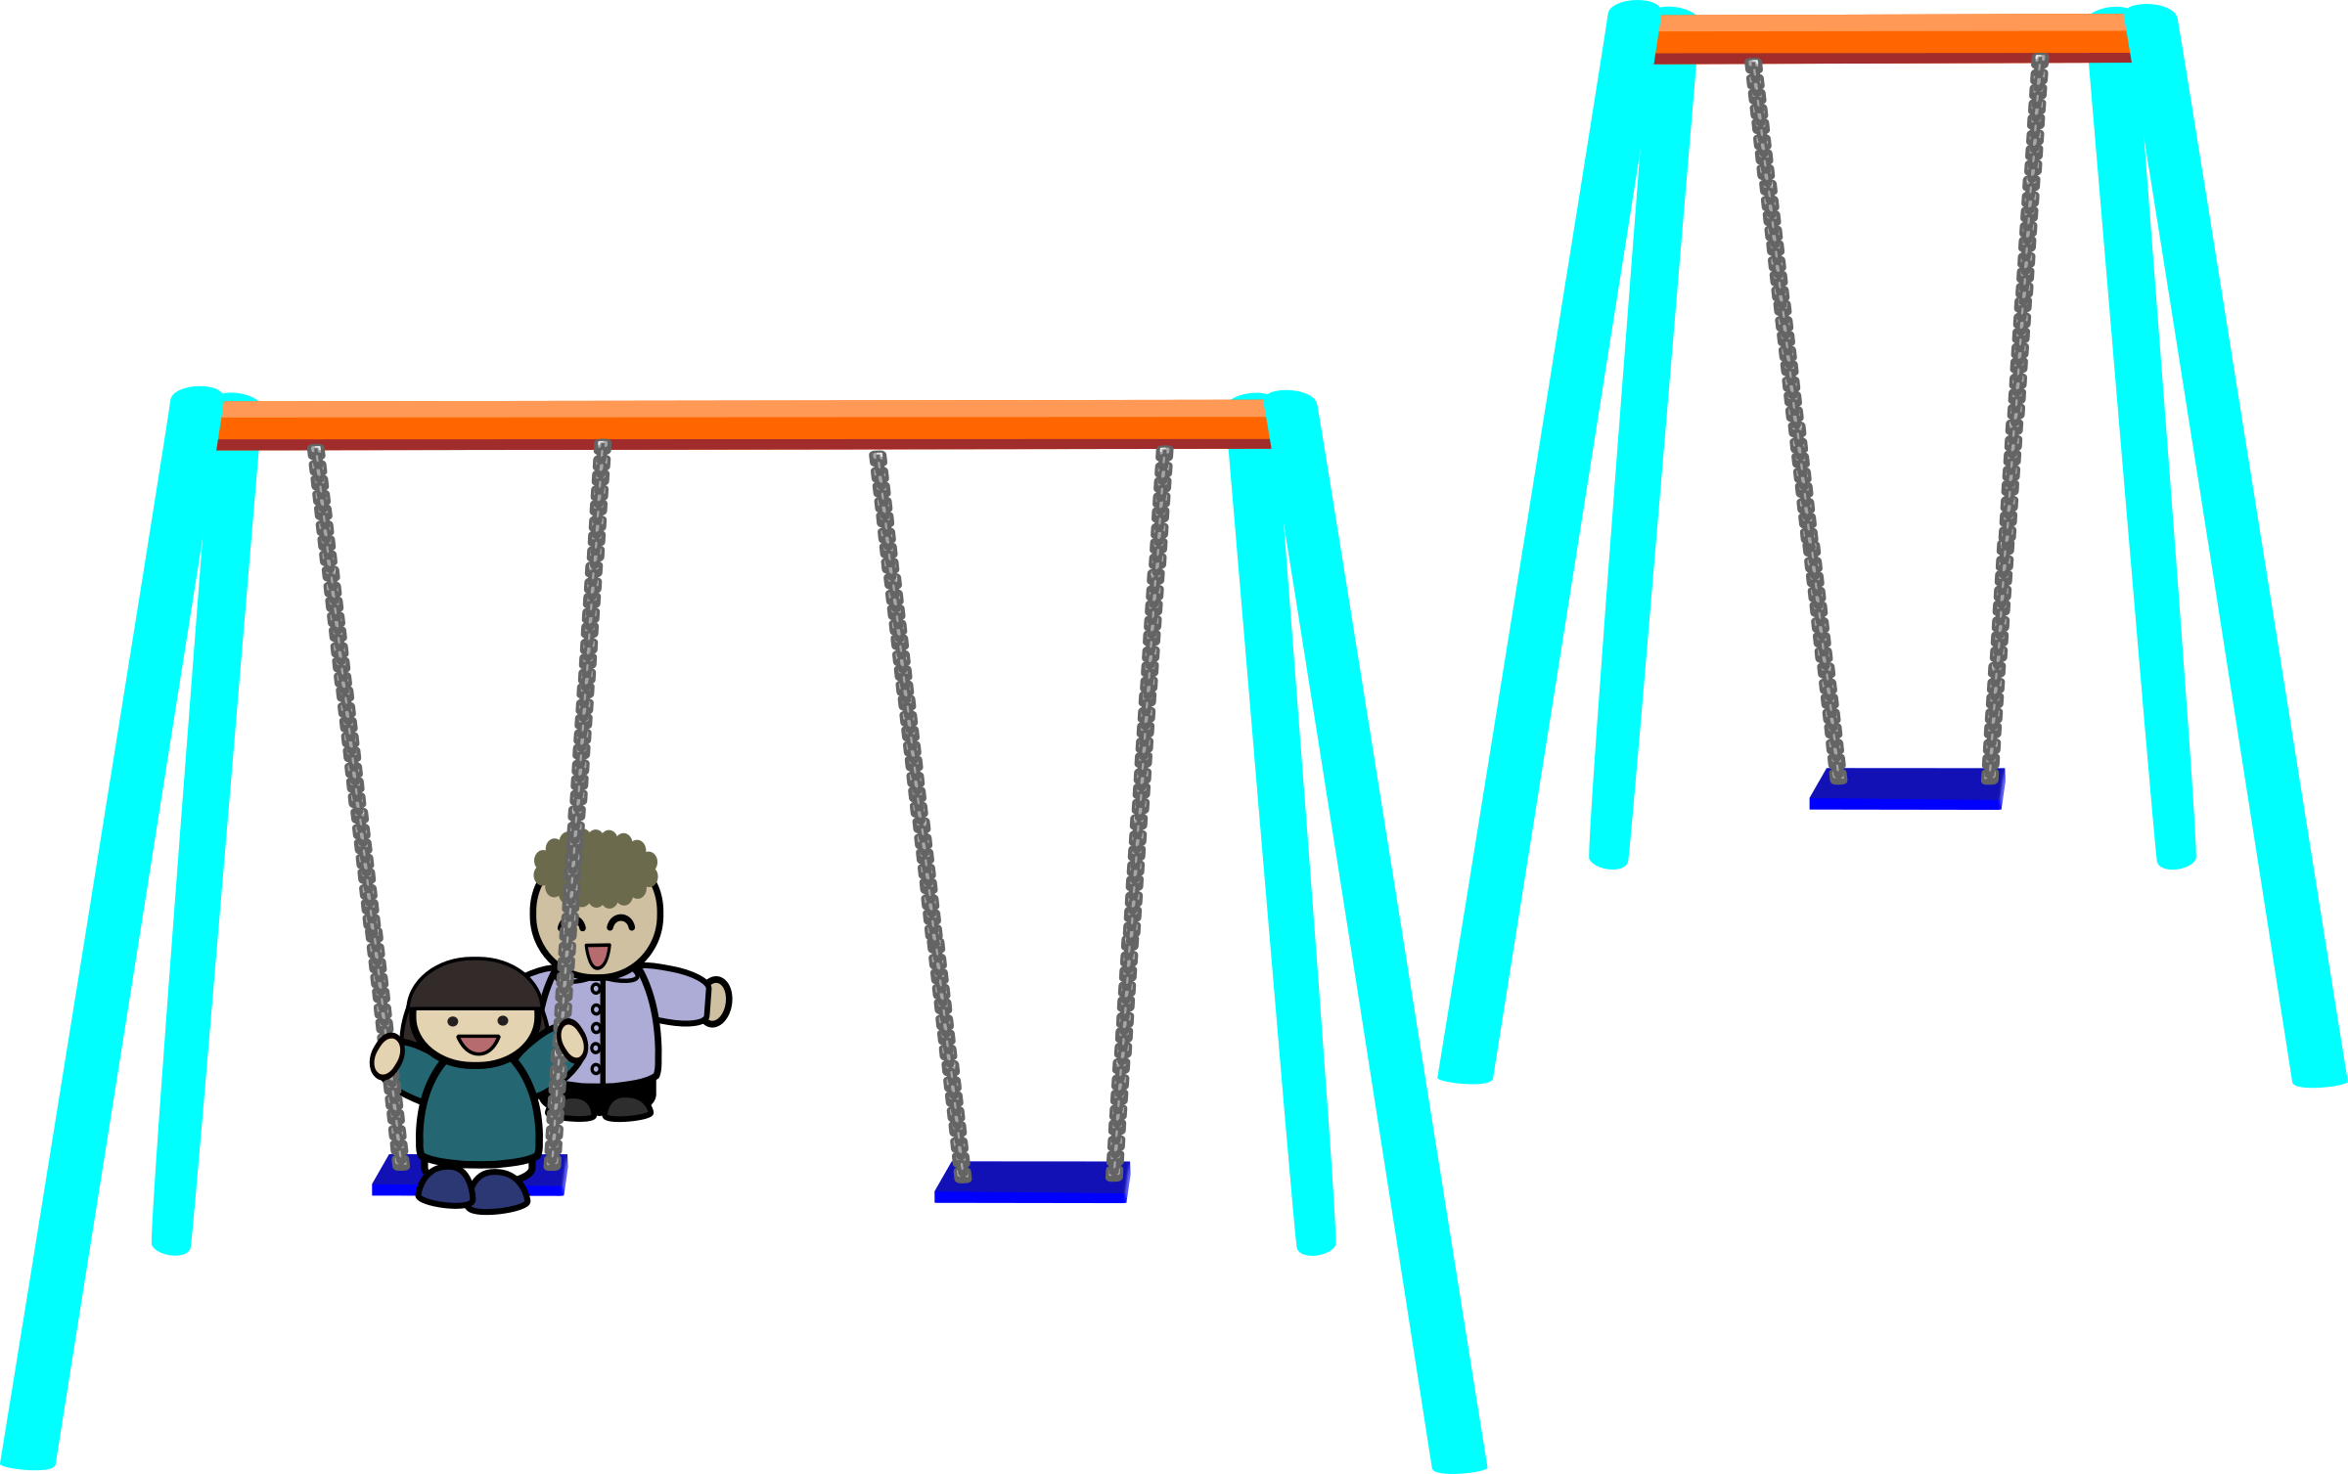
Have a go at reading these words. Click to see the picture:
park

Slide 12

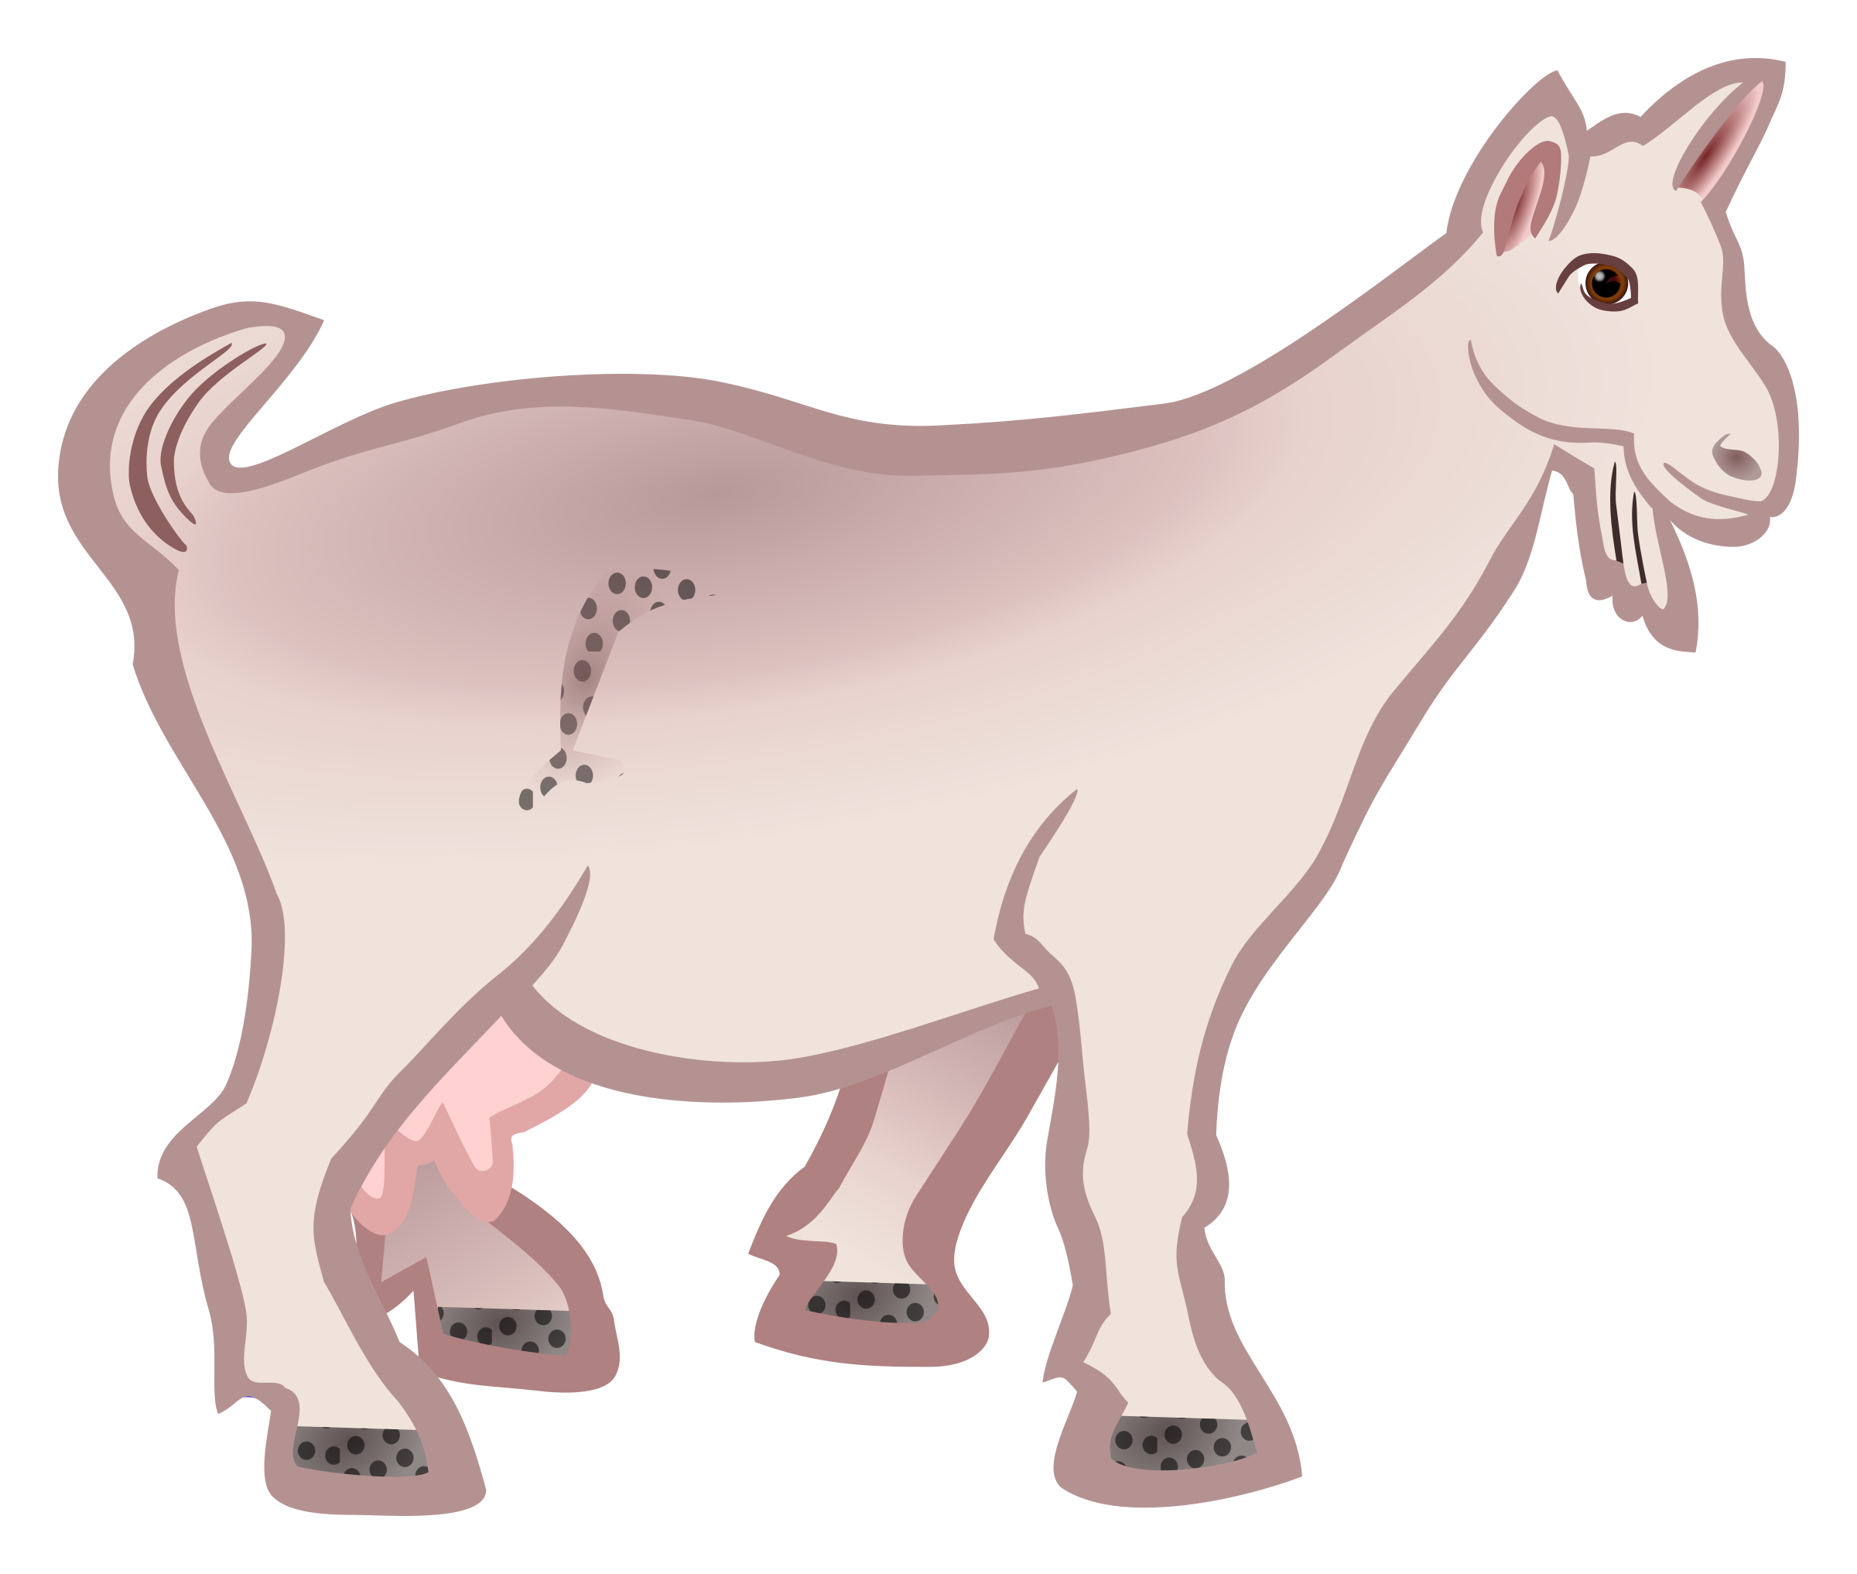
Write the sentence to go with this picture:
Goats in a farmyard.

Slide 13

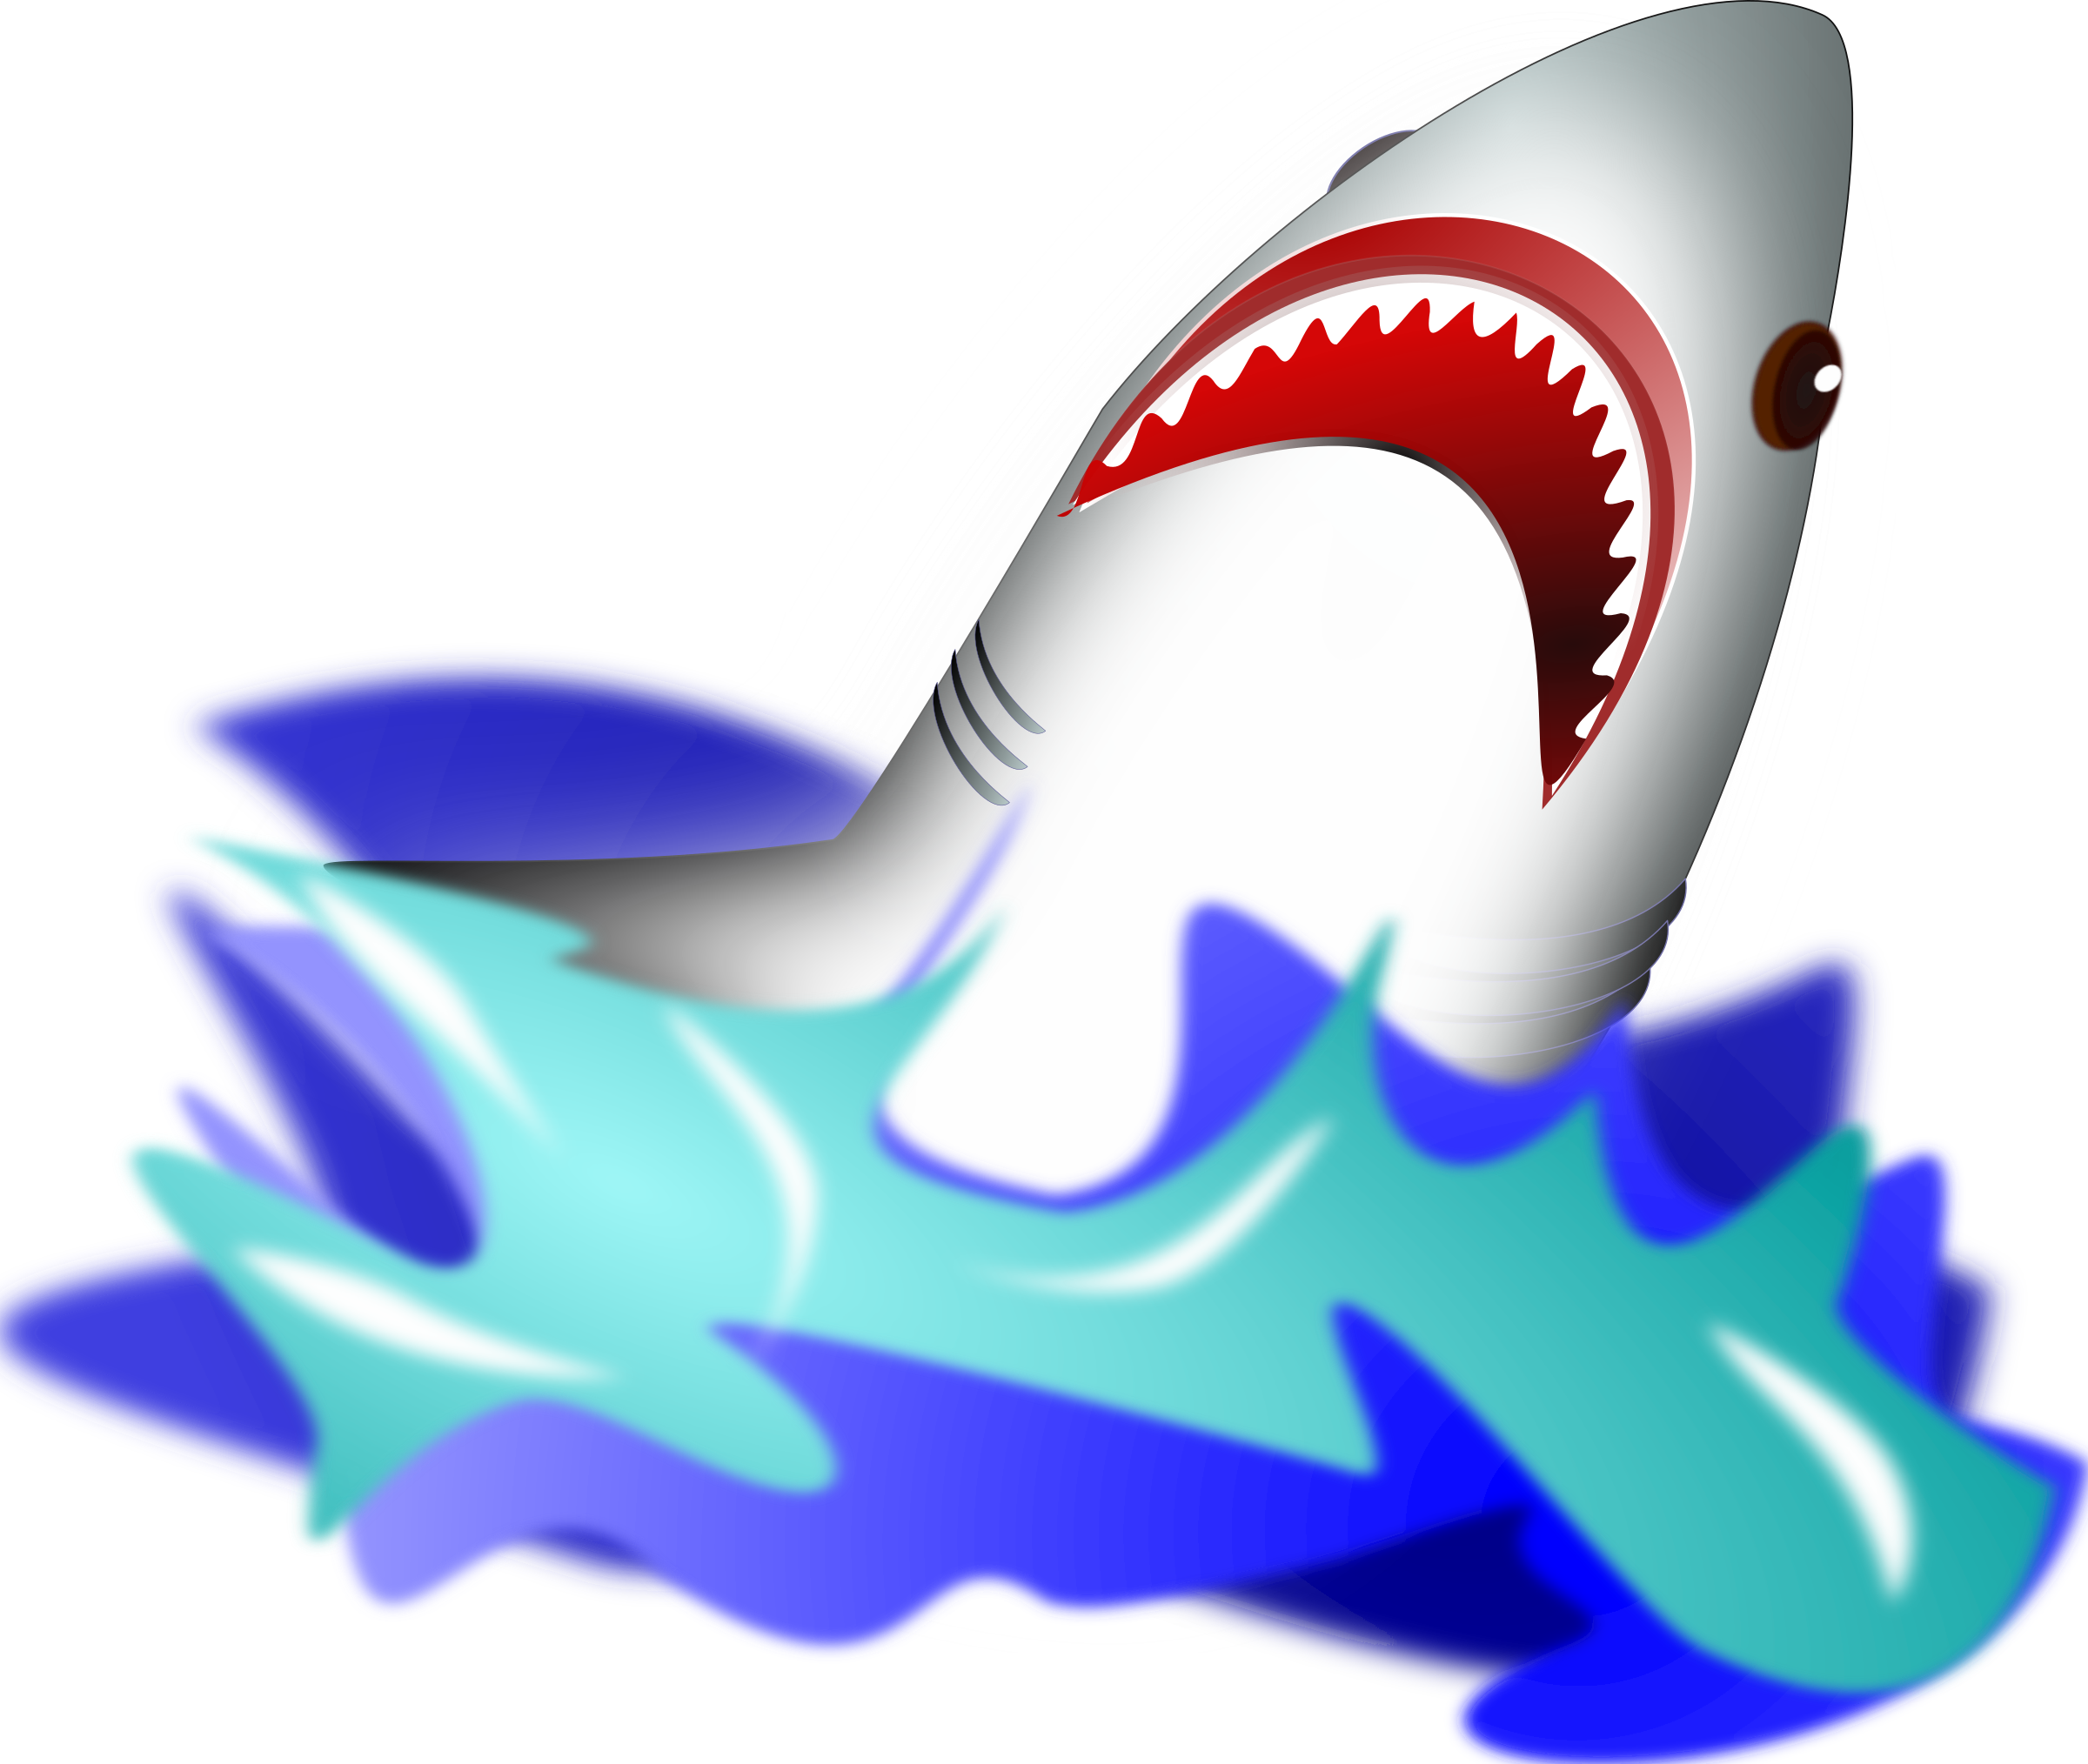
Yes/No Questions:
Are the teeth of sharks sharp?

Slide 14
Day 2 or

Slide 15
revisit
Can you remember these sounds from Phase 2?
s a t p i n
m d g o c k
e u r b f l
ff ll ss ck j

Slide 16
revisit
Can you remember these tricky words?
the
no
I
to
go

Slide 17
or

Slide 18
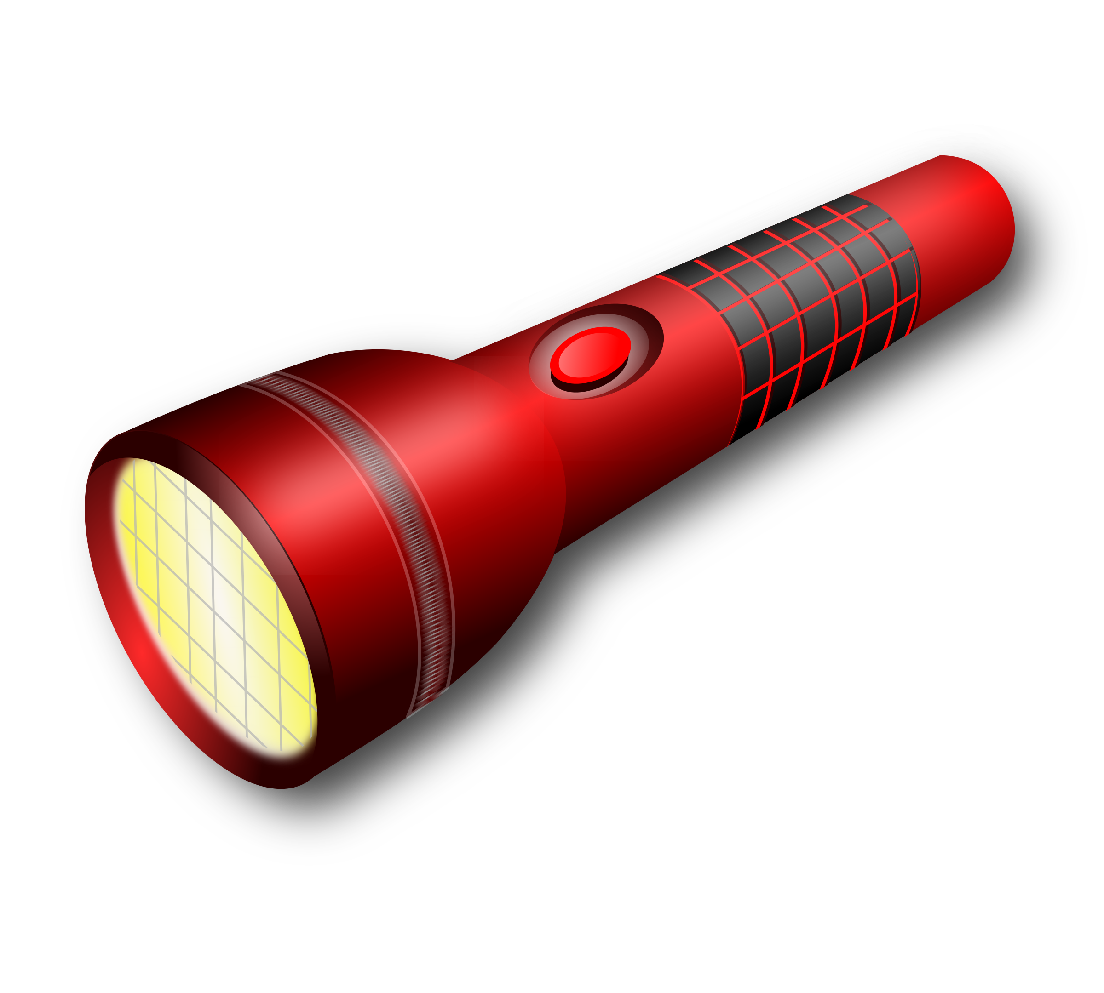

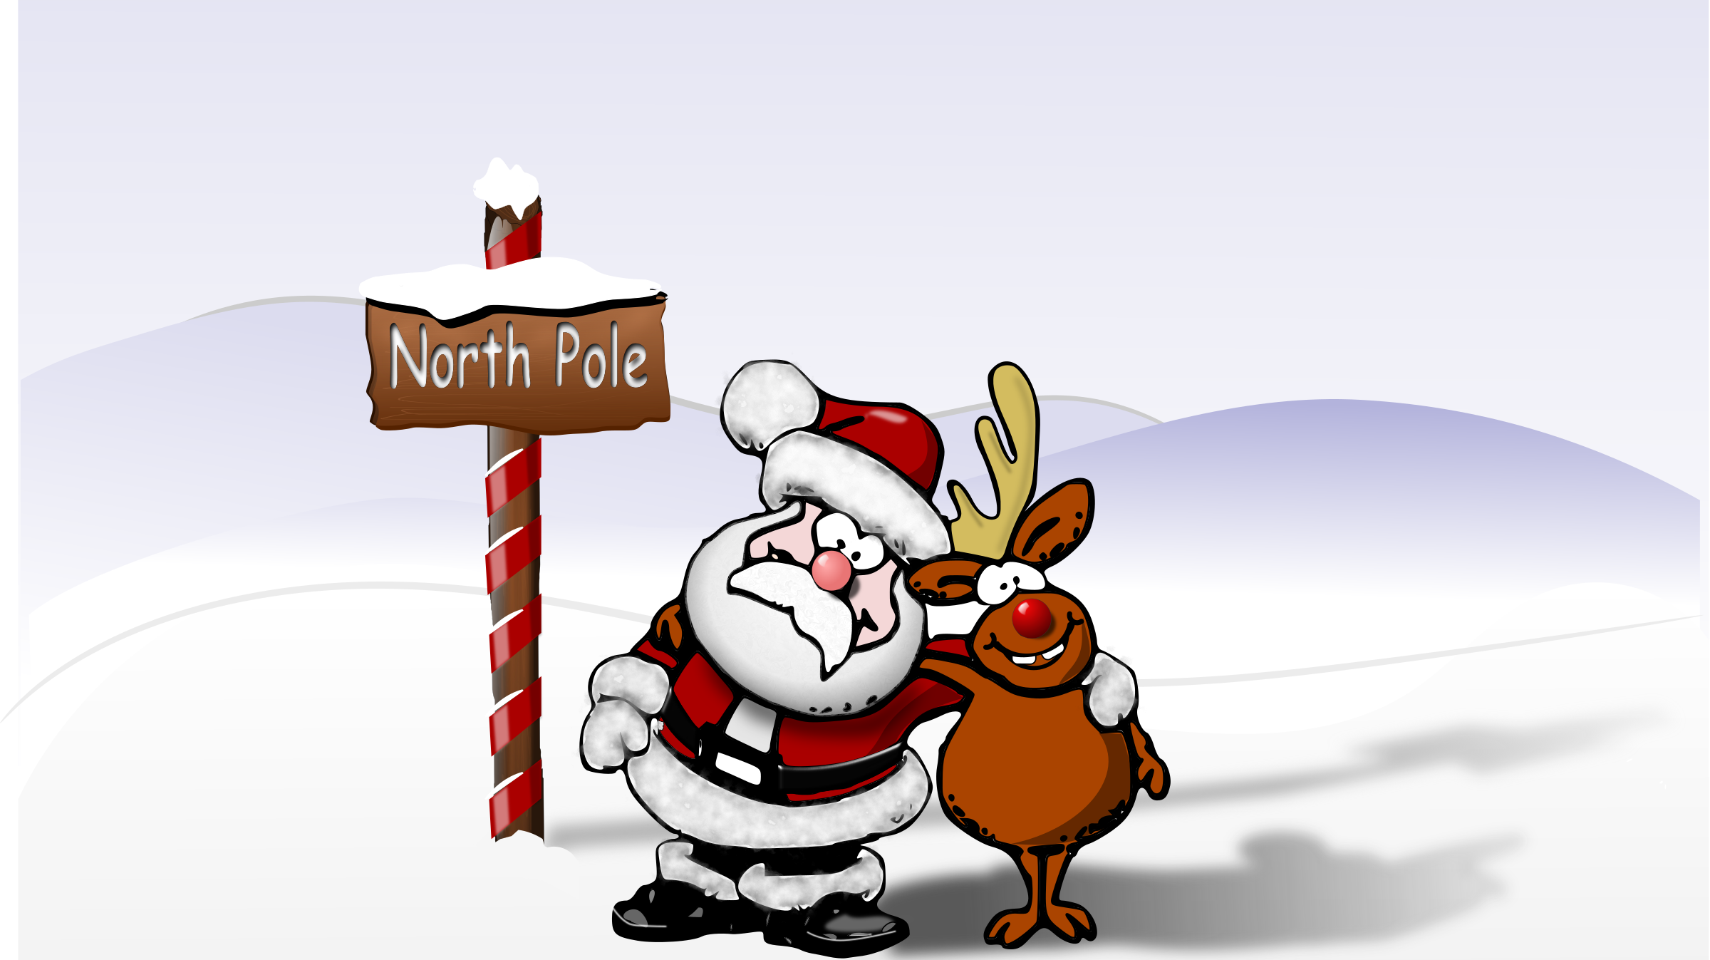

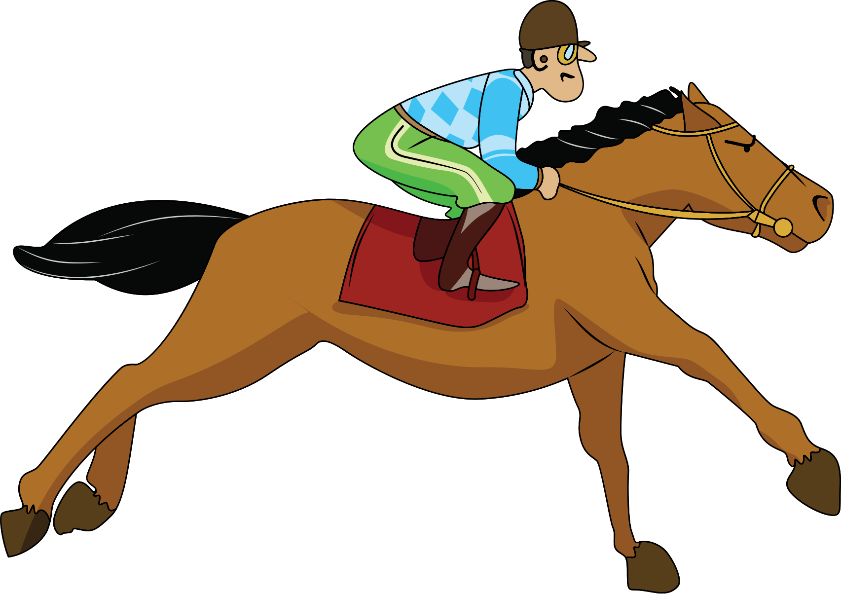
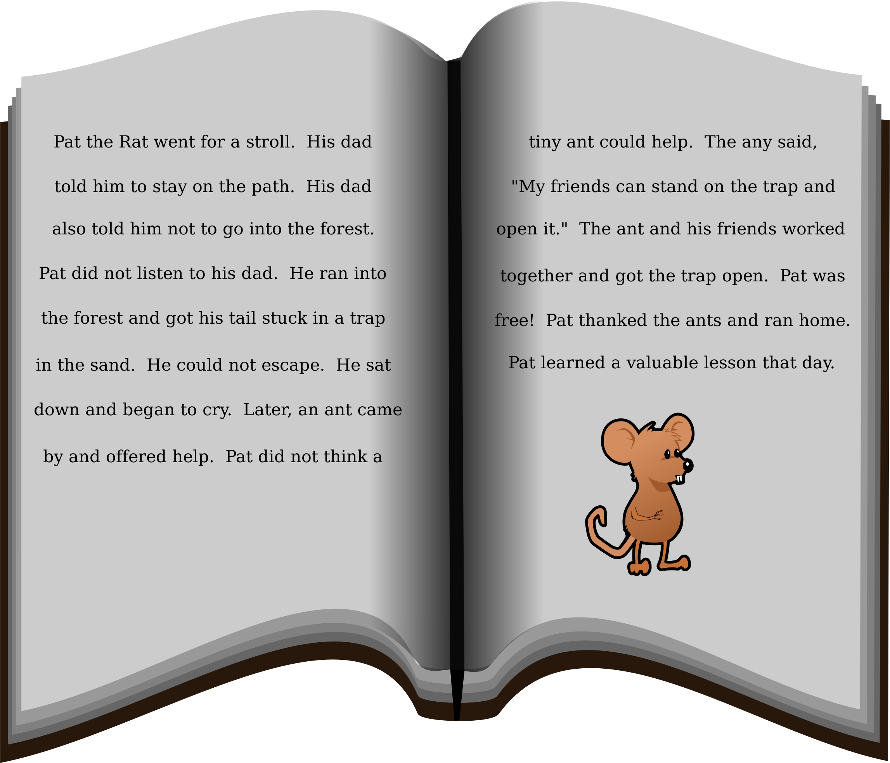
North
acorn
or
torch
story
storm
horse

Slide 19
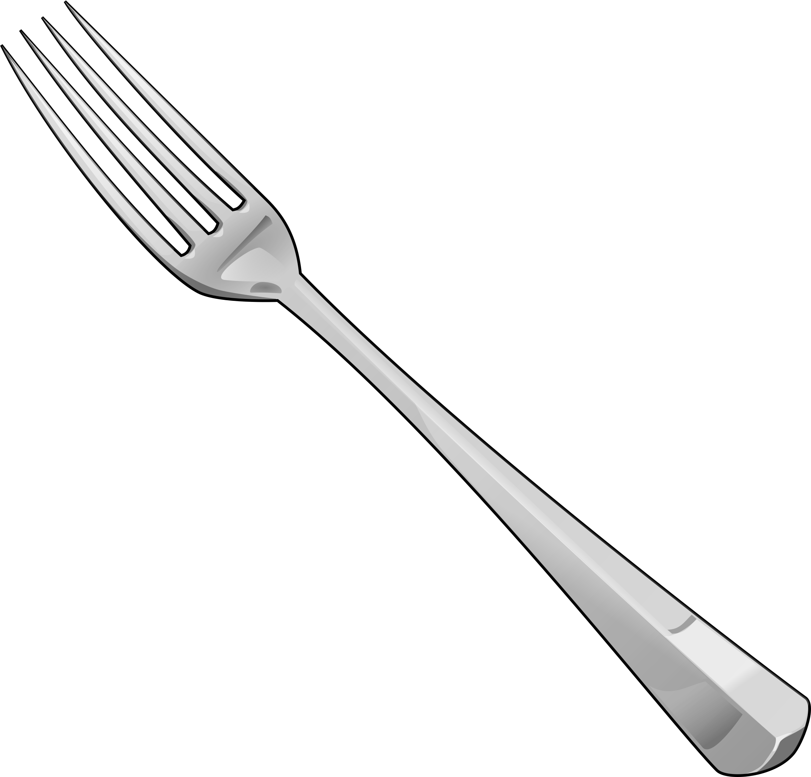
Try and spell out this word (either orally, on whiteboards, with letter fans or magnetic letters)
f
or
k

Slide 20
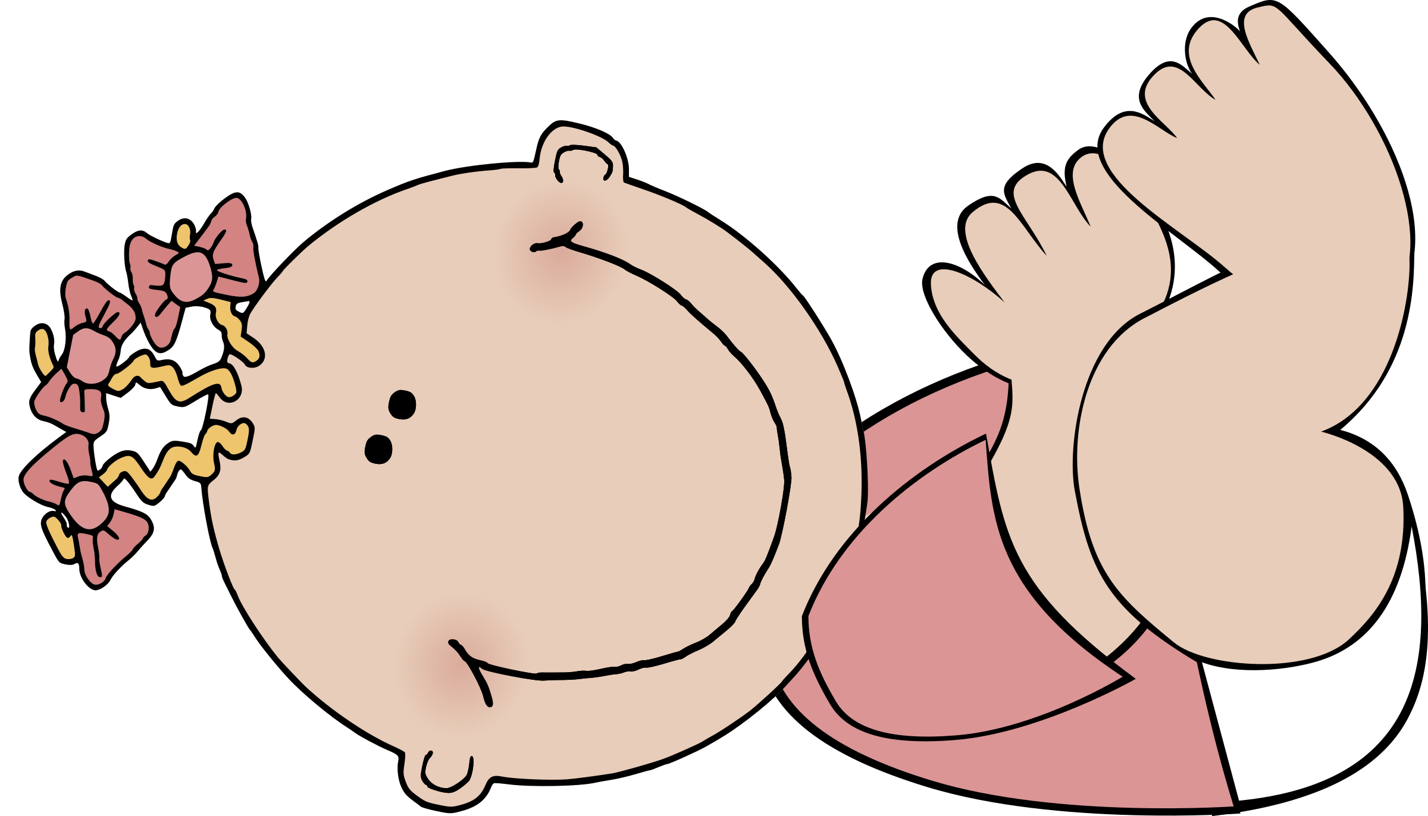
Try and spell out this word (either orally, on whiteboards, with letter fans or magnetic letters)
b
or
n

Slide 21

Try and spell out this word (either orally, on whiteboards, with letter fans or magnetic letters)
t
or
n

Slide 22
Try to read this caption:
the light of a torch

