Slide 1
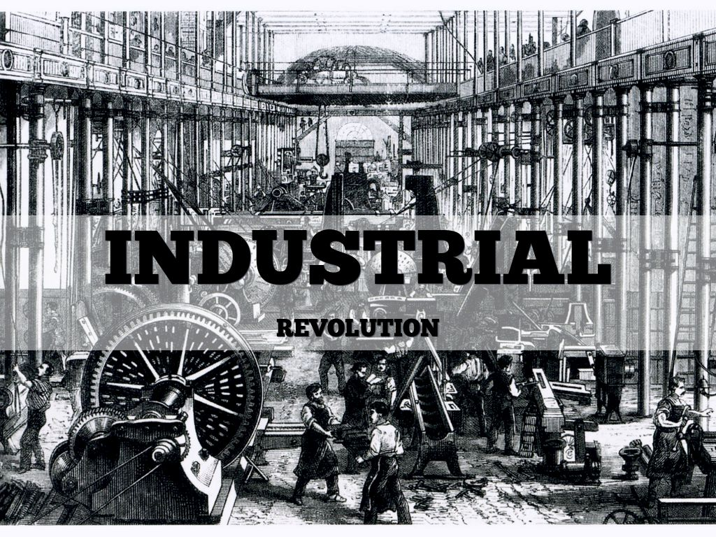
The industrial Revolution
By William Smith

Slide 2
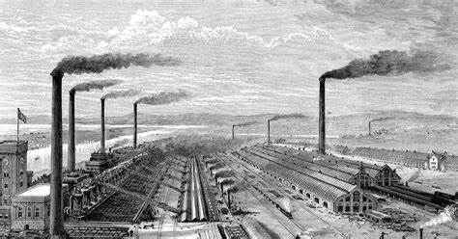
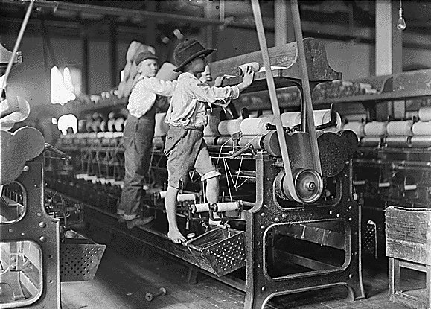
What was the industrial Revolution?
The Industrial Revolution was a tremendous change in Britain that started in 1750 and ended in 1900.
The Industrial Revolution introduced many new inventions that would change the world forever, such as the Spinning Jenny and the steam engine

Slide 3
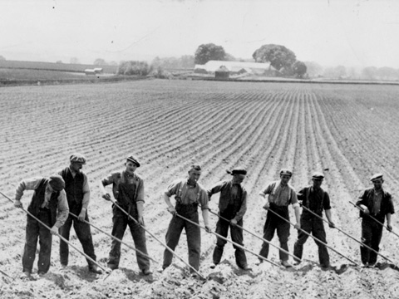
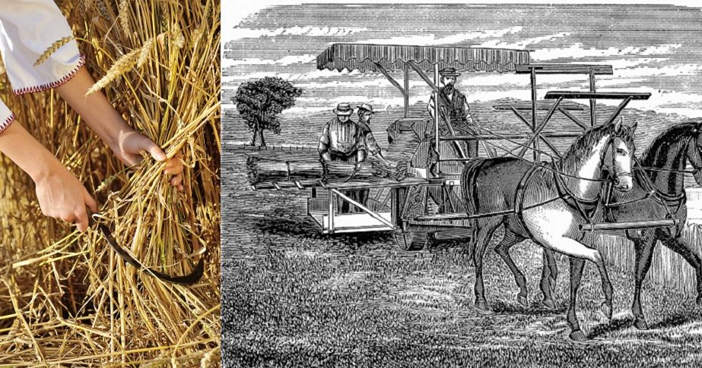
What was life like before the industrial revolution?
Before the Industrial Revolution there wasn’t that much housing built and they were made of wood, people’s main mode of transport were horses and there were no real roads, mainly dirt tracks.
Before the Industrial revolution, Britain’s main industry was farming and agriculture and there were no big factories, just cottage industries that made things by hand.

Slide 4
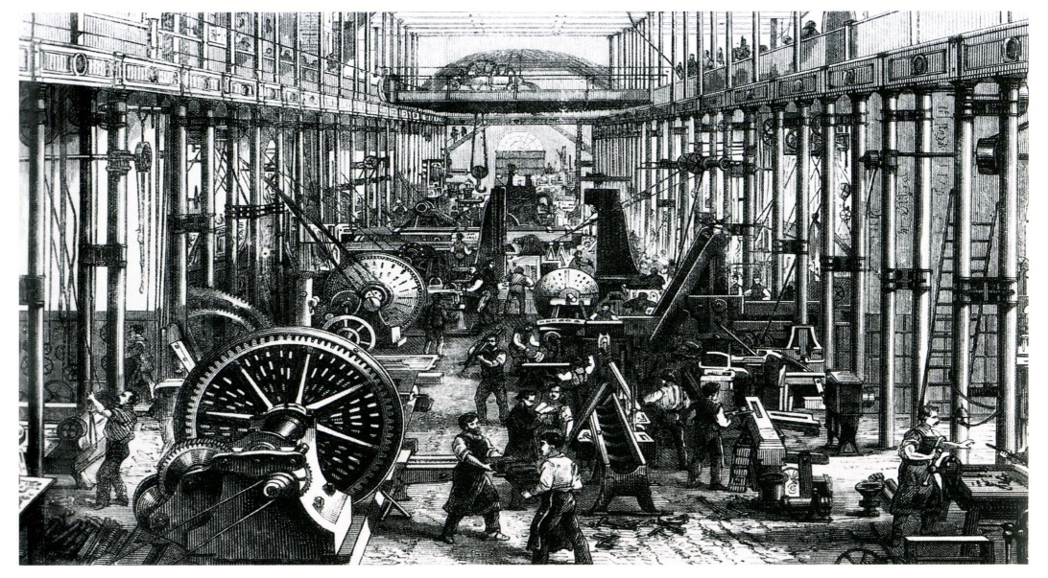
What was life like for adults and children?
Adults worked in things such as in huge factories spinning cotton and wool, their houses were now in large built up towns and cities and were very close together. They had to work long hours for low pay and conditions were terrible.
Children had to work as cleaners, chimney sweeps or servants but it made poor family's some money to buy some food.

Slide 5
How transport was effected?
The transport had changed A LOT!!! They were using horses for their transport before but because of the invention of steam powered locomotive, people could travel on the rail ways and trains.
Also the trains would make it faster and easier to get to cities like Manchester. Before the Industrial Revolution it used to take days to travel long distances, but travelling by train meant journey’s of hours instead. The canals were an important mode of transport for transporting goods around the country. Factories were often built at the side of canals so that they could load the goods straight on and off the barges.

Slide 6
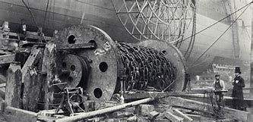
How Britain was effected by the industrial revolution
Britain was unrecognisable after the revolution. The inventions made life so much easier and meant that products could be mass produced. There were many more jobs created too.

Slide 7
Was the industrial revolution a good thing fir Britain?
Positives
Negatives?
There were more jobs
More houses
Better transport
Children had to work
Long work hours
Low pay
Dangerous working conditions

Slide 8
The end
Now you know a bit about the industrial Revolution.

