Slide 1
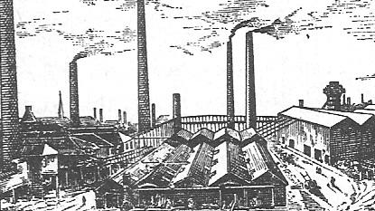
The Industrial Revolution
By Oli Harden

Slide 2
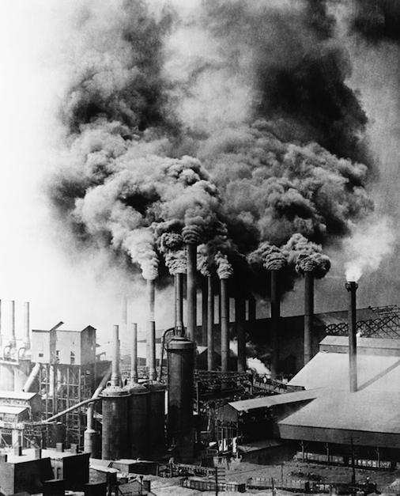
What was the Industrial Revolution?
The Industrial Revolution was a period of major changes in the way products are made. It took place more than 200 years ago between and greatly affected the way people lived as well as the way they worked. In earlier days, people made products by hand. They worked mostly in their own homes or in small workshops. During the Industrial Revolution, many factories were built. Laborers began making large numbers of things using machines powered by engines.

Slide 3
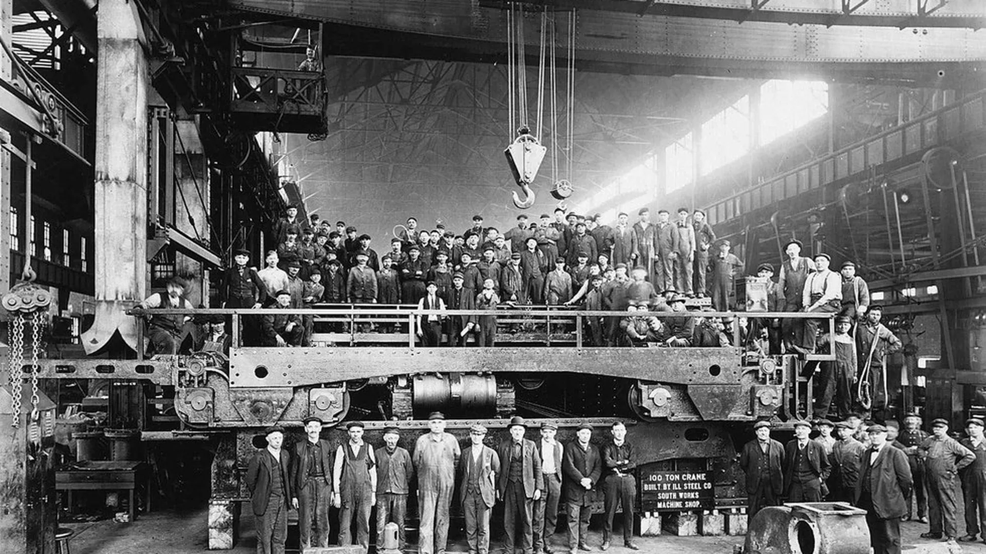
Why did it happen?
One of the triggers was the unusually high growth in the population which set in around the middle of the 18th century and produced a gigantic reservoir of workers.
Where did it start?
England was the first country in which these changes took place. However, the Industrial Revolution soon spread to other European countries, America and Japan.

Slide 4
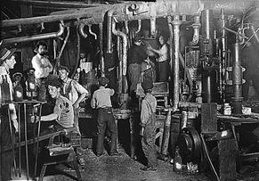
What was life like for adults during the Industrial Revolution?
The conditions for adults were terrible during the Industrial Revolution.
As factories were being built, businesses were in need of workers. With a long line of people willing to work, employers could set wages as low as they wanted because people were willing to do work as long as they got paid.

Slide 5
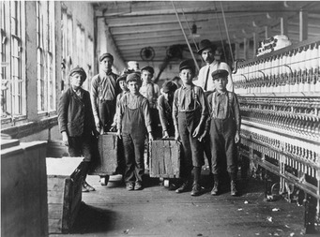
What was life like for children during the Industrial Revolution?
It was very hard because Children had to perform all sorts of jobs including working on machines in factories, selling newspapers on street corners, breaking up coal at the coal mines, and as chimney sweeps.
Sometimes children were preferred to adults because they were small and could easily fit between machines and into small spaces.

Slide 6
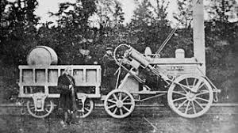
What happened to the transport?
The growth of the Industrial Revolution depended on the ability to transport raw materials and finished goods over long distances. There were three main types of transportation that increased during the Industrial Revolution: waterways, roads, and railroads. ... The roads also improved immensely during this time period.

Slide 7
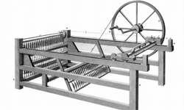
What impact did the Industrial Revolution have on Britain?
It began in Great Britain's textile industry and was boosted by advancements in steam power and the iron industry. The Industrial Revolution made some major impacts on British society, including the rise of factories, urbanization, humanitarian problems, and improvements in transportation.

