Slide 1


The revolution that started life as we know it.
By Lewis Roberts

Slide 2
What Happened?
The industrial revolution was a time were the hole of England and later the world changed. It was where hundreds of inventions ( e.g. the steam train) changed life from very self sufficient and only having the necessities of life to massive factories sending their product all over the country by trains and canals.

Slide 3
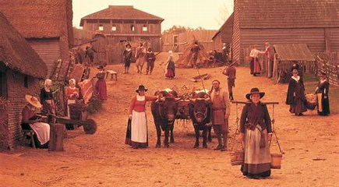
What Was lifelike before the revolution?
Before the Revolution, the majority of Brittan lived in little towns or villages. Also, all the work was done by hand and they used horses instead of trains and canals. The industrial revolution move things like spinning wool and weaving out of peoples houses and into factories where it would be produced faster and more efficiently.

Slide 4
What was it like to work in the factories?
Working in the factories was a very dangerous job especially as a child because they would be sent between or under the machines. It wasn’t unusual for them to be mangled or killed they also only got a small fraction of the pay that adults did but if you were an orphan you didn’t get paid at all. They also were very poorly treated and would often get beaten and verbally abused. Women also worked but they were treated better than the children however they would often get assaulted and didn’t get as high pay as the men. None of them had any job security as they could very easily get replaced.

Slide 5
What was it like to live in the industrial revolution?
The houses varied from large stately like homes to unclean houses that barely even had running water and if they did it would be very dirty. There are lots of examples of how the rich chose to live across the country Cliffe castle, Keighley is an example. It has large turrets and is based loosely on a castle. But the poor had a completely different perspective on life they lived in very crowded areas of the city (often referred to as slums) they were where the bulk of the working class lived. They would have communal toilets, open sewers and their houses were often very damp places.

Slide 6

transport
Amazingly, £3 m were being spent on roads a year in the 1800s.And Tomas Telford built 1000 roads and 1000 bridges from 1803 – 1821alone. There was a canal building spree in 1790s and £20m was spent between 1755 and 1835 there was 4000 miles of canals by 1850 but canals weren't an invention that was made in the industrial revolution as they had been use from as early as 1566. the first railway was built in 1825 and it was the Stockholm and Darlington railway and just 4 years later the rocket was invented by George Stephenson. There was another spree in the 18th century but this time it lasted till the 19th century and it was on trains. £3 b was spent in-between 1845 and 1900.`````````````````````````````

Slide 7
Population in city's
The population in cites was a massive problem e.g. as the pre revolution population for London was roughly 675,000 people and after the revolution was 4,563,000 people. Everyone flocked to the cites as they were in search of new jobs, so they were in search of a new house/ room. Landlords and builders had a massive opportunity to make lots of money. Some places had seep rent so some places had whole family’s living in one room and sometimes complete strangers paying for a few nights with a roof over their head.

Slide 8
pollution
Unfortunately nearly all the factory’s and workshops were powered by coal so they would be exerting giant billowing clouds of smoke from sun rise to sun set. The majority of houses were powered by coal. These were all components to the smog (the chemical compound for the smoke and the fog that constantly covered London and other major cites. Surprisingly, the ‘smog’ has claimed it’s fair share of victims as in 1873 approximately 700 civilians lost their life due to inhalation of the ‘smog’.

