Slide 1
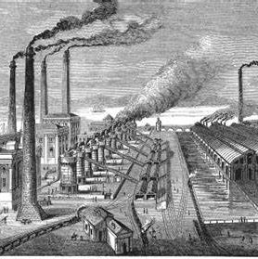
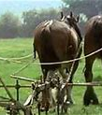
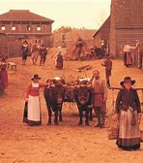
INDUSTIRAL REVOLUTION!
By Erin Lee chapman-Murphy

Slide 2
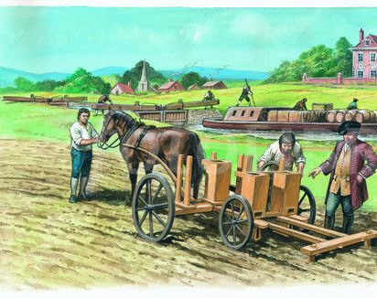
What was the IR?
The industrial revolution is
When a mass amount of
Machinery came handy to
Britain. Here is a power point
all about it!
When did it happen?
This happened in the 17th century
To around the 19th century!
It was a large change to the world
During that time.
Why did it happen?
This happened because all the people
Thought that they would help the
World with farming and all sorts.
Where did it happen>?
The industrial revolution happened
In great Britain in the 1770 before
Spreading to the rest of Europe.

Slide 3
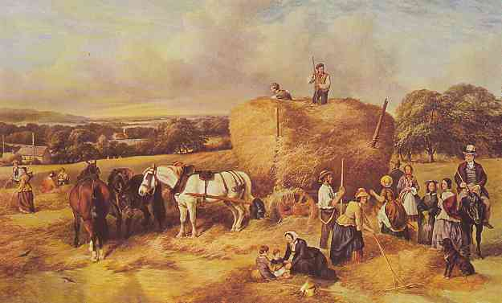
What was life like in Britain before the IR?
Britain was full of horse and cart with no train, no cars and horse and cart were the quickest way to get around. There were only cottages as homes and weaving and pottery ext. were done at home. At this time only a small persent of people lived in towns. Before the industrial Revolution happened only 15%
Of the population lived in towns but by 1900 85% did.

Slide 4
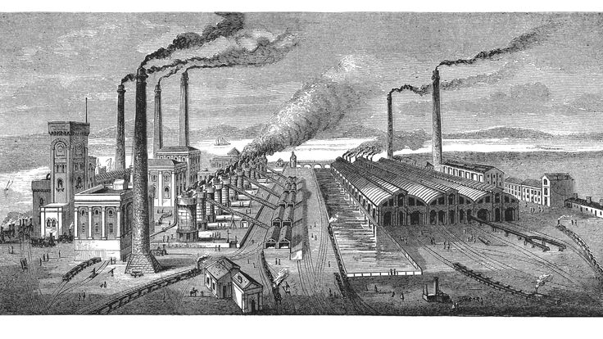
What was life like for adults during the IR?
During the Industrial revolution, for adults it could have been easier but mainly harder. Easier a tiny bit as machines
Are doing work for you. Harder as the gas was bad, they
Didn't get paid a lot and the work was harder.

Slide 5
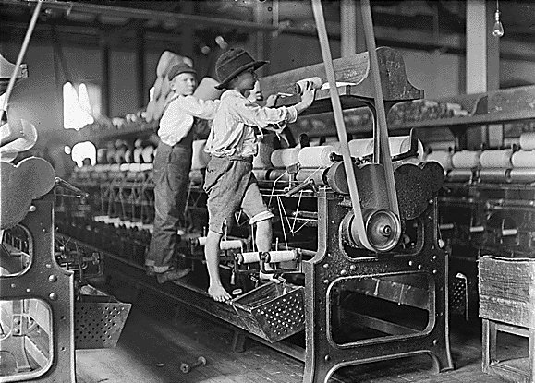
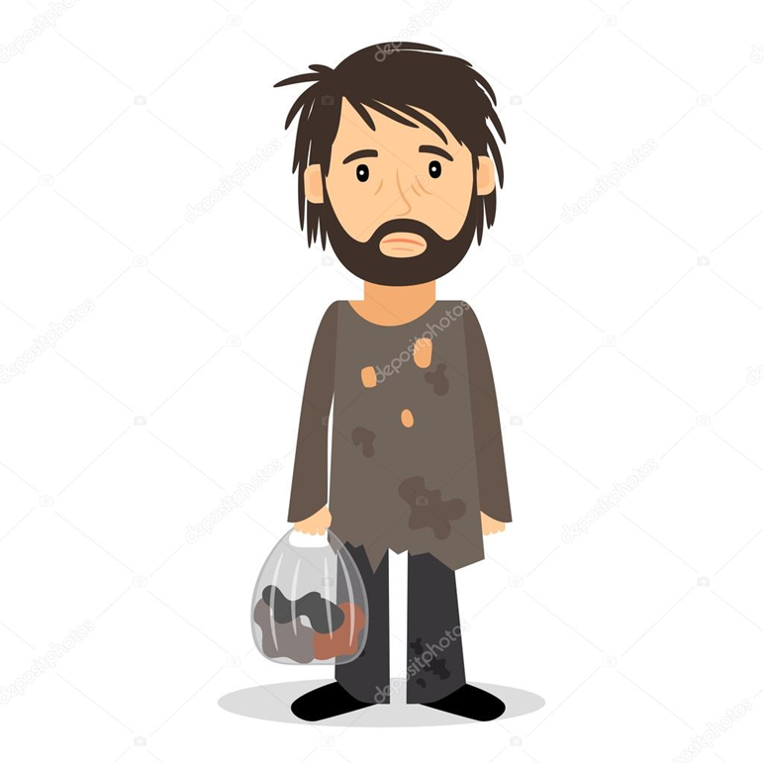
It was very hard for them.
What was life like for children during the IR?
For children it would have been even harder as very young kids maybe 5 years old were working and for us the would have just been out of Nursery. This was not healthy for them and they did really dangerous things.

Slide 6
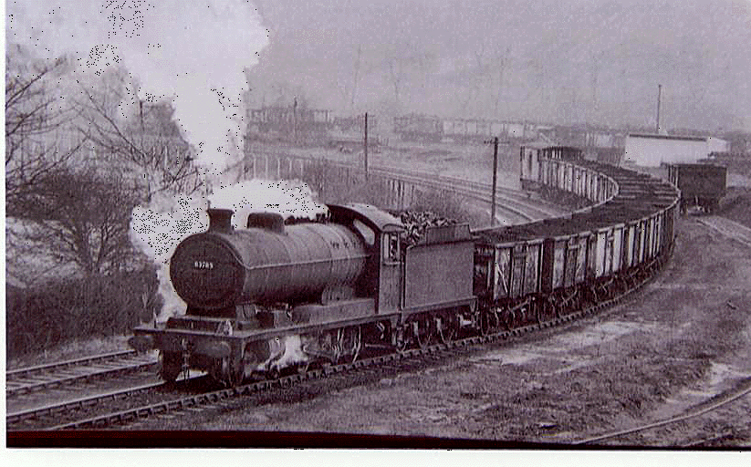

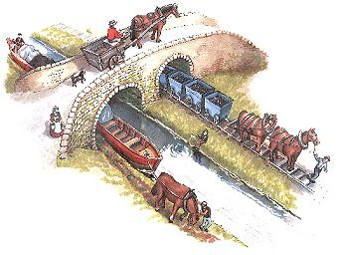
Transport
Transport was different when the industrial revolution was around. There used to only be horse and cart. When industrial revolution was around, they made a canal, boats and steam trains..
This helped me a lot and it took 4 hours to get to Manchester

Slide 7
Impact of the IR on Britain
Some good some bad.
There were factories to do things
The kids had to work extra hard
The transport was quicker
Crafting was easier
By 1914 England became a great trading nation
Cottages turned to homes
Weaving and pottery ext. were now done via machine

Slide 8
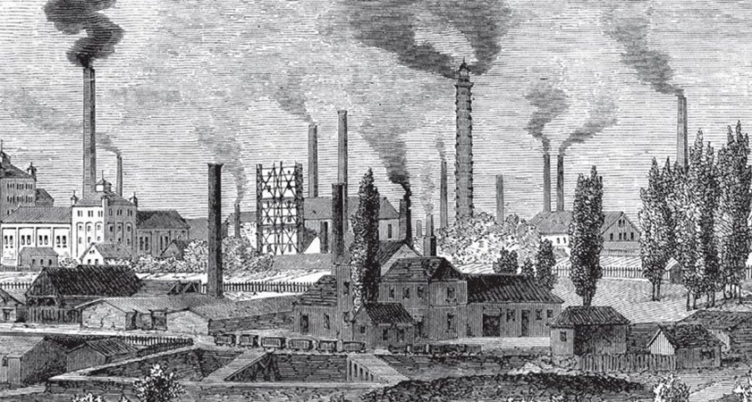
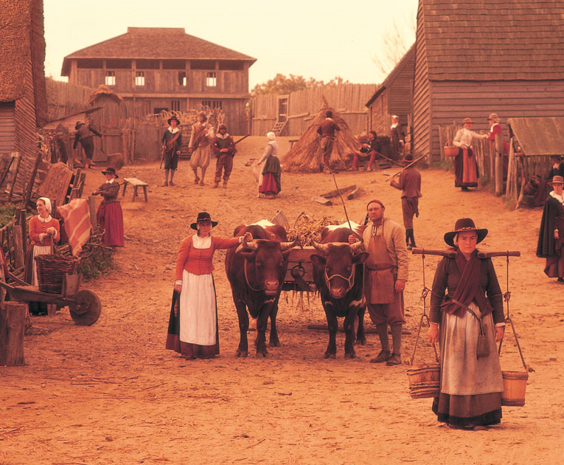
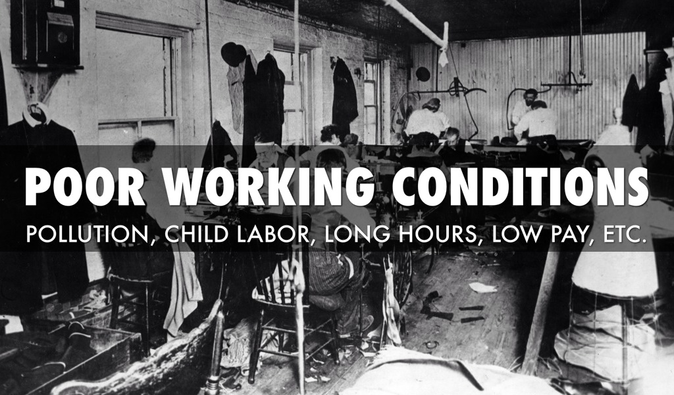
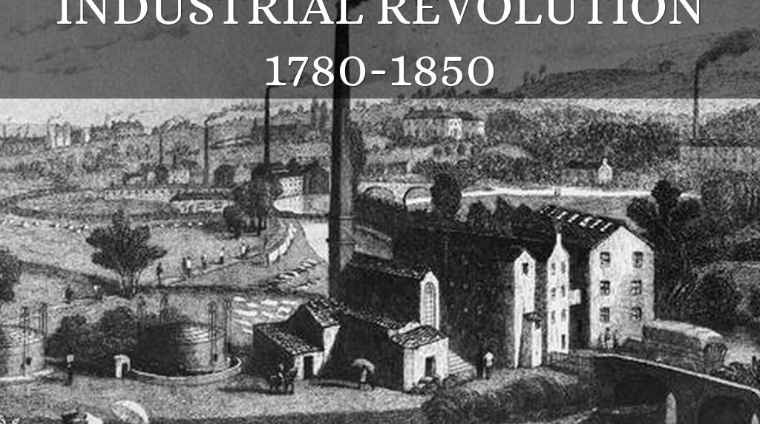

Slide 9
Who made what?
1701 Tull’s seed drill
1712 Newcomen engine
1733 Flying Shuttle
1764 Spinning Jenny
1772 Bridge water canal
1775 Watt’s Steam Engine

Slide 10
Some of these were really useful.
Tull’s Seed Drill
Jethro Tull’s Seed Drill embodies the shift from an agrarian economy to one domination by Urban industry and machine manufactory
Newcome Engine
Thomas Newcome engine is am early glimpse into the possibilities of steam power . It was mainly used for draining coal mines.

Slide 11
More of the inventions
Wow!
The flying shuttle. In the mid 18th century, the flying shuttle allowed a larger scale of weaving fabrics. The spinning machine reduced the amount of work needed to produce farming, allowing multiple spots to be created at once, increasing efficiency.
The successful completion of Bridge Water Canal in North-West England kicks off the rapid expansion of a canal network throughout the UK. James watt’s engine markedly improved on the Newcomen’s design.

Slide 12
Even more
Alessandro Volta invented the battery in 1800
John Dalton discovered atoms in 1806
Henry Talbot invented photography 1835
Issac Singer invented the sewing machine1851
Richard Gatling and the machine gun 1862
Alfred Nobel and dynamite1866
John Pemberlon and Coca Cola 1886
Wow even more ?!

Slide 13
What is the steam age?
The steam age is a common misconception that steam is visible. The characteristic white mist we see rising rom our kettles etc is in fact a haphazard clouds of water droplets, which cause condensation.

Slide 14

Some photos of before and after

Slide 15

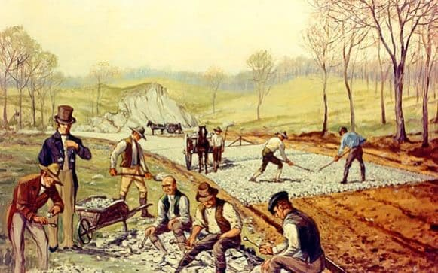
Before

Slide 16
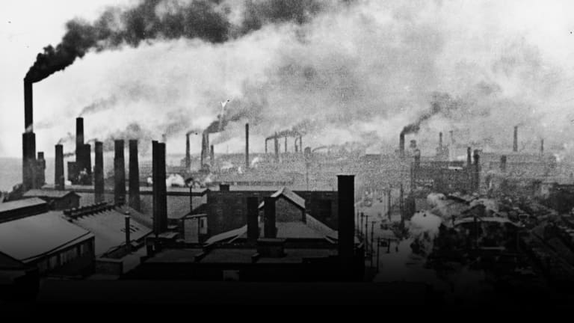
While

Slide 17
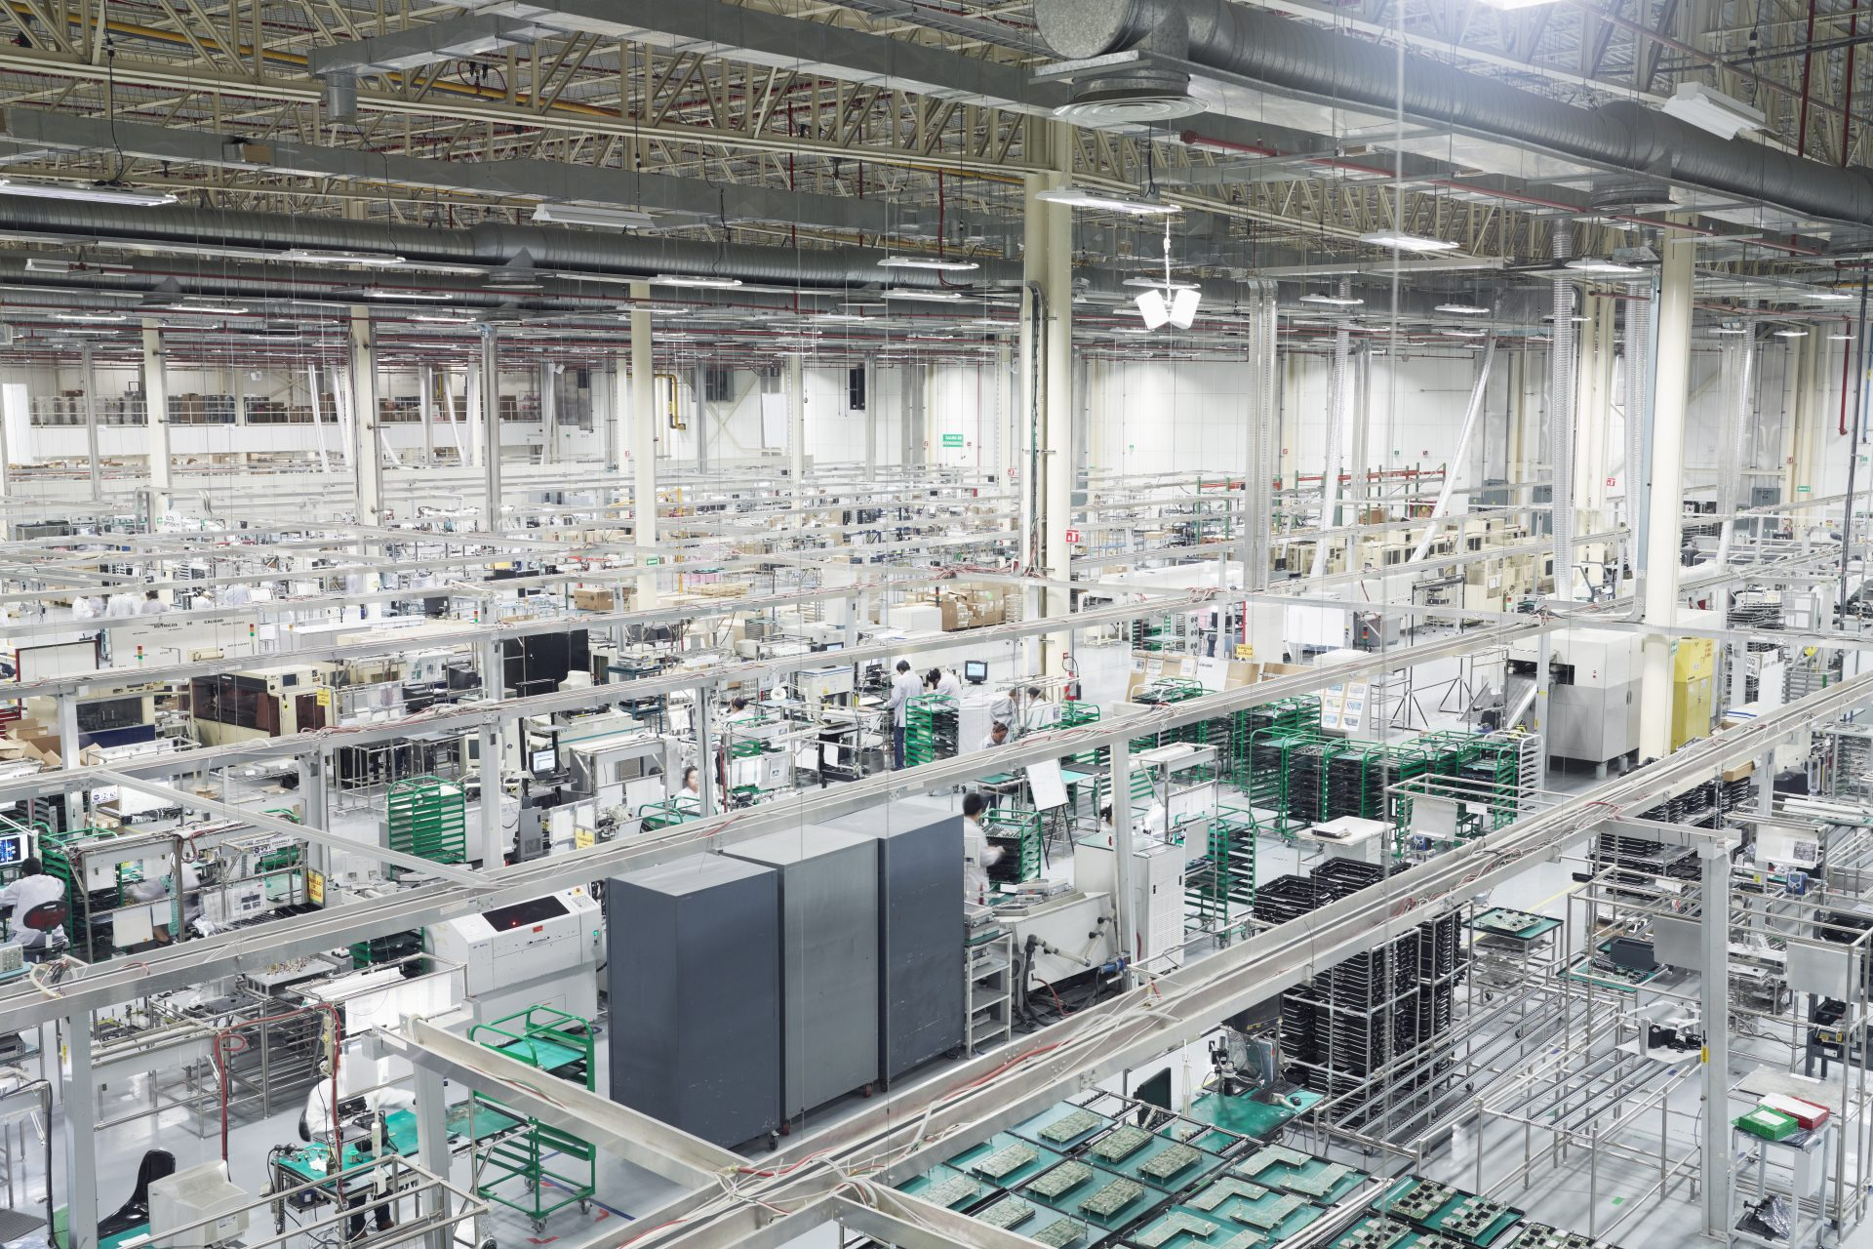
Now clean and less work.

Slide 18
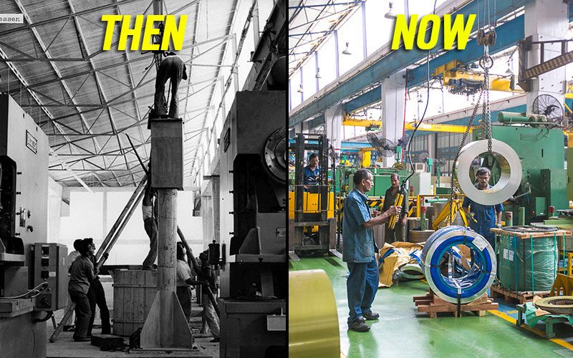
Then and now

Slide 19
Hope you enjoyed this power point
I hope you have learnt new things
I hope you could understand
I hope you had fun!!!

