Slide 1
What was the Industrial Revolution?
By Taylor Moseley

Slide 2
What was the Industrial Revolution?
The Industrial Revolution was a period of major changes in the way products are made. It took place more than 200 years ago and greatly affected the way people lived as well as the way they worked. In earlier days, people made products by hand. They worked mostly in their own homes or in small workshops.
The Industrial Revolution was a period of tremendous change in Britain, which lasted from 1750 up until around 1900. In this time period of 150 years, almost every aspect of life in Britain changed.

Slide 3
Why did it happen?
The Industrial Revolution was a period when new sources of energy, such as coal and steam, were used to power new machines designed to reduce human labour and increase production. The move to a more industrial society would forever change the face of labour.
The Industrial Revolution began in Britain because it possessed superior financial assets, a more stable governmental structure and a huge supply of natural resources that were necessary for the revolution to take place

Slide 4
What was life like before the Industrial Revolution?
Daily life in pre-industrial times changed very little for Europeans. Almost all people lived and worked in the country. From 1300 to 1750, for the average peasant, people's work and social life mixed, as families lived on small plots of land, growing crops mostly for home consumption.
Because it was so hard to move around and remember, there were no cars, aeroplanes or even tarmac roads, people had to rely upon themselves and their communities to provide the vast majority of the things that they needed. Food was produced locally, agriculture could provide for but a few large commercial towns. Clothing was made locally, making use of animal hides and furs: nylon wasn’t an option and cotton wasn’t imported in large quantities until developments enabled mass production of goods.

Slide 5
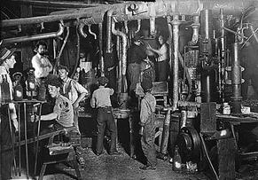
What was life like for adults during the Revolution?
Simply, the working conditions were terrible during the Industrial Revolution. As factories were being built, businesses were in need of workers. With a long line of people willing to work, employers could set wages as low as they wanted because people were willing to do work as long as they got paid.
Before the advent of industrialization, women were often tasked with traditional jobs such as making and repairing clothing. They were also commonly involved with helping manage the affairs of the farm and raising children. However, the traditional role for women began to change as the Industrial Revolution unfolded.

Slide 6
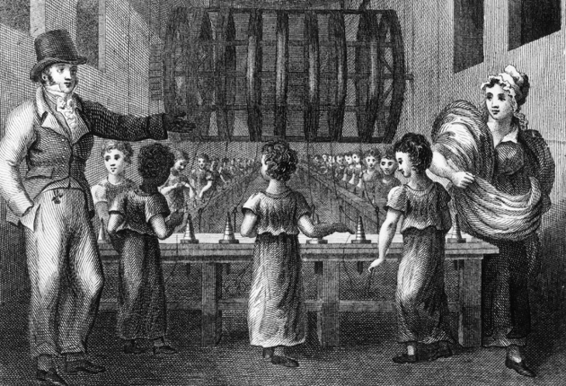
What was life like for children in the Industrial Revolution?
The Industrial Revolution was a time of few government regulations on working conditions and hours. Children often had to work under very dangerous conditions. They lost limbs or fingers working on high powered machinery with little training. They worked in mines with bad ventilation and developed lung diseases.
In particular, the Industrial Revolution impacted the lives of working class people and the children of industrial societies. Child labour was a common feature in industrial societies as children as young as four years old were often employed in the factories and mines that developed during the time.

Slide 7
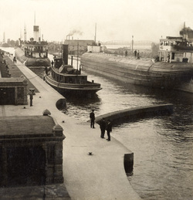
How was Transport affected by the Industrial Revolution?
The growth of the Industrial Revolution depended on the ability to transport raw materials and finished goods over long distances. There were three main types of transportation that increased during the Industrial Revolution: waterways, roads, and railroads. The roads also improved immensely during this time period.
The Industrial Revolution completely changed the way people travelled and how goods were transported. Before the Industrial Revolution, transportation relied on animals (like horses pulling a cart) and boats.

Slide 8
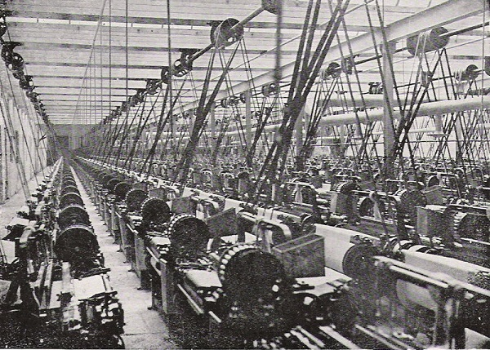
What impact did the Industrial Revolution have on Britain?
It began in Great Britain's textile industry and was boosted by advancements in steam power and the iron industry. The Industrial Revolution made some major impacts on British society, including the rise of factories, urbanization, humanitarian problems, and improvements in transportation.

