Slide 1
Industrial revolution
By Sophie Matthews

Slide 2
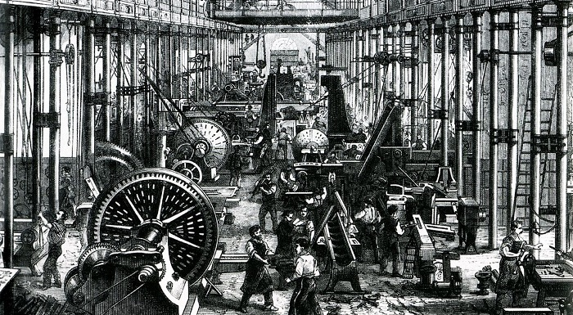
What is the industrial revolution?
The industrial revolution was when things that had always been done by hand started to be done by machines. Interestingly, the revolution started in 1760 and ended in 1840. The revolution began in the U.K ( United Kingdom ).

Slide 3
Before the Industrial Revolution, most people lived in rural areas ( the countryside ) and people made things like clothes and food at home. After industrialisation, more people lived in cities where things were made in factories. Many people were forced to move to urban areas ( cities ), where wages were higher, in order to earn enough money to survive.

Slide 4
Unbelievably , the working conditions were terrible during the Industrial Revolution. As factories were being built, businesses needed more workers. With so many people needing to work, employers could set wages as low as they wanted because people were willing to do work as long as they got paid. People worked around sixteen hours a day for six days a week. Workers got paid very little money. Skilled workers earned a little more, but not much. Women received one-third or sometimes one-half the pay that men received. Children got even less.

Slide 5
A lot of factories used children in unsafe conditions. Factories hired children because they worked for low wages. Sometimes, they hired small children because they could fit into places adults couldn't. Children were forced to work long hours in poor conditions as well as adults. Many children were killed or got sick working in factories.

Slide 6
One of the most famous new developments was the invention of the railway. Before railways were invented, it took a very long time to travel between different places. There were no railways, cars or buses to transport people and goods. For shorter distances, people could walk or ride on horses. For longer journeys, people would have used carriages or carts pulled by horses. The new steam railways meant that:
Heavier goods could be easily transported from place to place (this was good news for factory owners).
Longer journeys were much faster.
More people could travel together
People did not need to rely on animals to travel

Slide 7
The Industrial Revolution changed Britain in lots of ways – some were good, some bad:
Good:
Britain became wealthy
It was quicker to produce goods like textiles
There were plenty of jobs for people
It was quicker to transport goods and people across the country
More steel meant stronger bridges and better machines
Bad:
Some of the work in factories or mines was dangerous, especially for children
Smoke from factories polluted the air
Cities became overcrowded and cramped
Diseases spread easily in the cities
Factories and vehicles made the landscape look ugly

