Slide 1
Industrial Revolution
By Megan

Slide 2
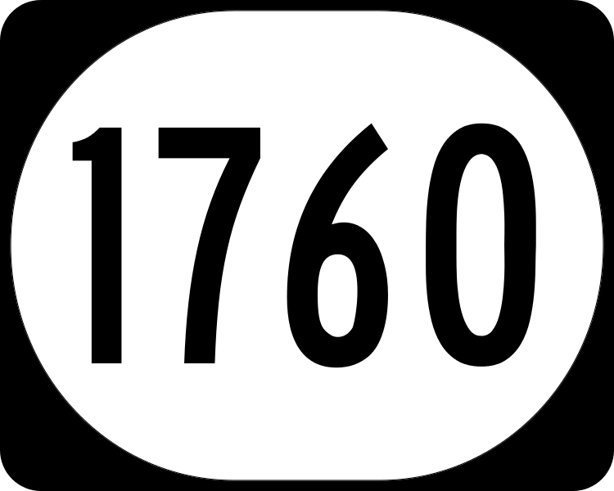

Would you rather…
Live in
Or live in

Slide 3
Why ?

Slide 4
Its because back in the 1760 it was like this…

Slide 5
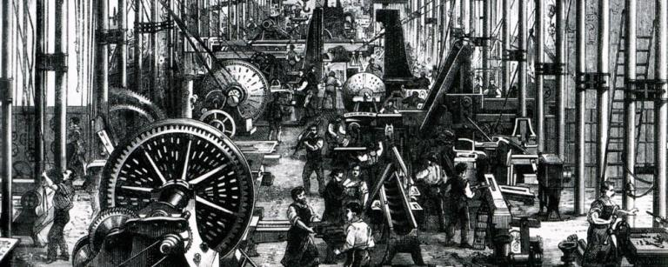

Slide 6

Yuck
Its was dangerous and dirty it was horrible

Slide 7
What it was like back then in Britain ?
Life in Britain was peculiar before the dawn of the IR Britain was a quite different place to the one that exist today. Industrialization brought with it new types of roads and trains and many other forms of communication which simply did not exist prior to industrialization.

Slide 8
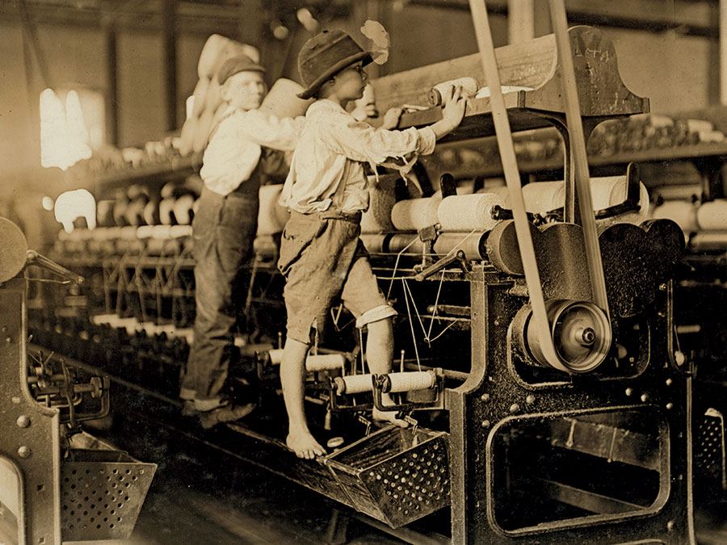

Slide 9


Slide 10
What life was like working in the factories ?
Despite such progress , life was not as easy as a worker during the IR . Working conditions were poor and sometimes dangerous. Working during the IR were expected to work long hours or they would lose their jobs ! Many working had to work 12 hours a day , six days a week.

Slide 11

It was so boring…

Slide 12
What it was like for children ?
The IR was a few government regulations on working conditions and hours. Children often had to work under very dangerous conditions . They lost limbs or fingers working on high powered machinery with little training . They worked in mines with bad ventilation and developed lung disease all the time.

Slide 13
What impact did the IR have on Britain ?
It began in Great Britain textile industry and was boosted by advancements in steam power and the iron industusty. The IR made some major impacts on Britain's society , including the rice of factories, urbanization humanitarian problems and improvements in transportation.

Slide 14
Thankyou for watching

Slide 15


