Slide 1



LIFE/work balance
We have started a #LIFEworkbalance campaign and we need your help to complete our LIFE/work balance survey.
We hope to publish the results soon, so please give 15 minutes of your time to help us get a true picture of school life.
Want to be a part of this campaign? Take the survey on our website and share it with your colleagues!
© Classroom Secrets Limited 2019

Slide 2
Year 6 – Spring Block 6 – Ratio – Calculating Scale Factors
About This Resource:
This PowerPoint has been designed to support your teaching of this small step. It includes a starter activity and an example of each question from the Varied Fluency and Reasoning and Problem Solving resources also provided in this pack. You can choose to work through all examples provided or a selection of them depending on the needs of your class.
National Curriculum Objectives:
Mathematics Year 6: (6R3) Solve problems involving similar shapes where the scale factor is known or can be found
More Year 6 Ratio resources.
Did you like this resource? Don’t forget to review it on our website.
© Classroom Secrets Limited 2019

Slide 3
Year 6 – Spring Block 6 – Ratio
Step 6: Calculating Scale Factors
© Classroom Secrets Limited 2019

Slide 4
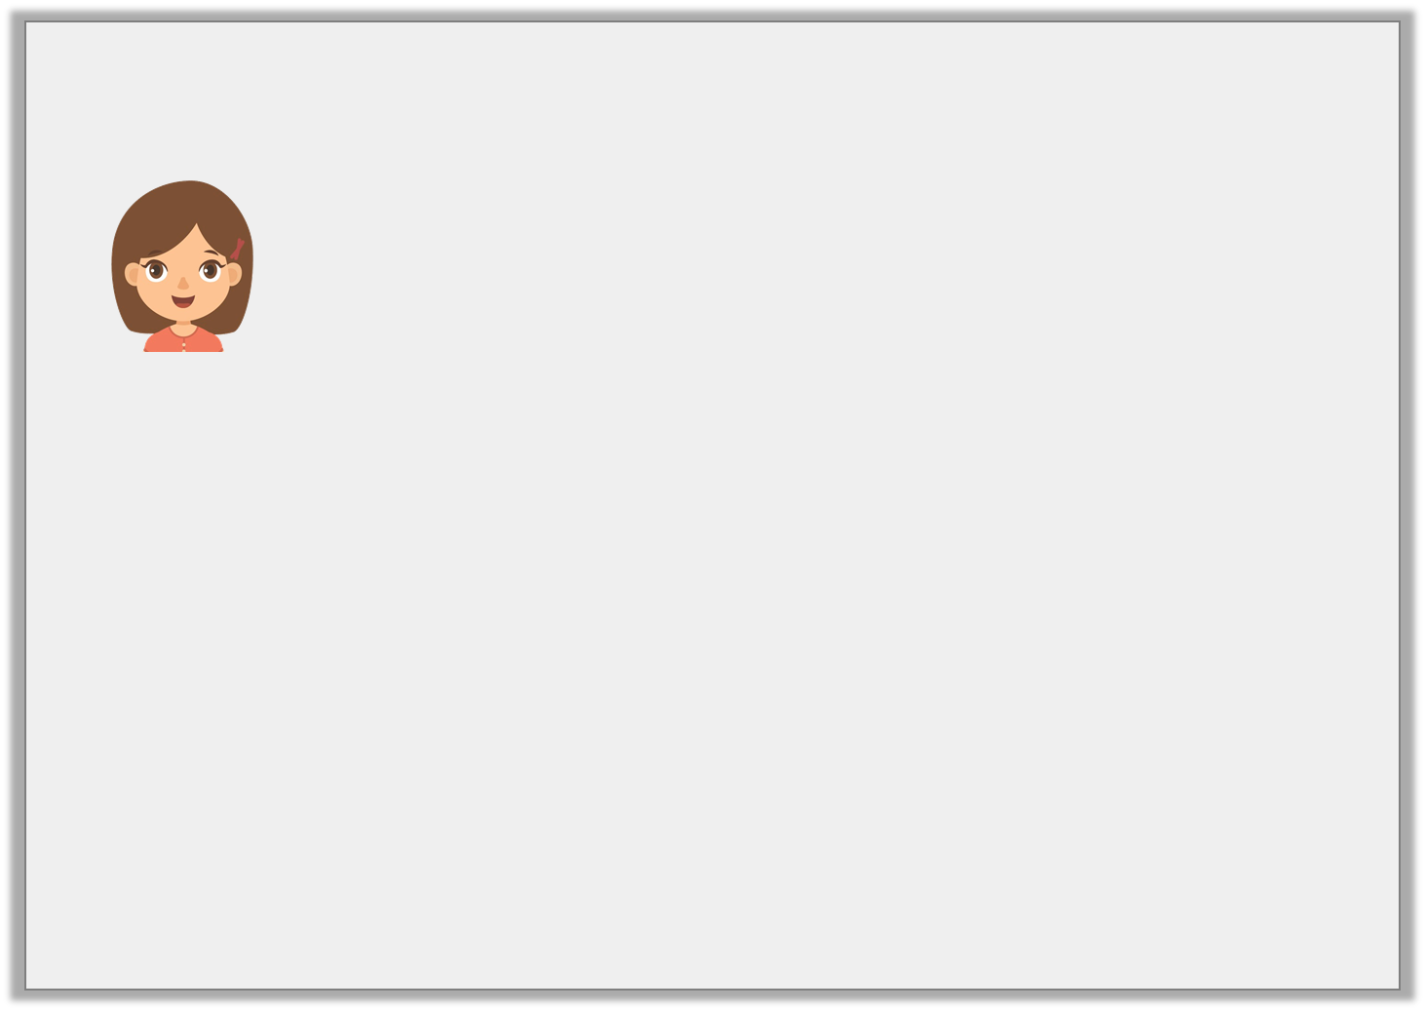
Introduction
Maeve says,
Is she correct? Explain your answer.
Shape B has been enlarged from shape A by a scale factor of 4.
B
A
3cm
6cm
2cm
4cm
Not to scale
© Classroom Secrets Limited 2019

Slide 5
Introduction
Maeve says,
Is she correct? Explain your answer.
No because it has been enlarged by a scale factor of 2 not 4.
Shape B has been enlarged from shape A by a scale factor of 4.
B
A
3cm
6cm
2cm
4cm
Not to scale
© Classroom Secrets Limited 2019

Slide 6
Varied Fluency 1
True or false?
Shape A has been increased by a scale factor of 2.5 to create shape B.
B
A
© Classroom Secrets Limited 2019

Slide 7
Varied Fluency 1
True or false?
Shape A has been increased by a scale factor of 2.5 to create shape B.
False. It has been increased by a scale factor of 3.
B
A
© Classroom Secrets Limited 2019

Slide 8
Varied Fluency 2
Maggie says she has enlarged her shape by a scale factor of 2.5. Shape B is her new shape.
Is she correct?
B
A
2cm
5cm
4cm
10cm
Not to scale
© Classroom Secrets Limited 2019

Slide 9
Varied Fluency 2
Maggie says she has enlarged her shape by a scale factor of 2.5. Shape B is her new shape.
Is she correct?
Yes, each measurement is 2.5 times its original size.
B
A
2cm
5cm
4cm
10cm
Not to scale
© Classroom Secrets Limited 2019

Slide 10
Varied Fluency 3
Triangle B has been scaled from triangle A.
Find the missing lengths.
6cm
A
2cm
4cm
B
A. _______cm
7cm
B. _______cm
Not to scale
© Classroom Secrets Limited 2019

Slide 11
Varied Fluency 3
Triangle B has been scaled from triangle A.
Find the missing lengths.
6cm
A
2cm
4cm
B
21
A. _______cm
7cm
B. _______cm
14
Not to scale
© Classroom Secrets Limited 2019

Slide 12
Varied Fluency 4
Square B and C has been scaled from square A.
Complete the table.
Square | Length of side | Scale Factor
A | 8cm | -
B | ? | 2.5
C | 40cm | ?
© Classroom Secrets Limited 2019

Slide 13
Varied Fluency 4
Square B and C has been scaled from square A.
Complete the table.
Square | Length of side | Scale Factor
A | 8cm | -
B | 20cm | 2.5
C | 40cm | 5
© Classroom Secrets Limited 2019

Slide 14
Problem Solving 1
A rectangle has been enlarged to create shape B. Using the clues below, identify which scale factor has been used.
Shape B has an area of 450cm².
The length of the original rectangle is 12cm.
The perimeter of the original rectangle is 36cm.
© Classroom Secrets Limited 2019

Slide 15
Problem Solving 1
A rectangle has been enlarged to create shape B. Using the clues below, identify which scale factor has been used.
Scale factor of 2.5
Shape B has an area of 450cm².
The length of the original rectangle is 12cm.
The perimeter of the original rectangle is 36cm.
© Classroom Secrets Limited 2019

Slide 16
Reasoning 1
Kayla has increased shape A to create shape B. She says if she created shape C using the same scale factor, one side would have a length of 8cm.
Do you agree? Explain your answer.
B
A
4cm
6cm
Not to scale
© Classroom Secrets Limited 2019

Slide 17
Reasoning 1
Kayla has increased shape A to create shape B. She says if she created shape C using the same scale factor, one side would have a length of 8cm.
Do you agree? Explain your answer.
No because…
B
A
4cm
6cm
Not to scale
© Classroom Secrets Limited 2019

Slide 18
Reasoning 1
Kayla has increased shape A to create shape B. She says if she created shape C using the same scale factor, one side would have a length of 8cm.
Do you agree? Explain your answer.
No because the scale factor used is 1.5. If she calculates 6 x 1.5, she would have one side of the square as 9cm.
B
A
4cm
6cm
Not to scale
© Classroom Secrets Limited 2019

Slide 19
Reasoning 2
When enlarged, the perimeter of the rectangle below increases to 70cm.
What scale factor has the shape been increased by?
Explain your answer.
4cm
10cm
Not to scale
© Classroom Secrets Limited 2019

Slide 20
Reasoning 2
When enlarged, the perimeter of the rectangle below increases to 70cm.
What scale factor has the shape been increased by?
Explain your answer.
The original perimeter of the shape is 28cm, so…
4cm
10cm
Not to scale
© Classroom Secrets Limited 2019

Slide 21
Reasoning 2
When enlarged, the perimeter of the rectangle below increases to 70cm.
What scale factor has the shape been increased by?
Explain your answer.
The original perimeter of the shape is 28cm, so the shape has been increased by a scale factor of 2.5. 28 x 2.5 = 70cm.
4cm
10cm
Not to scale
© Classroom Secrets Limited 2019

