Slide 1


Year 6 – Spring Block 6 – Ratio – Introducing the Ratio Symbol
About This Resource:
This PowerPoint has been designed to support your teaching of this small step. It includes a starter activity and an example of each question from the Varied Fluency and Reasoning and Problem Solving resources also provided in this pack. You can choose to work through all examples provided or a selection of them depending on the needs of your class.
National Curriculum Objectives:
Mathematics Year 6: (6R1) Solve problems involving the relative sizes of two quantities where missing values can be found by using integer multiplication and division facts
More Year 6 Ratio resources.
Did you like this resource? Don’t forget to review it on our website.
© Classroom Secrets Limited 2019

Slide 2
Year 6 – Spring Block 6 – Ratio
Step 3: Introducing the Ratio Symbol
© Classroom Secrets Limited 2019

Slide 3
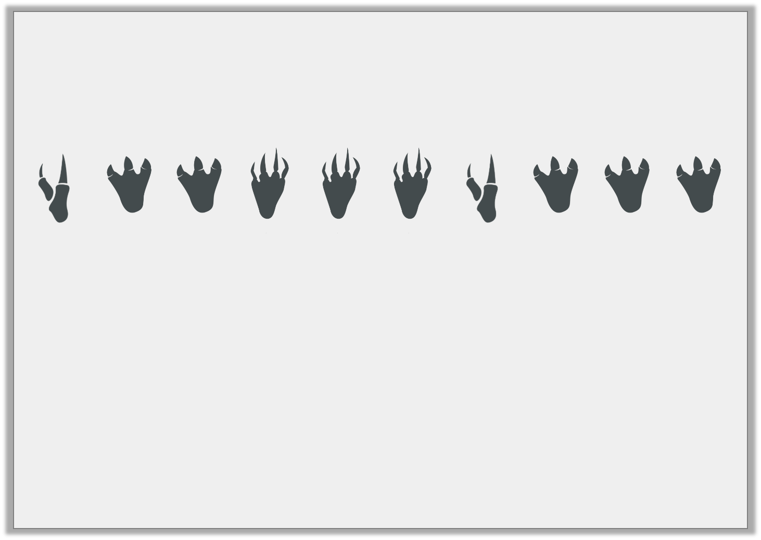
Introduction
Zack discovered these footprints in the forest.
Complete the statements.
For every three footprints with four toes, there are ____ footprints with three toes.
For every two footprints with two toes, there are three footprints with ____ toes.
© Classroom Secrets Limited 2019

Slide 4
Introduction
Zack discovered these footprints in the forest.
Complete the statements.
For every three footprints with four toes, there are five footprints with three toes.
For every two footprints with two toes, there are three footprints with four toes.
© Classroom Secrets Limited 2019

Slide 5

Varied Fluency 1
True or false? The ratio of cupcakes with sprinkles to cupcakes with a cherry is 3:1.
© Classroom Secrets Limited 2019

Slide 6
Varied Fluency 1
True or false? The ratio of cupcakes with sprinkles to cupcakes with a cherry is 3:1.
False; it is 2:3.
© Classroom Secrets Limited 2019

Slide 7
Varied Fluency 2
Match the statements that mean the same thing.
5:2 oranges to apples
2:5 oranges to apples
5:1 oranges to apples
For every 2 apples, there are 5 oranges.
For every 5 oranges, there is 1 apple.
For every 2 oranges, there are 5 apples.
© Classroom Secrets Limited 2019

Slide 8
Varied Fluency 2
Match the statements that mean the same thing.
5:2 oranges to apples
2:5 oranges to apples
5:1 oranges to apples
For every 2 apples, there are 5 oranges.
For every 5 oranges, there is 1 apple.
For every 2 oranges, there are 5 apples.
© Classroom Secrets Limited 2019

Slide 9
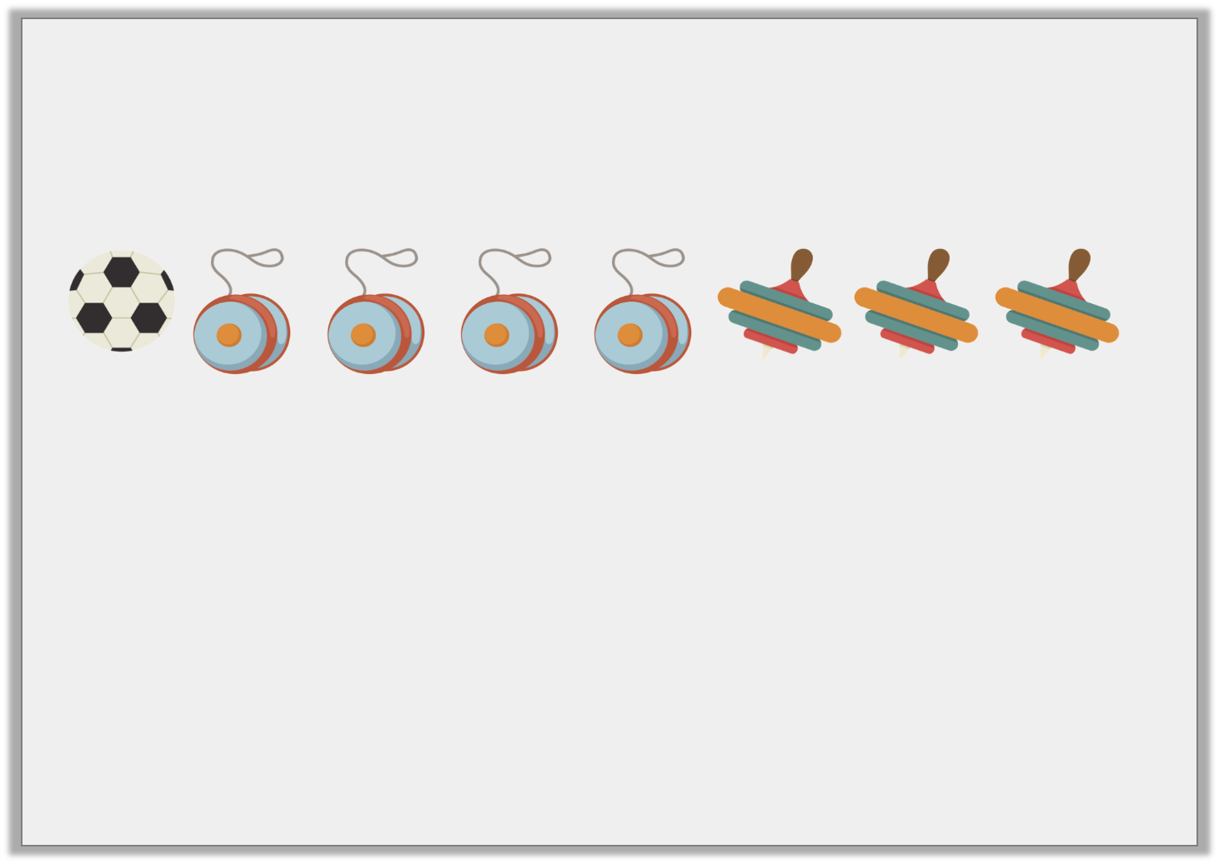
Varied Fluency 3
Write a statement to describe the ratio 4:1 shown below.
© Classroom Secrets Limited 2019

Slide 10
Varied Fluency 3
Write a statement to describe the ratio 4:1 shown below.
There are 4 yoyos for every football.
© Classroom Secrets Limited 2019

Slide 11

Varied Fluency 4
Circle the odd one out by matching the ratios to the description.
10:4
2:10:4
4:2:10
Speckled fish to striped fish to plain fish
Striped fish to plain fish
© Classroom Secrets Limited 2019

Slide 12
Varied Fluency 4
Circle the odd one out by matching the ratios to the description.
10:4
2:10:4
4:2:10
Speckled fish to striped fish to plain fish
Striped fish to plain fish
© Classroom Secrets Limited 2019

Slide 13
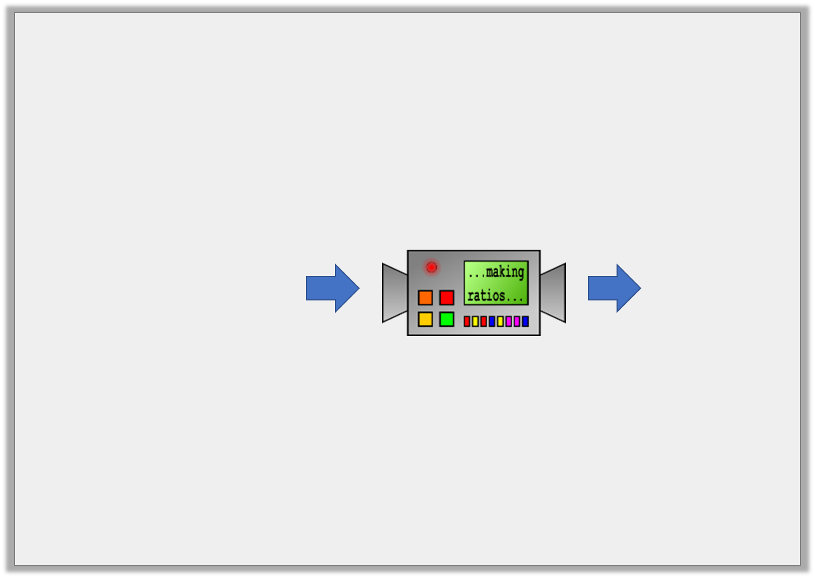
Reasoning 1
This machine turns sentences into ratios.
Could this ratio be correct? Convince me.
For every 5 red cars, there is 1 blue car. There are three times as many white cars as blue cars.
2:3:5
© Classroom Secrets Limited 2019

Slide 14
Reasoning 1
This machine turns sentences into ratios.
Could this ratio be correct? Convince me.
No because…
For every 5 red cars, there is 1 blue car. There are three times as many white cars as blue cars.
2:3:5
© Classroom Secrets Limited 2019

Slide 15
Reasoning 1
This machine turns sentences into ratios.
Could this ratio be correct? Convince me.
No because the ratio of red cars to blue cars to white cars would be 5:1:3.
For every 5 red cars, there is 1 blue car. There are three times as many white cars as blue cars.
2:3:5
© Classroom Secrets Limited 2019

Slide 16
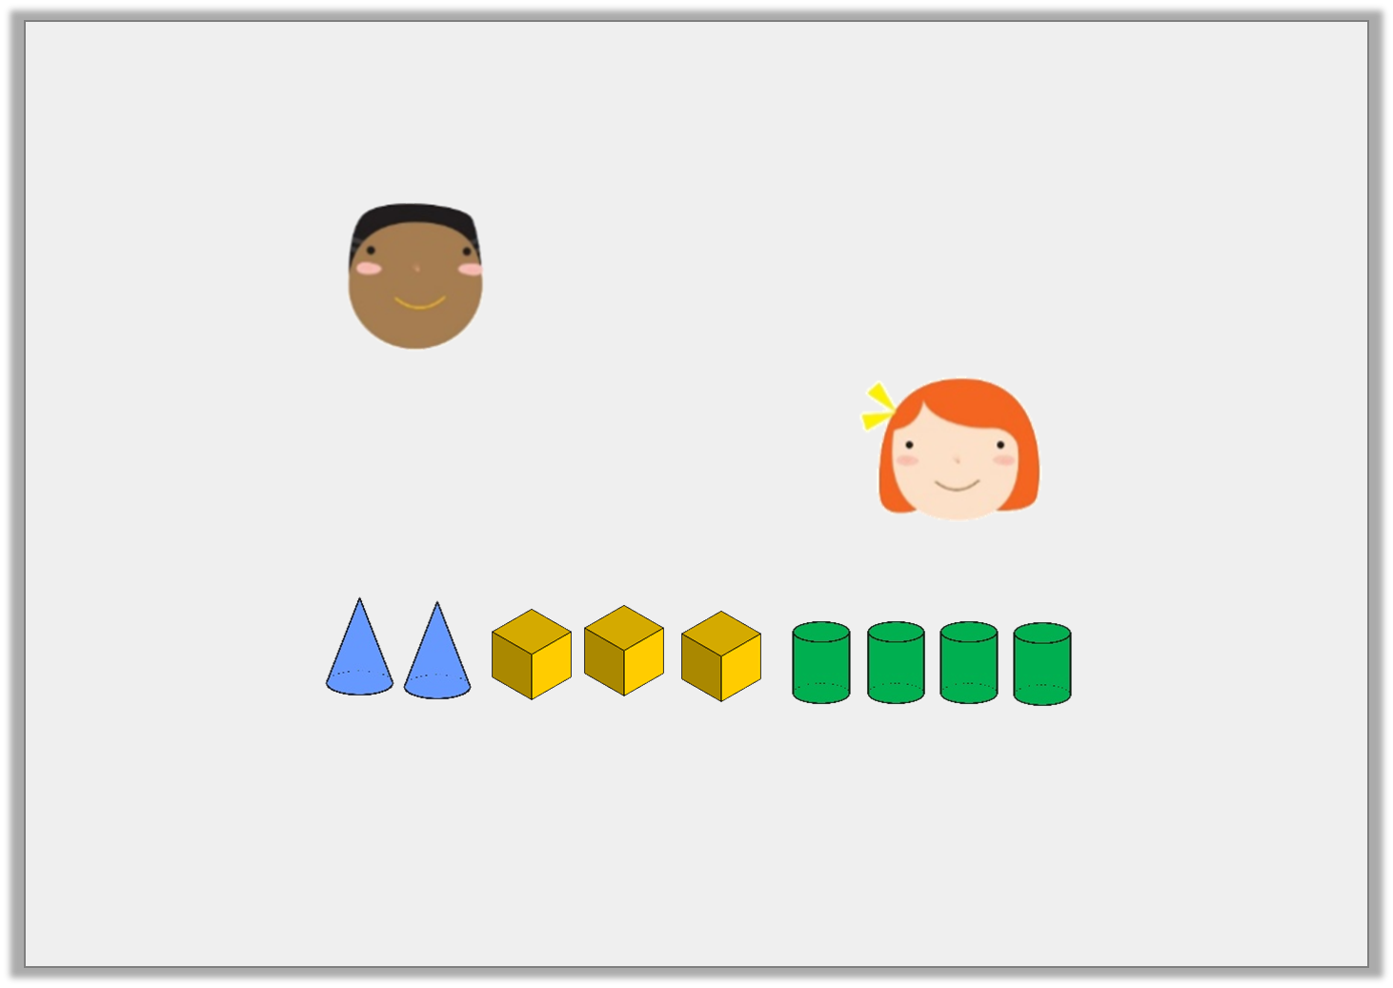
Reasoning 2
Each child’s statement is correct.
Explain how this is possible.
The ratio is 4:3.
Kimiko
2
9
The fraction is .
Sasha
© Classroom Secrets Limited 2019

Slide 17
Reasoning 2
Each child’s statement is correct.
Explain how this is possible.
Kimiko is describing the ratio…
Sasha is describing what proportion…
The ratio is 4:3.
Kimiko
2
9
The fraction is .
Sasha
© Classroom Secrets Limited 2019

Slide 18
Reasoning 2
Each child’s statement is correct.
Explain how this is possible.
Kimiko is describing the ratio of cylinders to cubes.
Sasha is describing what proportion of the shapes are cones.
The ratio is 4:3.
Kimiko
2
9
The fraction is .
Sasha
© Classroom Secrets Limited 2019

Slide 19
Problem Solving 1
In a box of 15 chocolates, are milk chocolate. The rest are white or dark chocolate.
Write down three solutions for the possible ratio of white to milk to dark chocolate.
Draw counters to support your answers.
3
5
© Classroom Secrets Limited 2019

Slide 20
Problem Solving 1
In a box of 15 chocolates, are milk chocolate. The rest are white or dark chocolate.
Write down three solutions for the possible ratio of white to milk to dark chocolate.
Draw counters to support your answers.
Possible answers include: 1:9:5, 2:9:4, 3:9:3, 4:9:2, 5:9:1
3
5
D
M
M
M
M
M
M
M
M
M
W
W
W
W
W
© Classroom Secrets Limited 2019

